Slide 1
CS 61C: Great Ideas in Computer Architecture (Machine Structures)
Warehouse Scale Computers
Instructors:
Krste Asanovic
Randy H. Katz
http://inst.eecs.Berkeley.edu/~cs61c/F12

Slide 2
Agenda
Warehouse Scale Computers
Administrivia
Data Parallel Map-Reduce

Slide 3
Agenda
Warehouse Scale Computers
Administrivia
Data Parallel Map-Reduce

Slide 4
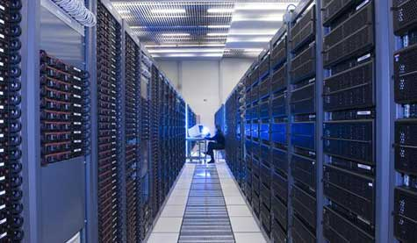



New-School Machine Structures
(It’s a bit more complicated!)
Project 1
Software Hardware
Parallel Requests
  Assigned to computer
  e.g., Search “Katz”
Parallel Threads
  Assigned to core
  e.g., Lookup, Ads
Parallel Instructions
  >1 instruction @ one time
  e.g., 5 pipelined instructions
Parallel Data
  >1 data item @ one time
  e.g., Add of 4 pairs of words
Hardware descriptions
  All gates functioning in parallel at same time
Warehouse Scale Computer
Smart
Phone
Harness
Parallelism &
Achieve High
Performance
Computer
Core
…
Core
Memory (Cache)
Input/Output
Core
Instruction Unit(s)
Functional
Unit(s)
A₀+B₀
A₁+B₁
A₂+B₂
A₃+B₃
Main Memory
Logic Gates

Slide 5

The Big Switch: Cloud Computing
“A hundred years ago, companies stopped generating their own power with steam engines and dynamos and plugged into the newly built electric grid. The cheap power pumped out by electric utilities didn’t just change how businesses operate. It set off a chain reaction of economic and social transformations that brought the modern world into existence. Today, a similar revolution is under way. Hooked up to the Internet’s global computing grid, massive information-processing plants have begun pumping data and software code into our homes and businesses. This time, it’s computing that’s turning into a utility.”

Slide 6
Why Cloud Computing Now?
“The Web Space Race”: Build-out of extremely large datacenters (10,000’s of commodity PCs)
  Build-out driven by growth in demand (more users)
  Infrastructure software and Operational expertise
Discovered economy of scale: 5-7x cheaper than provisioning a medium-sized (1000 servers) facility
More pervasive broadband Internet so can access remote computers efficiently
Commoditization of HW & SW
  Standardized software stacks

Slide 7


Peer Instruction
Increase real-time learning in lecture, test understanding of concepts vs. details
mazur-www.harvard.edu/education/pi.phtml
As complete a “segment”
ask multiple choice question
  <1 minute: decide yourself, vote
  <2 minutes: discuss in pairs,
  then team vote; flash card to pick answer
    Try to convince partner; learn by teaching
Mark and save flash cards
(handed out in lecture last week)
1
2
3
4

Slide 8
Coping with Failures
4 disks/server, 50,000 servers
Failure rate of disks: 2% to 10% / year
  Assume 4% annual failure rate
On average, how often does a disk fail?
  1 / month
  1 / week
  1 / day
  1 / hour

Slide 9
Coping with Failures
4 disks/server, 50,000 servers
Failure rate of disks: 2% to 10% / year
  Assume 4% annual failure rate
On average, how often does a disk fail?
  1 / month
  1 / week
  1 / day
  1 / hour
50,000 x 4 = 200,000 disks
200,000 x 4% = 8000 disks fail
365 days x 24 hours = 8760 hours

Slide 10
Warehouse Scale Computers
Massive scale datacenters: 10,000 to 100,000 servers + networks to connect them together
  Emphasize cost-efficiency: performance/$
  Attention to power: distribution and cooling
Homogeneous hardware/software
Offer small number of very large applications (Internet services): search, social networking, video sharing
Very highly available: <1 hour down/year
  Must cope with failures common at scale

Slide 11
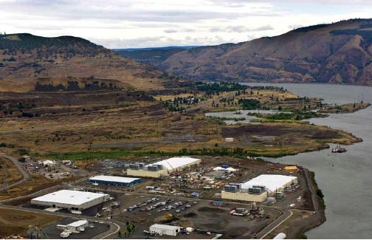
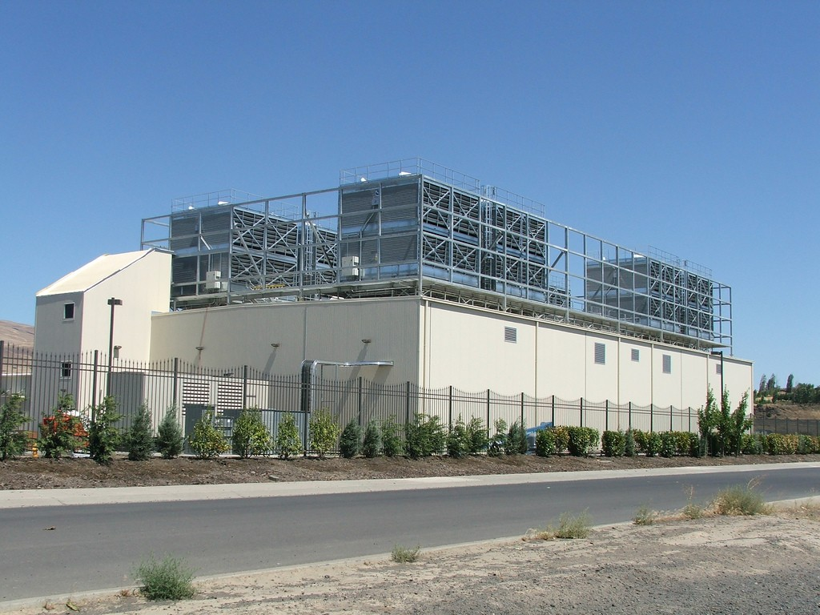
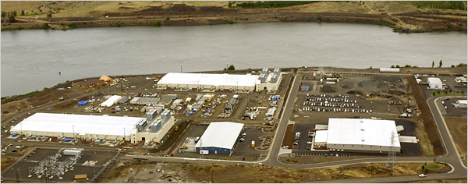
E.g., Google’s Oregon WSC

Slide 12
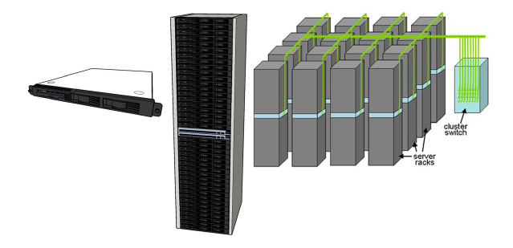
Equipment Inside a WSC
Server (in rack format):
1 ¾ inches high “1U”,
x 19 inches x 16-20 inches: dual sockets, 8 GB DRAM, 4x1 TB disk
Array (aka cluster):
16-32 server racks + larger local area network switch (“array switch”) 10X faster => cost 100X: cost f(N²)
7 foot rack: 40-80 servers + Ethernet local area network (1-10 Gbps) switch in middle (“rack switch”)

Slide 13
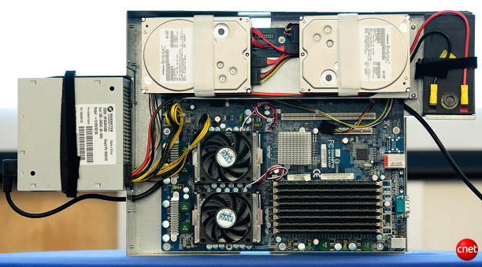
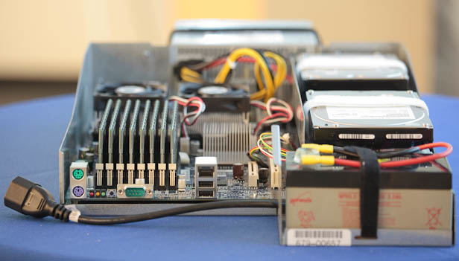
Server Internals
Google Server
Notes:
Most companies buy servers from the likes of Dell, Hewlett-Packard, IBM, or Sun Microsystems. But Google, which has hundreds of thousands of servers and considers running them part of its core expertise, designs and builds its own. Ben Jai, who designed many of Google's servers, unveiled a modern Google server before the hungry eyes of a technically sophisticated audience.
Google's big surprise: each server has its own 12-volt battery to supply power if there's a problem with the main source of electricity. The company also revealed for the first time that since 2005, its data centers have been composed of standard shipping containers--each with 1,160 servers and a power consumption that can reach 250 kilowatts.
It may sound geeky, but a number of attendees--the kind of folks who run data centers packed with thousands of servers for a living--were surprised not only by Google's built-in battery approach, but by the fact that the company has kept it secret for years. Jai said in an interview that Google has been using the design since 2005 and now is in its sixth or seventh generation of design.
Read more: http://news.cnet.com/8301-1001_3-10209580-92.html#ixzz0yo8bhTOH

Slide 14
Datacenter Power
Peak
Power %

Slide 15
Coping with Performance in Array
Lower latency to DRAM in another server than local disk
Higher bandwidth to local disk than to DRAM in another server
 | Local | Rack | Array
DRAM Latency (microseconds) | 0.1 | 100 | 300
Disk Latency (microseconds) | 10,000 | 11,000 | 12,000
DRAM Bandwidth (MB/sec) | 20,000 | 100 | 10
Disk Bandwidth (MB/sec) | 200 | 100 | 10
DRAM Capacity (GB) | 16 | 1,040 | 31,200
Disk Capacity (GB) | 4,000 | 320,000 | 9,600,000
2 microprocessors, 8 GB DRAM, 4 1TB disks/server
80 servers/rack
30 racks / array => 2400 servers / array

Slide 16
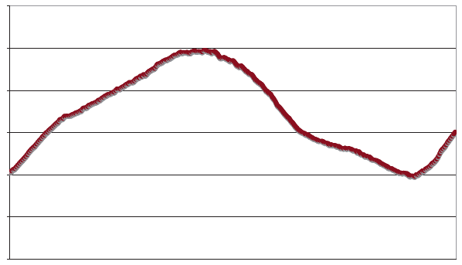
Coping with Workload Variation
Workload
2X
Midnight
Noon
Midnight
Online service: Peak usage 2X off-peak

Slide 17
Impact of Latency, Bandwidth, Failure, Varying Workload on WSC Software?
WSC Software must take care where it places data within an array to get good performance
WSC Software must cope with failures gracefully
WSC Software must scale up and down gracefully in response to varying demand
More elaborate hierarchy of memories, failure tolerance, workload accommodation makes
WSC software development more challenging than software for single computer

Slide 18
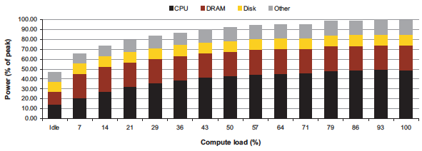
Power vs. Server Utilization
Server power usage as load varies idle to 100%
Uses ½ peak power when idle!
Uses ⅔ peak power when 10% utilized! 90%@ 50%!
Most servers in WSC utilized 10% to 50%
Goal should be Energy-Proportionality:
% peak load = % peak energy

Slide 19
Power Usage Effectiveness
Overall WSC Energy Efficiency: amount of computational work performed divided by the total energy used in the process
Power Usage Effectiveness (PUE):
Total building power / IT equipment power
  An power efficiency measure for WSC, not including efficiency of servers, networking gear
  1.0 = perfection

Slide 20
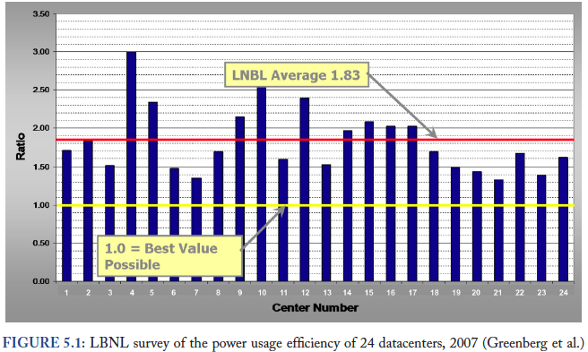
PUE in the Wild (2007)

Slide 21
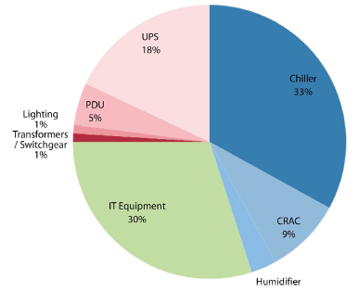
High PUE: Where Does Power Go?
Uninterruptable
Power Supply
(battery)
Chiller cools warm
water from Air
Conditioner
Power
Distribution
Unit
Computer
Room
Air
Conditioner
Servers +
Networking

Slide 22
Google WSC A PUE: 1.24
Careful air flow handling
Don’t mix server hot air exhaust with cold air (separate warm aisle from cold aisle)
Short path to cooling so little energy spent moving cold or hot air long distances
Keeping servers inside containers helps control air flow

Slide 23
Google WSC A PUE: 1.24
Elevated cold aisle temperatures
81°F instead of traditional 65°- 68°F
Found reliability OK if run servers hotter
Use of free cooling
Cool warm water outside by evaporation in cooling towers
Locate WSC in moderate climate so not too hot or too cold

Slide 24
Google WSC A PUE: 1.24
Per-server 12-V DC UPS
Rather than WSC wide UPS, place single battery per server board
Increases WSC efficiency from 90% to 99%
Measure vs. estimate PUE, publish PUE, and improve operation

Slide 25
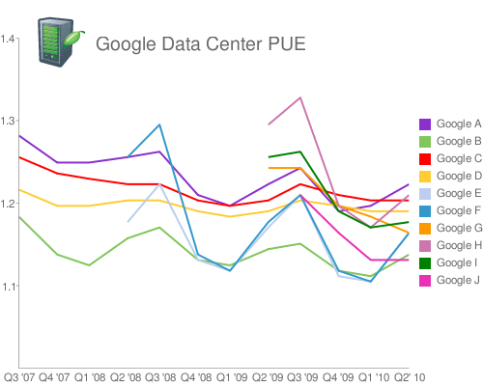
Google WSC PUE: Quarterly Avg
PUE
www.google.com/corporate/green/datacenters/measuring.htm

Slide 26
Agenda
Warehouse Scale Computers
Administrivia
Data Parallel Map Reduce

Slide 27
Reminders
Labs begin THIS week (W, Th)
  Part of first lab is discussion relevant to first HW
  Switching Sections: if you find another 61C student willing to swap discussion AND lab, talk to your TAs
  Partner (only Project 3 and EC): OK if partners mix sections but have same TA
New Labs: W 1-3, W 3-5, W 9-11 (Nite Owls) in SDH 200 (original labs are in Soda 330)
Discussions start week AFTER Labor Day
First HW assignment due 2 September by 11:59:59 PM
  Reading assignment on course page

Slide 28
Late Policy
Assignments due Sundays at 11:59:59 PM
Late homeworks not accepted (100% penalty)
Late projects get 20% penalty, accepted up to Tuesdays at 11:59:59 PM
  No credit if more than 48 hours late
  No “slip days” in 61C
    Used by Dan Garcia and a few faculty to cope with 100s of students who often procrastinate without having to hear the excuses, but not widespread in EECS courses
    More late assignments if everyone has no-cost options; better to learn now how to cope with real deadlines

Slide 29
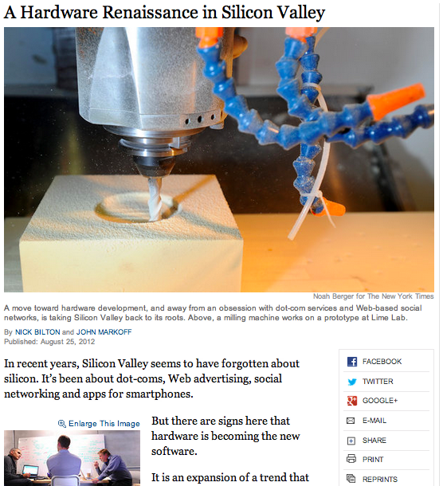
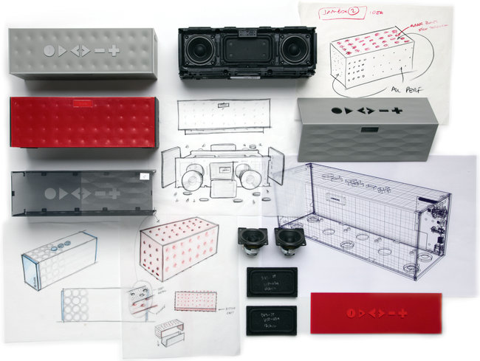
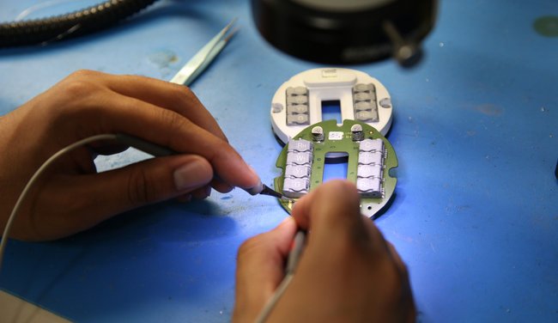
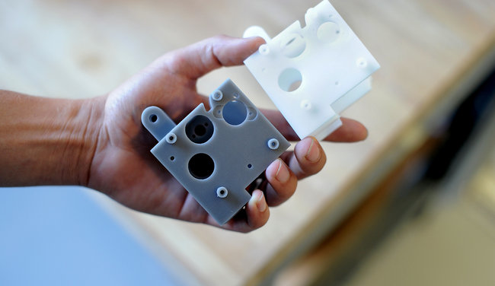
CS 61c in the News:
“Hardware is Hip!”
http://www.nytimes.com/
2012/08/26/technology/
silicon-valleys-hardware-renaissance.html

Slide 30


CS61c in the News
Talk today at 2 PM in Soda Hall Woz Lounge
  “Efficiency Challenges in Warehouse-Scale Computers”, Prof. Thomas Wenisch, UMich
  ABSTRACT: Architects and circuit designers have made enormous strides in managing the energy efficiency and peak power demands of processors and other silicon systems. Sophisticated power management features and modes are now myriad across system components, from DRAM to processors to disks. And yet, despite these advances, typical data centers today suffer embarrassing energy inefficiencies. … In this talk, I discuss what, if anything, can be done to make datacenters more energy-proportional. Specifically, through a case study of Google's Web Search application, I will discuss the applicability of existing and proposed active and idle low-power modes to reduce the power consumed by the primary server components (processor, memory, and disk), while maintaining tight response time constraints, particularly on 95th-percentile latency.
  Undergrads are welcome!

Slide 31
Agenda
Warehouse Scale Computers
Administrivia
Data Parallel Map Reduce (Introduction)

Slide 32
Request-Level Parallelism (RLP)
Hundreds or thousands of requests per second
  Not your laptop or cell-phone, but popular Internet services like Google search
  Such requests are largely independent
    Mostly involve read-only databases
    Little read-write (aka “producer-consumer”) sharing
    Rarely involve read–write data sharing or synchronization across requests
Computation easily partitioned within a request and across different requests

Slide 33
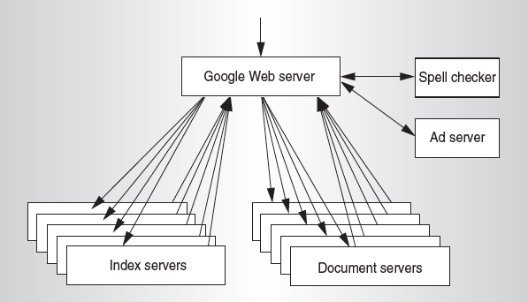
Google Query-Serving Architecture

Slide 34
Anatomy of a Web Search
Google “Randy H. Katz”
  Direct request to “closest” Google Warehouse Scale Computer
  Front-end load balancer directs request to one of many clusters of servers within WSC
  Within cluster, select one of many Google Web Servers (GWS) to handle the request and compose the response pages
  GWS communicates with Index Servers to find documents that contain the search words, “Randy”, “Katz”, uses location of search as well
  Return document list with associated relevance score

Slide 35
Anatomy of a Web Search
In parallel,
  Ad system: books by Katz at Amazon.com
  Images of Randy Katz
Use docids (document IDs) to access indexed documents
Compose the page
  Result document extracts (with keyword in context) ordered by relevance score
  Sponsored links (along the top) and advertisements (along the sides)

Slide 36
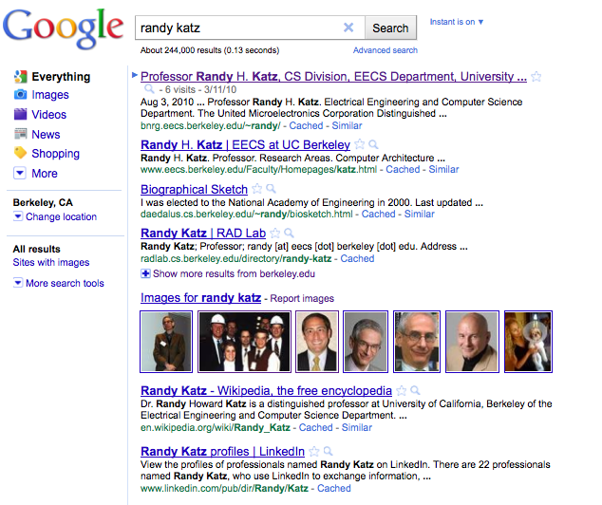

Slide 37
Anatomy of a Web Search
Implementation strategy
  Randomly distribute the entries
  Make many copies of data (aka “replicas”)
  Load balance requests across replicas
Redundant copies of indices and documents
  Breaks up hot spots, e.g., “Justin Bieber”
  Increases opportunities for request-level parallelism
  Makes the system more tolerant of failures

Slide 38
Question: Which statements are NOT TRUE about about Request Level Parallelism?
☐
RLP runs naturally independent requests in parallel
☐
RLP also runs independent tasks within a request
☐
RLP typically uses equal number of reads and writes
☐
Search uses redundant copies of indices and data to deliver parallelism
Notes:
VertLeftWhiteCheck1

Slide 39
Question: Which statements are NOT TRUE about about Request Level Parallelism?
☐
RLP runs naturally independent requests in parallel
☐
RLP also runs independent tasks within a request
☐
RLP typically uses equal number of reads and writes
☐
Search uses redundant copies of indices and data to deliver parallelism
Notes:
VertLeftWhiteCheck1

Slide 40
Data-Level Parallelism (DLP)
Two kinds
  Lots of data in memory that can be operated on in parallel (e.g., adding together two arrays)
  Lots of data on many disks that can be operated on in parallel (e.g., searching for documents)
3rd project does memory-based Data Level Parallelism (DLP)
1st project does DLP across 1000s of servers and disks using MapReduce

Slide 41
Problem Trying To Solve
How process large amounts of raw data (crawled documents, request logs, …) every day to compute derived data (inverted indicies, page popularity, …) when computation conceptually simple but input data large and distributed across 100s to 1000s of servers so that finish in reasonable time?
Challenge: Parallelize computation, distribute data, tolerate faults without obscuring simple computation with complex code to deal with issues
Jeffrey Dean and Sanjay Ghemawat, “MapReduce: Simplified Data Processing on Large Clusters,” Communications of the ACM, Jan 2008.

Slide 42
MapReduce Solution
Apply Map function to user supplied record of key/value pairs
Compute set of intermediate key/value pairs
Apply Reduce operation to all values that share same key to combine derived data properly
  Often produces smaller set of values
  Typically 0 or 1 output value per Reduce invocation
User supplies Map and Reduce operations in functional model so can parallelize, re-execute for fault tolerance

Slide 43
Data-Parallel “Divide and Conquer”
(MapReduce Processing)
Map:
  Slice data into “shards” or “splits”, distribute these to workers, compute sub-problem solutions
  map(in_key,in_value)->list(out_key,intermediate value)
    Processes input key/value pair
    Produces set of intermediate pairs
Reduce:
  Collect and combine sub-problem solutions
  reduce(out_key,list(intermediate_value))->list(out_value)
    Combines all intermediate values for a particular key
    Produces a set of merged output values (usually just one)
Fun to use: focus on problem, let MapReduce library deal with messy details

Slide 44
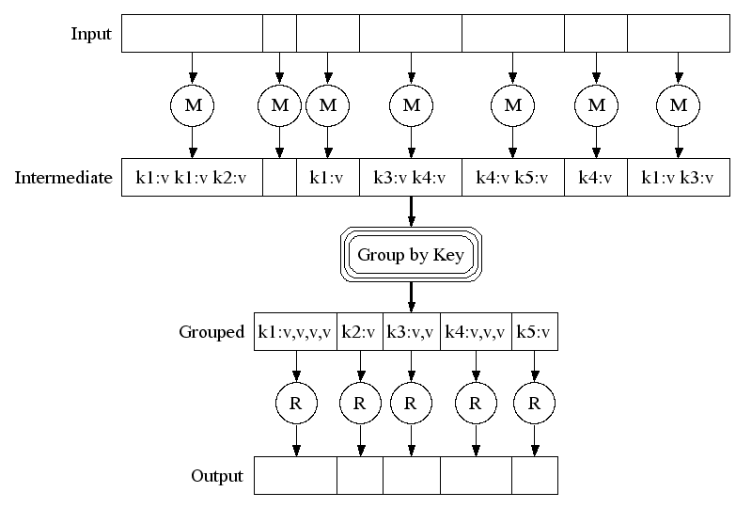
MapReduce Execution
Fine granularity tasks: many more map tasks than machines
Bucket sort
to get same keys
together
2000 servers =>
≈ 200,000 Map Tasks, ≈ 5,000 Reduce tasks

Slide 45
Google Uses MapReduce For …
Web crawl: Find outgoing links from HTML documents, aggregate by target document
Google Search: Generating inverted index files using a compression scheme
Google Earth: Stitching overlapping satellite images to remove seams and to select high-quality imagery
Google Maps: Processing all road segments on Earth and render map tile images that display segments
More than 10,000 MR programs at Google in 4 years,
run 100,000 MR jobs per day (2008)

Slide 46
MapReduce Popularity at Google
 | Aug-04 | Mar-06 | Sep-07 | Sep-09
Number of MapReduce jobs | 29,000 | 171,000 | 2,217,000 | 3,467,000
Average completion time (secs) | 634 | 874 | 395 | 475
Server years used | 217 | 2,002 | 11,081 | 25,562
Input data read (TB) | 3,288 | 52,254 | 403,152 | 544,130
Intermediate data (TB) | 758 | 6,743 | 34,774 | 90,120
Output data written (TB) | 193 | 2,970 | 14,018 | 57,520
Average number servers /job | 157 | 268 | 394 | 488

Slide 47
What if Ran Google Workload on EC2?
 | Aug-04 | Mar-06 | Sep-07 | Sep-09
Number of MapReduce jobs | 29,000 | 171,000 | 2,217,000 | 3,467,000
Average completion time (secs) | 634 | 874 | 395 | 475
Server years used | 217 | 2,002 | 11,081 | 25,562
Input data read (TB) | 3,288 | 52,254 | 403,152 | 544,130
Intermediate data (TB) | 758 | 6,743 | 34,774 | 90,120
Output data written (TB) | 193 | 2,970 | 14,018 | 57,520
Average number of servers per job | 157 | 268 | 394 | 488
Average Cost/job EC2 | $17 | $39 | $26 | $38
Annual Cost if on EC2 | $0.5M | $6.7M | $57.4M | $133.1M

Slide 48
Question: Which statements are NOT TRUE about about MapReduce?
☐
Users express computation as two functions, Map and Reduce, and supply code for them
☐
MapReduce is well-matched to parallel processing of small data sets
☐
There are typically many more Map Tasks than Reduce Tasks (e.g., 40:1)
☐
MapReduce hides details of parallelization, fault tolerance, locality optimization, and load balancing
Notes:
VertLeftWhiteCheck1

Slide 49
Question: Which statements are NOT TRUE about about MapReduce?
☐
Users express computation as two functions, Map and Reduce, and supply code for them
☐
MapReduce is well-matched to parallel processing of small data sets
☐
There are typically many more Map Tasks than Reduce Tasks (e.g., 40:1)
☐
MapReduce hides details of parallelization, fault tolerance, locality optimization, and load balancing
Notes:
VertLeftWhiteCheck1

Slide 50
“And in Conclusion, …”
Post PC Era: Parallel processing, smart phone to WSC
WSC SW must cope with failures, varying load, varying HW latency bandwidth
WSC HW sensitive to cost, energy efficiency
Request-Level Parallelism
  High request volume, each largely independent of other
  Use replication for better request throughput, availability
MapReduce Data Parallelism
  Map: Divide large data set into pieces for independent parallel processing
  Reduce: Combine and process intermediate results to obtain final result

