Slide 1
CS 61C: Great Ideas in Computer Architecture Introduction to C, Part I
Instructors:
Krste Asanovic Randy H. Katz
http://inst.eecs.Berkeley.edu/~cs61c/F12

Slide 2
Agenda
Review
Compile vs. Interpret
Python vs. Java vs. C
Administrivia
Quick Start Introduction to C
Technology Break
More C
Summary

Slide 3
Review
Request-Level Parallelism
High request volume, each largely independent of other
Use replication for better request throughput, availability
MapReduce Data Parallelism
Map: Divide large data set into pieces for independent parallel processing
Reduce: Combine and process intermediate results to obtain final result

Slide 4
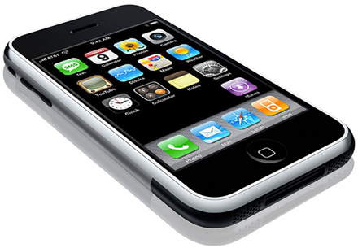
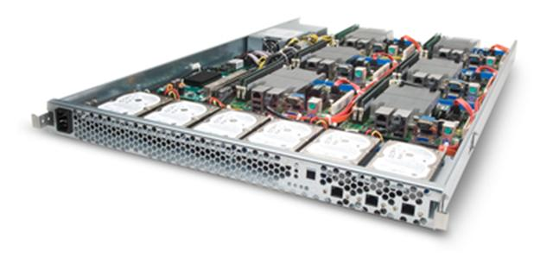
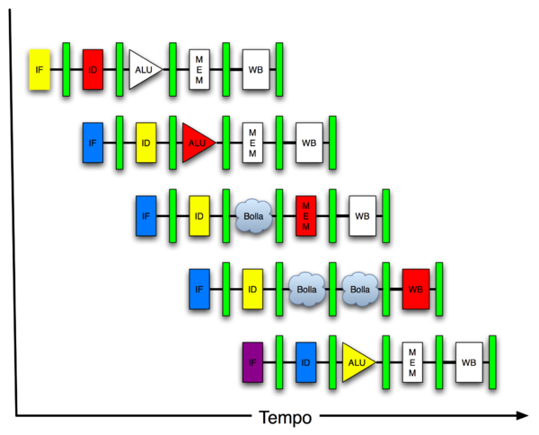
New-School Machine Structures (It’s a bit more complicated!)
Software Hardware
Parallel Requests
Assigned to computer
e.g., Search “Katz”
Parallel Threads
Assigned to core
e.g., Lookup, Ads
Parallel Instructions
>1 instruction @ one time
e.g., 5 pipelined instructions
Parallel Data
>1 data item @ one time
e.g., Add of 4 pairs of words
Hardware descriptions
All gates @ one time
Programming Languages
Warehouse Scale Computer
Smart Phone
Harness Parallelism &
Achieve High Performance
Computer
Core
…
Core
Memory (Cache)
Input/Output
Core
Instruction Unit(s)
Functional
Unit(s)
A₀+B₀
A₁+B₁
A₂+B₂
A₃+B₃
Cache Memory
Today’s Lecture
Logic Gates

Slide 5
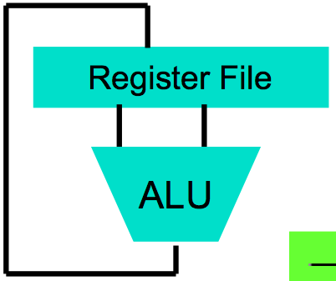
Big Idea #1: Levels of Representation/Interpretation
High-Level Language Program (e.g., C)
temp = v[k];
v[k] = v[k+1];
v[k+1] = temp;
We are here!
Compiler
Anything can be represented as a number, i.e., data or instructions
lw $t0, 0($2)
lw $t1, 4($2)
sw $t1, 0($2)
sw $t0, 4($2)
Assembly Language Program (e.g., MIPS)
Assembler
0000 1001 1100 0110 1010 1111 0101 1000
1010 1111 0101 1000 0000 1001 1100 0110
1100 0110 1010 1111 0101 1000 0000 1001
0101 1000 0000 1001 1100 0110 1010 1111
Machine Language Program (MIPS)
Machine Interpretation
Hardware Architecture Description (e.g., block diagrams)
Architecture Implementation
Logic Circuit Description (Circuit Schematic Diagrams)

Slide 6
Introduction to C “The Universal Assembly Language”
“Some” experience is required before CS61C
C++ or Java OK
Class pre-req included classes teaching Java
Java used in two labs and one project
C used for everything else

Slide 7
Flash Card Language Poll!
Please raise card for first one of following you can say yes to
☐
I have programmed in C,C++,C#, or Objective-C
☐
I have programmed in Java
I have programmed in FORTRAN, Cobol, Algol-68, Ada, Pascal, or Basic
☐
☐
None of the above
Notes:
VertLeftWhiteCheck1
A is wrong: short, int, long are 16, 32, 64 signed integers, but they could all be 64 bits in C
B is wrong. Java has boolean, byte; C has long long, unisigned int
C is wrong; Java uses JIT; also, still compile to produce byte codes

Slide 8
Disclaimer
You will not learn how to fully code in C in these lectures! Can only learn a language by using it!
You’ll need your C reference for this course
K&R is a must-have
Check online for more sources
“Java in a Nutshell,” O’Reilly
Chapter 2, “How Java Differs from C”
http://oreilly.com/catalog/javanut/excerpt/index.html
Brian Harvey’s helpful transition notes
On CS61C class website: pages 3-19
http://inst.eecs.berkeley.edu/~cs61c/resources/HarveyNotesC1-3.pdf
Key C concepts: Pointers, Arrays, Implications for Memory management

Slide 9
Intro to C
C is not a “very high level” language, nor a “big” one, and is not specialized to any particular area of application. But its absence of restrictions and its generality make it more convenient and effective for many tasks than supposedly more powerful languages.
Kernighan and Ritchie
Enabled first operating system not written in assembly language: UNIX - A portable OS!
C and derivatives (C++/Obj-C/C#) still one of the most popular application programming languages after >40 years!

Slide 10
TIOBE Index of Language Popularity

Slide 11
Basic C Concepts
Compiler
Typed variables
Typed functions
Header files (.h)
Structs
Enums
Pointers
Creates useable programs from C source
Kind of data that a variable contains
The kind of data returned from a function
Declare functions and variables in a separate file
Groups of related values
Lists of predefined values
Aliases to other variables
These concepts distinguish C from other languages you may know

Slide 12
Integers: Python vs. Java vs. C
Language | sizeof(int)
Python | >=32 bits (plain ints), infinite (long ints)
Java | 32 bits
C | Depends on computer; 16 or 32 or 64
C: int should be integer type that target processor is most efficient working with
Only guarantee: sizeof(long long) ≥ sizeof(long) ≥ sizeof(int) ≥ sizeof(short)
All could be 64 bits
Notes:
C: The actual size of integer types varies by implementation. The only guarantee is that the long long is not smaller than long, which is not smaller than int, which is not smaller than short. Also, int should be the integer type that the target processor is most efficient working with. This allows great flexibility: for example, all types can be 64-bit.

Slide 13
C vs. Java
 | C | Java
Type of Language | Function Oriented | Object Oriented
Program-ming Unit | Function | Class = Abstract Data Type
Compilation | gcc hello.c creates machine language code | javac Hello.java creates Java virtual machine language bytecode
Execution | a.out loads and executes program | java Hello interprets bytecodes
hello, world | #include<stdio.h> int main(void) { printf("Hello\n"); return 0; } | public class HelloWorld { public static void main(String[] args) { System.out.printl("Hello"); } }
Storage | Manual (malloc, free) | Automatic (garbage collection)
From http://www.cs.princeton.edu/introcs/faq/c2java.html

Slide 14
C vs. Java
 | C | Java
Comments | /* … */ | /* … */ or // … end of line
Constants | const, #define | final
Preprocessor | Yes | No
Variable declaration | At beginning of a block | Before you use it
Variable naming conventions | sum_of_squares | sumOfSquares
Accessing a library | #include <stdio.h> | import java.io.File;
From http://www.cs.princeton.edu/introcs/faq/c2java.html

Slide 15
Compilation: Overview
C compilers map C programs into architecture-specific machine code (string of 1s and 0s)
Unlike Java, which converts to architecture-independent bytecode
Unlike Python environments, which interpret the code
These differ mainly in exactly when your program is converted to low-level machine instructions (“levels of interpretation”)
For C, generally a two part process of compiling .c files to .o files, then linking the .o files into executables;
Assembling is also done (but is hidden, i.e., done automatically, by default); we’ll talk about that later

Slide 16
Compilation: Advantages
Excellent run-time performance: generally much faster than Scheme or Java for comparable code (because it optimizes for a given architecture)
Fair compilation time: enhancements in compilation procedure (Makefiles) allow only modified files to be recompiled
Why C?: we can write programs that allow us to exploit underlying features of the architecture – memory management, special instructions, parallelism

Slide 17
Compilation: Disadvantages
Compiled files, including the executable, are architecture-specific, depending on processor type and the operating system
Executable must be rebuilt on each new system
I.e., “porting your code” to a new architecture
“Change → Compile → Run [repeat]” iteration cycle can be slow, during the development cycle

Slide 18
Typed Variables in C
int variable1 = 2;
float variable2 = 1.618;
char variable3 = 'A';
Must declare the type of data a variable will hold
Types can't change
Type Description Examples
int integer numbers, including negatives 0, 78, -1400
unsigned int integer numbers (no negatives) 0, 46, 900
float floating-point numbers 0.0, 1.618, -1.4
char single text character or symbol 'a', 'D', '?’
double greater precision/big FP number 10E100 long larger signed integer 6,000,000,000

Slide 19
Typed Functions in C
int number_of_people ()
{
return 3;
}
float dollars_and_cents ()
{
return 10.33;
}
char first_letter ()
{
return 'A';
}
You have to declare the type of data you plan to return from a function
Return type can be any C variable type, and is placed to the left of the function name
You can also specify the return type as void
Just think of this as saying that no value will be returned
Also necessary to declare types for values passed into a function
Variables and functions MUST be declared before they are used

Slide 20
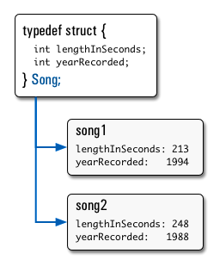
Structs in C
Structs are structured groups of variables, e.g.,
typedef struct {
int length_in_seconds;
int yearRecorded;
} Song;
Song song1;
Song1.length_in_seconds= 213;
song1.yearRecorded = 1994;
Song song2;
Song2.length_in_seconds = 248;
song2.yearRecorded = 1988;
Dot notation: x.y = value

Slide 21
Consts and Enums in C
Constant is assigned a value once in the declaration; value can't change during entire execution of program
const float golden_ratio = 1.618;
const int days_in_week = 7;
You can have a constant version of any of the standard C variable types
Enums: a group of related integer constants used to parameterize libraries:
enum cardsuit {CLUBS,DIAMONDS,HEARTS,SPADES};

Slide 22
Question: Which statement is TRUE regarding C and Java?
☐
short, int, and long are in both languages and they have the same meaning
☐
As Java was derived from C, it has the same names of data types
☐
C programs use compilers to produce executable code but Java does not
☐
C has a preprocessor that allows conditional compilation, but Java does not
Notes:
VertLeftWhiteCheck1
A is wrong: short, int, long are 16, 32, 64 signed integers, but they could all be 64 bits in C
B is wrong. Java has boolean, byte; C has long long, unisigned int
C is wrong; Java uses JIT; also, still compile to produce byte codes

Slide 23
Administrivia
CS61c is relentless!
Next week: Lab #2, HW #2
Lab #2, Amazon EC2
HW #2 will soon be posted
Monday is Labor Day Holiday – no lecture!
Wonderful to see the valuable discussion and help going on in Piazza!

Slide 24
Agenda
Review
Compile vs. Interpret
Scheme vs. Java vs. C
Administrivia
Quick Start Introduction to C
Technology Break
More C
Summary

Slide 25
A First C Program: Hello World
Original C:
main()
{
printf("\nHello World\n");
}
ANSI Standard C:
#include <stdio.h>
int main(void)
{
printf("\nHello World\n");
return (0);
}

Slide 26
C Syntax: main
When C program starts,
1st runs initialization code to set up process for your program
Then calls your procedure named main()
To get arguments to the main function, use:
int main (int argc, char *argv[])
What does this mean?
argc contains the number of strings on the command line (the executable counts as one, plus one for each argument). Here argc is 2:
unix% sort myFile
argv is a pointer to an array containing the arguments as strings (more on pointers later)

Slide 27
Example
foo hello 87
argc = 3 /* number arguments */
argv[0] = "foo", argv[1] = "hello", argv[2] = "87"
Array of pointers to strings (cover later)

Slide 28
A Second C Program: Compute Table of Sines
#include <stdio.h>
#include <math.h>
int main(void)
{
int angle_degree;
double angle_radian, pi, value;
/* Print a header */
printf("\nCompute a table of the sine function\n\n");
/* obtain pi once for all */
/* or just use pi = M_PI, where */
/* M_PI is defined in math.h */
pi = 4.0*atan(1.0);
printf("Value of PI = %f \n\n", pi);
printf("angle Sine \n");
angle_degree = 0;
/* initial angle value */
/* scan over angle */
while (angle_degree <= 360)
/* loop until angle_degree > 360 */
{
angle_radian = pi*angle_degree/180.0;
value = sin(angle_radian);
printf (" %3d %f \n ", angle_degree, value);
angle_degree = angle_degree + 10;
/* increment the loop index */
}
}

Slide 29
Second C Program Sample Output
Compute a table of the sine function
Value of PI = 3.141593
angle Sine
0 0.000000
10 0.173648
20 0.342020
30 0.500000
40 0.642788
50 0.766044
60 0.866025
70 0.939693
80 0.984808
90 1.000000
100 0.984808
110 0.939693
120 0.866025
130 0.766044
140 0.642788
150 0.500000
160 0.342020
170 0.173648
180 0.000000
190 -0.173648
200 -0.342020
210 -0.500000
220 -0.642788
230 -0.766044
240 -0.866025
250 -0.939693
260 -0.984808
270 -1.000000
280 -0.984808
290 -0.939693
300 -0.866025
310 -0.766044
320 -0.642788
330 -0.500000
340 -0.342020
350 -0.173648
360 -0.000000

Slide 30
C Syntax: Variable Declarations
Similar to Java, but with a few minor but important differences
All variable declarations must appear before they are used (e.g., at the beginning of the block)
A variable may be initialized in its declaration; if not, it holds garbage!
Examples of declarations:
Correct: {
int a = 0, b = 10;
...
Incorrect: for (int i = 0; i < 10; i++)
}

Slide 31
C Syntax : Control Flow (1/2)
Within a function, remarkably close to Java constructs (shows Java’s legacy) in terms of control flow
if-else
if (expression) statement
if (expression) statement1
else statement2
while
while (expression)
statement
do
statement
while (expression);

Slide 32
C Syntax : Control Flow (2/2)
for
for (initialize; check; update) statement
switch
switch (expression){
case const1: statements
case const2: statements
default: statements
}
break

Slide 33
C Syntax: True or False
What evaluates to FALSE in C?
0 (integer)
NULL (a special kind of pointer: more on this later)
No explicit Boolean type
What evaluates to TRUE in C?
Anything that isn’t false is true
Same idea as in Python: only 0s or empty sequences are false, anything else is true!

Slide 34
C and Java operators nearly identical
arithmetic: +, -, *, /, %
assignment: =
augmented assignment: +=, -=, *=, /=, %=, &=, |=, ^=, <<=, >>=
bitwise logic: ~, &, |, ^
bitwise shifts: <<, >>
boolean logic: !, &&, ||
equality testing: ==, !=
subexpression grouping: ( )
order relations: <, <=, >, >=
increment and decrement: ++ and --
member selection: ., ->
conditional evaluation: ? :

Slide 35
And In Conclusion, …
All data C is an efficient compiled language, widely used for systems programming (operating systems) and application development
C successors (C++, Objective-C, C#) are also popular
Java syntax based on C, due to C’s popularity
BUT C can be more difficult to use than more modern programming languages

