Slide 1
CS 61C: Great Ideas in Computer Architecture Introduction to C, Part II
Instructors:
Krste Asanovic Randy H. Katz
http://inst.eecs.Berkeley.edu/~cs61c/F12

Slide 2
Agenda
Review
Pointers
Administrivia
Arrays
Technology Break
Summary

Slide 3
Review
C is a popular and efficient compiled language used for systems programming and application development
Derivatives include C++, Objective-C, C#
Java borrowed much of the basic syntax
Very close to machine, so sometimes difficult to program and debug
Key concepts last time: compilation, preprocessor, typed data and functions, main(), structs, enums, control flow

Slide 4
Address vs. Value
Consider memory to be a single huge array
Each cell of the array has an address associated with it
Each cell also stores some value
Do you think they use signed or unsigned numbers? Negative address?!
Don’t confuse the address referring to a memory location with the value stored there
...
101 102 103 104 105 ...
...
23
42

Slide 5
Pointers
An address refers to a particular memory location; e.g., it points to a memory location
Pointer: A variable that contains the address of a variable
Location (address)
...
101 102 103 104 105 ...
...
23
42
104
x
y
p
name

Slide 6
Pointer Syntax
int *x;
Tells compiler that variable x is address of an int
x = &y;
Tells compiler to assign address of y to x
& called the “address operator” in this context
z = *x;
Tells compiler to assign value at address in x to z
* called the “dereference operator” in this context

Slide 7
Creating and Using Pointers
How to create a pointer:
& operator: get address of a variable
int *p, x;
Note the “*” gets used 2 different ways in this example. In the declaration to indicate that p is going to be a pointer, and in the printf to get the value pointed to by p.
p
?
x
?
x = 3;
p
?
x
3
p = &x;
p
x
3
How get a value pointed to?
“*” (dereference operator): get the value that the pointer points to
printf(“p points to %d\n”,*p);

Slide 8
Using Pointer for Writes
How to change a variable pointed to?
Use the dereference operator * on left of assignment operator =
p
x
3
*p = 5;
p
x
5

Slide 9
Pointers and Parameter Passing
Java and C pass parameters “by value”
Procedure/function/method gets a copy of the parameter, so changing the copy cannot change the original
void addOne (int x) { x = x + 1; }
int y = 3;
addOne(y);
y remains equal to 3

Slide 10
Pointers and Parameter Passing
How can we get a function to change the value held in a variable?
void addOne (int *p) { *p = *p + 1; }
int y = 3;
addOne(&y);
y is now equal to 4

Slide 11
Types of Pointers
Pointers are used to point to any kind of data (int, char, a struct, etc.)
Normally a pointer only points to one type (int, char, a struct, etc.).
void * is a type that can point to anything (generic pointer)
Use sparingly to help avoid program bugs, and security issues, and other bad things!

Slide 12
More C Pointer Dangers
Declaring a pointer just allocates space to hold the pointer – it does not allocate the thing being pointed to!
Local variables in C are not initialized, they may contain anything (aka “garbage”)
What does the following code do?
void f()
{
int *ptr;
*ptr = 5;
}

Slide 13
Pointers and Structures
struct Point {
int x;
int y;
};
Point p1;
Point p2;
Point *paddr;
/* dot notation */
int h = p1.x;
p2.y = p1.y;
/* arrow notation */
int h = paddr->x;
int h = (*paddr).x;
/* This works too */
p1 = p2;

Slide 14
Pointers in C
Why use pointers?
If we want to pass a large struct or array, it’s easier / faster / etc. to pass a pointer than the whole thing
In general, pointers allow cleaner, more compact code
So what are the drawbacks?
Pointers are probably the single largest source of bugs in C, so be careful anytime you deal with them
Most problematic with dynamic memory management—which you will to know by the end of the semester, but not for the projects (there will be a lab later in the semester)
Dangling references and memory leaks

Slide 15
Why Pointers in C?
At time C was invented (early 1970s), compilers often didn’t produce efficient code
Computers 25,000 times faster today, compilers better
C designed to let programmer say what they want code to do without compiler getting in way
Even give compilers hints which registers to use!
Still useful for low-level system code
Today’s compilers produce much better code, so may not need to use pointers
Compilers even ignore hints since they do it better!

Slide 16
How many logic and syntax errors?
void main(); { int *p, x=5, y; // init y = *(p = &x) + 1; int z; flip-sign(p); printf("x=%d,y=%d,p=%d\n",x,y,p); } flip-sign(int *n){*n = -(*n)}
☐
1
☐
2
☐
3
☐
≥4
Notes:
VertLeftWhiteCheck1
A is wrong: short, int, long are 16, 32, 64 signed integers, but they could all be 64 bits in C
B is wrong. Java has boolean, byte; C has long long, unisigned int
C is wrong; Java uses JIT; also, still compile to produce byte codes

Slide 17
Peer Instruction Answer
#insert <stdio.h>
void main(); { int *p, x=5, y; // init y = *(p = &x) + 1; int z; flip-sign(p); printf("x=%d,y=%d,p=%d\n",x,y,*p); } flip-sign(int *n){*n = -(*n);}
5 syntax + logic errors in this C code
Notes:
See following answer slide

Slide 18
What is output after correct errors?
void main(); { int *p, x=5, y; // init int z;
y = *(p = &x) + 1; flip-sign(p); printf("x=%d,y=%d,p=%d\n",
x,y,*p); } flip-sign(int *n) {*n = -(*n); }
☐
x=5,y=6,p=-5
☐
x=-5,y=6,p=-5
☐
x=-5,y=4,p=-5
☐
x=-5,y=-6,p=-5
Notes:
VertLeftWhiteCheck1
B is correct; p points to x

Slide 19
Administrivia
HW #2
Lab #2
No Discussion sections this week, but extra office hours…

Slide 20
Extra Office Hours This Week
(Alan Christopher: Tue 5-7 320 Soda)
Loc Do: Fri 12-2pm Qualcomm Cyber Café
(James Ferguson: Tue 10-11 AM & 1-2 PM, 320 Soda)
Anirudh Garg: Wed 4-6 Qualcomm Cyber Café
William Ku: 6-8 Thursday 283E Soda
Brandon Luong: Wed 6-8 283E Soda
Ravi Punj: Wed 12-2 Free Speech Movement Cafe.
Sung Roa Yoon: Thu 7-9 283E Soda.
Watch Piazza!

Slide 21
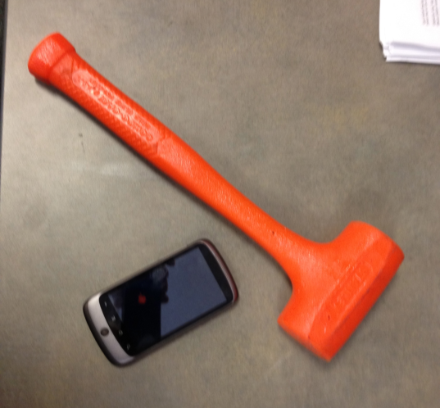
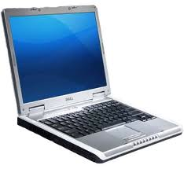
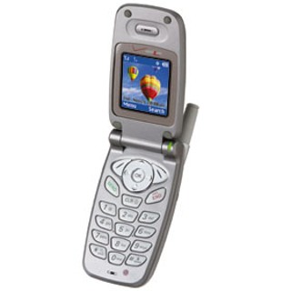
The Rules (and we really mean it!)

Slide 22
Arrays (1/5)
Declaration:
int ar[2];
declares a 2-element integer array: just a block of memory
int ar[] = {795, 635};
declares and initializes a 2-element integer array
Accessing elements:
ar[num]
returns the num^{th} element

Slide 23
Arrays (2/5)
C arrays are (almost) identical to pointers
char *string and char string[] are nearly identical declarations
Differ in subtle ways: incrementing, declaration of filled arrays
End of C string marked by 0 in last character
Key Concept: Array variable is a “pointer” to the first (0th) element

Slide 24
C Strings
String in C is just an array of characters
char string[] = "abc";
How do you tell how long a string is?
Last character is followed by a 0 byte (aka “null terminator”)
int strlen(char s[])
{
int n = 0;
while (s[n] != 0) n++;
return n;
}

Slide 25
Arrays (3/5)
Consequences:
ar is an array variable, but looks like a pointer
ar[0] is the same as *ar
ar[2] is the same as *(ar+2)
We can use pointer arithmetic to conveniently access arrays
Declared arrays are only allocated while the scope is valid
char *foo() { char string[32]; ...; return string; }
is incorrect and very very bad

Slide 26
Arrays (4/5)
Array size n; want to access from 0 to n-1, so you should use counter AND utilize a variable for declaration & incrementation
Bad pattern int i, ar[10]; for(i = 0; i < 10; i++){ ... }
Better pattern int ARRAY_SIZE = 10 int i, a[ARRAY_SIZE]; for(i = 0; i < ARRAY_SIZE; i++){ ... }
SINGLE SOURCE OF TRUTH
You’re utilizing indirection and avoiding maintaining two copies of the number 10
DRY: “Don’t Repeat Yourself”

Slide 27
Arrays (5/5)
Pitfall: An array in C does not know its own length, and its bounds are not checked!
Consequence: We can accidentally access off the end of an array
Consequence: We must pass the array and its size to any procedure that is going to manipulate it
Segmentation faults and bus errors:
These are VERY difficult to find; be careful! (You’ll learn how to debug these in lab)

Slide 28
Array Summary
Array indexing is syntactic sugar for pointers
a[i] is treated as *(a+i)
E.g., three equivalent ways to zero an array:
for (i=0; i < size; i++) a[i] = 0;
for (i=0; i < size; i++) *(a+i) = 0;
for (p=a; p < a+size; p++) *p = 0;
Incrementing a pointer makes it point to the next variable in memory (type of pointer says how big each variable is)

Slide 29
What is TRUE about this function?
void foo(char *s, char *t) { while (*s)
s++;
while (*s++ = *t++)
; }
☐
It has syntax errors
☐
No syntax errors; it changes characters in string t to next character in the string s
☐
No syntax errors; it copies a string at address t to the string at address s
☐
No syntax errors; it appends the string at address t to the end of the string at address s
Notes:
VertLeftWhiteCheck1
D is correct

Slide 30
Question: Which statement is FALSE regarding C and Java?
☐
Arrays in C are just pointers to the 0-th element
☐
As Java was derived from C, it has the same control flow constructs
☐
Like Java, in C you can check the length of an array ( a.length gives no. elements in a)
☐
C has pointers but Java does not allow you to manipulate pointers or memory addresses of any kind
Notes:
VertLeftWhiteCheck1
C is wrong; variable length

Slide 31
FYI—Update to ANSI C
“C99” or “C9X” standard
gcc -std=c99 to compile
References
http://en.wikipedia.org/wiki/C99
http://home.tiscalinet.ch/t_wolf/tw/c/c9x_changes.html
Highlights
Declarations in for loops, like Java
Java-like // comments (to end of line)
Variable-length non-global arrays
<inttypes.h>: explicit integer types
<stdbool.h>: for boolean logic types and definitions

Slide 32
And In Conclusion, …
All data is in memory
Each memory location has an address to use to refer to it and a value stored in it
Pointer is a C version (abstraction) of a data address
* “follows” a pointer to its value
& gets the address of a value
Arrays and strings are implemented as variations on pointers
C is an efficient language, but leaves safety to the programmer
Array bounds not checked
Variables not automatically initialized
Use pointers with care: they are a common source of bugs in programs

