Slide 1
CS 61C: Great Ideas in Computer Architecture Functions and Numbers
Instructor:
Krste Asanovic, Randy H. Katz
http://inst.eecs.Berkeley.edu/~cs61c/sp12

Slide 2
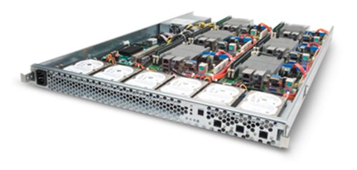
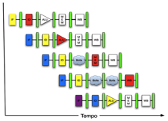
New-School Machine Structures (It’s a bit more complicated!)
Software Hardware
Parallel Requests
Assigned to computer
e.g., Search “Katz”
Parallel Threads
Assigned to core
e.g., Lookup, Ads
Parallel Instructions
>1 instruction @ one time
e.g., 5 pipelined instructions
Parallel Data
>1 data item @ one time
e.g., Add of 4 pairs of words
Hardware descriptions
All gates @ one time
Programming Languages
Warehouse Scale Computer
Smart Phone
Harness Parallelism &
Achieve High Performance
Computer
Core
…
Core
Memory (Cache)
Input/Output
Core
Instruction Unit(s)
Functional
Unit(s)
A₀+B₀
A₁+B₁
A₂+B₂
A₃+B₃
Cache Memory
Today’s Lecture
Logic Gates

Slide 3
Agenda
Review
Functions
Administrivia
Everything is a Number
And in Conclusion, …

Slide 4
Agenda
Review
Functions
Administrivia
Everything is a Number
And in Conclusion, …

Slide 5
Six Fundamental Steps in Calling a Function
Put parameters in a place where function can access them
Transfer control to function
Acquire (local) storage resources needed for function
Perform desired task of the function
Put result value in a place where calling program can access it and restore any registers you used
Return control to point of origin, since a function can be called from several points in a program

Slide 6
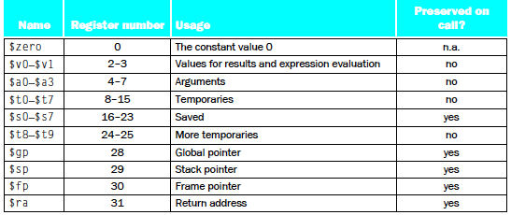
Register Allocation and Numbering

Slide 7
MIPS Function Call Instructions
Invoke function: jump and link instruction (jal)
“link” means form an address or link that points to calling site to allow function to return to proper address
Jumps to address and simultaneously saves the address of following instruction in register $ra
jal ProcedureAddress
Return from function: jump register instruction (jr)
Unconditional jump to address specified in register
jr $ra

Slide 8
Notes on Functions
Calling program (caller) puts parameters into registers $a0-$a3 and uses jal X to invoke X (callee)
Must have register in computer with address of currently executing instruction
Instead of Instruction Address Register (better name), historically called Program Counter (PC)
It’s a program’s counter; it doesn’t count programs!
jr $ra puts address inside $ra into PC
What value does jal X place into $ra? ????
Student Roulette?

Slide 9
Notes on Functions
Calling program (caller) puts parameters into registers $a0-$a3 and uses jal X to invoke X (callee)
Must have register in computer with address of currently executing instruction
Instead of Instruction Address Register (better name), historically called Program Counter (PC)
It’s a program’s counter, it doesn’t count programs!
jr $ra puts address inside $ra into PC
What value does jal X place into $ra? Next PC
PC + 4

Slide 10
Where Are Old Register Values Saved to Restore Them After Function Call
Need a place to save old values before call function, restore them when return, and delete
Ideal is stack: last-in-first-out queue (e.g., stack of plates)
Push: placing data onto stack
Pop: removing data from stack
Stack in memory, so need register to point to it
$sp is the stack pointer in MIPS
Convention is grow from high to low addresses
Push decrements $sp, Pop increments $sp
(28 out of 32, 4 left!)

Slide 11
Example
int leaf_example (int g, int h, int i, int j)
{
int f;
f = (g + h) – (i + j);
return f;
}
Parameter variables g, h, i, and j in argument registers $a0, $a1, $a2, and $a3, and f in $s0
Assume need one temporary register $t0

Slide 12
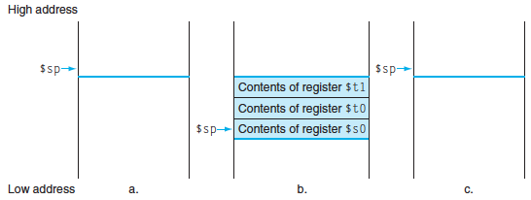
Stack Before, During, After Function
Need to save old values of $s0 and $t0
Contents of $t0
Contents of $s0

Slide 13
MIPS Code for leaf_example
leaf_example:
# adjust stack for 2 int items
# save $t0 for use afterwards
# save $s0 for use afterwards
# f = g + h
# t0 = i + j
# return value (g + h) – (i + j)
# restore $s0 for caller
# restore $t0 for caller
# delete 2 items from stack
# jump back to calling routine
Student Roulette?
Notes:
addi $sp,$sp,-8 # adjust stack for 2 items
sw $t0, 4($sp) # save $t0 for use afterwards
sw $s0, 0($sp) # save $s0 for use afterwards
add $s0,$a0,$a1 # f = g + h
add $t0,$a2,$a3 # t0 = i + j
sub $v0,$s0,$t0 # return value (g + h) – (i + j)
lw $s0, 0($sp) # restore register $s0 for caller
lw $t0, 4($sp) # restore register $t0 for caller
addi $sp,$sp,8 # adjust stack to delete 2 items
jr $ra # jump back to calling routine

Slide 14
MIPS Code for leaf_example
leaf_example:
addi $sp,$sp,-8 # adjust stack for 2 int items
# save $t0 for use afterwards
# save $s0 for use afterwards
# f = g + h
# $t0 = i + j
# return value (g + h) – (i + j)
# restore register $s0 for caller
# restore register $t0 for caller
# adjust stack to delete 2 items
# jump back to calling routine
Student Roulette?

Slide 15
MIPS Code for leaf_example
leaf_example:
addi $sp,$sp,-8 # adjust stack for 2 int items
sw $t0, 4($sp) # save $t0 for use afterwards
# save $s0 for use afterwards
# f = g + h
# $t0 = i + j
# return value (g + h) – (i + j)
# restore register $s0 for caller
# restore register $t0 for caller
# adjust stack to delete 2 items
# jump back to calling routine
Student Roulette?

Slide 16
MIPS Code for leaf_example
leaf_example:
addi $sp,$sp,-8 # adjust stack for 2 int items
sw $t0, 4($sp) # save $t0 for use afterwards
sw $s0, 0($sp) # save $s0 for use afterwards
# f = g + h
# $t0 = i + j
# return value (g + h) – (i + j)
# restore register $s0 for caller
# restore register $t0 for caller
# adjust stack to delete 2 items
# jump back to calling routine
Student Roulette?

Slide 17
MIPS Code for leaf_example
leaf_example:
addi $sp,$sp,-8 # adjust stack for 2 int items
sw $t0, 4($sp) # save $t0 for use afterwards
sw $s0, 0($sp) # save $s0 for use afterwards
add $s0,$a0,$a1 # f = g + h
# $t0 = i + j
# return value (g + h) – (i + j)
# restore register $s0 for caller
# restore register $t0 for caller
# adjust stack to delete 2 items
# jump back to calling routine
Student Roulette?

Slide 18
MIPS Code for leaf_example
leaf_example:
addi $sp,$sp,-8 # adjust stack for 2 int items
sw $t0, 4($sp) # save $t0 for use afterwards
sw $s0, 0($sp) # save $s0 for use afterwards
add $s0,$a0,$a1 # f = g + h
add $t0,$a2,$a3 # $t0 = i + j
# return value (g + h) – (i + j)
# restore register $s0 for caller
# restore register $t0 for caller
# adjust stack to delete 2 items
# jump back to calling routine
Student Roulette?

Slide 19
MIPS Code for leaf_example
leaf_example:
addi $sp,$sp,-8 # adjust stack for 2 int items
sw $t0, 4($sp) # save $t0 for use afterwards
sw $s0, 0($sp) # save $s0 for use afterwards
add $s0,$a0,$a1 # f = g + h
add $t0,$a2,$a3 # $t0 = i + j
sub $v0,$s0,$t0 # return value (g + h) – (i + j)
# restore register $s0 for caller
# restore register $t0 for caller
# adjust stack to delete 2 items
# jump back to calling routine
Student Roulette?

Slide 20
MIPS Code for leaf_example
leaf_example:
addi $sp,$sp,-8 # adjust stack for 2 int items
sw $t0, 4($sp) # save $t0 for use afterwards
sw $s0, 0($sp) # save $s0 for use afterwards
add $s0,$a0,$a1 # f = g + h
add $t0,$a2,$a3 # t0 = i + j
sub $v0,$s0,$t0 # return value (g + h) – (i + j)
lw $s0, 0($sp) # restore register $s0 for caller
# restore register $t0 for caller
# adjust stack to delete 2 items
# jump back to calling routine
Student Roulette?

Slide 21
MIPS Code for leaf_example
leaf_example:
addi $sp,$sp,-8 # adjust stack for 2 int items
sw $t0, 4($sp) # save $t0 for use afterwards
sw $s0, 0($sp) # save $s0 for use afterwards
add $s0,$a0,$a1 # f = g + h
add $t0,$a2,$a3 # $t0 = i + j
sub $v0,$s0,$t0 # return value (g + h) – (i + j)
lw $s0, 0($sp) # restore register $s0 for caller
lw $t0, 4($sp) # restore register $t0 for caller
# adjust stack to delete 2 items
# jump back to calling routine
Student Roulette?

Slide 22
MIPS Code for leaf_example
leaf_example:
addi $sp,$sp,-8 # adjust stack for 2 int items
sw $t0, 4($sp) # save $t0 for use afterwards
sw $s0, 0($sp) # save $s0 for use afterwards
add $s0,$a0,$a1 # f = g + h
add $t0,$a2,$a3 # $t0 = i + j
sub $v0,$s0,$t0 # return value (g + h) – (i + j)
lw $s0, 0($sp) # restore register $s0 for caller
lw $t0, 4($sp) # restore register $t0 for caller
addi $sp,$sp,8 # adjust stack to delete 2 items
# jump back to calling routine
Student Roulette?

Slide 23
MIPS Code for leaf_example
leaf_example:
addi $sp,$sp,-8 # adjust stack for 2 int items
sw $t0, 4($sp) # save $t0 for use afterwards
sw $s0, 0($sp) # save $s0 for use afterwards
add $s0,$a0,$a1 # f = g + h
add $t0,$a2,$a3 # $t0 = i + j
sub $v0,$s0,$t0 # return value (g + h) – (i + j)
lw $s0, 0($sp) # restore register $s0 for caller
lw $t0, 4($sp) # restore register $t0 for caller
addi $sp,$sp,8 # adjust stack to delete 2 items
jr $ra # jump back to calling routine

Slide 24
What will the printf output?
static int *p;
int leaf (int g, int h, int i, int j)
{
int f; p = &f;
f = (g + h) – (i + j);
return f;
}
int main(void) { int x;
x = leaf(1,2,3,4);
x = leaf(3,4,1,2);
…
printf(”%d\n”,*p);
}
☐
Print -4
☐
Print 4
☐
a.out will crash
☐
None of the above
Notes:
VertLeftWhiteCheck1
B: Print 4 …because ints in this system are 4-bytes long and the actual address increments by 4 even though it appears to only incrememt 1.

Slide 25
What will the printf output?
static int *p;
int leaf (int g, int h, int i, int j)
{
int f; p = &f;
f = (g + h) – (i + j);
return f;
}
int main(void) { int x;
x = leaf(1,2,3,4);
x = leaf(3,4,1,2);
…
printf(”%d\n”,*p);
}
☐
Print -4
☐
Print 4
☐
a.out will crash
☐
None of the above
Really?
Notes:
VertLeftWhiteCheck1
B: Print 4 …because ints in this system are 4-bytes long and the actual address increments by 4 even though it appears to only incrememt 1.

Slide 26
What If a Function Calls a Function? Recursive Function Calls?
Would clobber values in $a0 to $a3 and $ra
What is the solution?
Student Roulette?
Notes:
Save $ra on the stack

Slide 27
Allocating Space on Stack
C has two storage classes: automatic and static
Automatic variables are local to function and discarded when function exits
Static variables exist across exits from and entries to procedures
Use stack for automatic (local) variables that don’t fit in registers
Procedure frame or activation record: segment of stack with saved registers and local variables
Some MIPS compilers use a frame pointer ($fp) to point to first word of frame
(29 of 32, 3 left!)

Slide 28
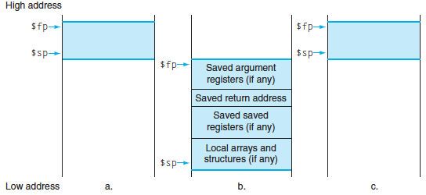
Stack Before, During, After Call

Slide 29
Recursive Function Factorial
int fact (int n)
{
if (n < 1) return (1);
else return (n * fact(n-1));
}

Slide 30
Recursive Function Factorial
Fact: # adjust stack for 2 items
addi $sp,$sp,-8
# save return address
sw $ra, 4($sp) # save argument n
sw $a0, 0($sp) # test for n < 1
slti $t0,$a0,1
# if n >= 1, go to L1
beq $t0,$zero,L1 # Then part (n==1) return 1
addi $v0,$zero,1 # pop 2 items off stack
addi $sp,$sp,8 # return to caller
jr $ra
L1:
# Else part (n >= 1) # arg. gets (n – 1)
addi $a0,$a0,-1 # call fact with (n – 1)
jal fact
# return from jal: restore n
lw $a0, 0($sp) # restore return address
lw $ra, 4($sp) # adjust sp to pop 2 items
addi $sp, $sp,8 # return n * fact (n – 1)
mul $v0,$a0,$v0 # return to the caller
jr $ra
mul is a pseudo instruction
Notes:
Slti: set dst to 1 if src is less than imm (signed immediate)

Slide 31
Optimized Function Convention
To reduce expensive loads and stores from spilling and restoring registers, MIPS divides registers into two categories:
Preserved across function call
Caller can rely on values being unchanged
$ra, $sp, $gp, $fp, “saved registers” $s0- $s7
Not preserved across function call
Caller cannot rely on values being unchanged
Return value registers $v0,$v1, Argument registers $a0-$a3, “temporary registers” $t0-$t9

Slide 32
Where is the Stack in Memory?
MIPS convention
Stack starts in high memory and grows down
Hexadecimal (base 16) : 7fff fffc_{hex}
MIPS programs (text segment) in low end
0040 0000_{hex}
static data segment (constants and other static variables) above text for static variables
MIPS convention global pointer ($gp) points to static
(30 of 32, 2 left! – will see when talk about OS)
Heap above static for data structures that grow and shrink ; grows up to high addresses

Slide 33
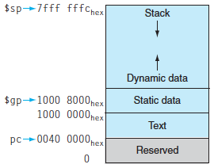
MIPS Memory Allocation

Slide 34
Register Allocation and Numbering

Slide 35
Which statement is FALSE?
☐
MIPS uses jal to invoke a function and jr to return from a function
☐
jal saves PC+1 in %ra
☐
The callee can use temporary registers (%ti) without saving and restoring them
☐
The caller can rely on save registers (%si) without fear of callee changing them
Notes:
VertLeftWhiteCheck1
B: Print It saves PC+4 …because ints in this system are 4-bytes long and the actual address increments by 4 even though it appears to only incrememt 1.

Slide 36
Which statement is FALSE?
☐
MIPS uses jal to invoke a function and jr to return from a function
☐
jal saves PC+1 in %ra
☐
The callee can use temporary registers (%ti) without saving and restoring them
☐
The caller can rely on save registers (%si) without fear of callee changing them
Notes:
VertLeftWhiteCheck1
B: Print It saves PC+4 …because ints in this system are 4-bytes long and the actual address increments by 4 even though it appears to only incrememt 1.

Slide 37
Agenda
Review
Functions
Administrivia
Everything is a Number
And in Conclusion, …

Slide 38
Project #1
Doc 1
Doc 2
Doc n
Randy
Krste
Dave
Randy
Randy
Dave
Dave
Krste
Randy
. . .
Mapper 1
Mapper 2
Mapper n
Occurrences A_{Randy}: 4, A_{Krste}: 2, A_{Dave}: 3
Target word = Dave
C_{Randy}: 4, C_{Krste}: 2
Co-occurrence with Krste: C_{Krste} * (log(C_{Krste}))³ / A_{Krste} = 2 * (log(2))³ / 2 = 0.03
Co-occurrence with Randy: C_{Randy} * (log(C_{Randy}))³ / A_{Randy} = 4 * (log(4))³ / 4 = 0.22
Your task: compute and sort co-occurrence for n-gram (for small n) word sequences, using several distance weighting functions

Slide 39
Project #1
Document:
“It was the best of times, it was the worst of times”
1-grams: it was the best of times worst
it-was: distance 1, it-the: distance 2, it-best: distance 3, …
2-grams: it was, was the, the best, best of, of times, times it, was the, the worst, worst of, of times
it was—was the: distance 1, it was—the best: distance 2, it was—best of: distance 3, …
3-grams: it was the, was the best, the best of, best of times, of times it, times it was, was the worst, the worst of, worst of times
etc.

Slide 40
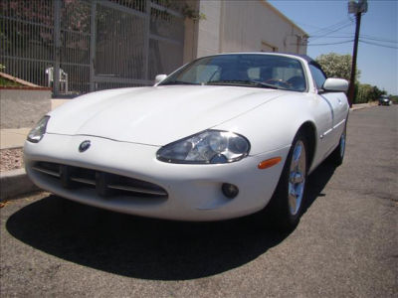
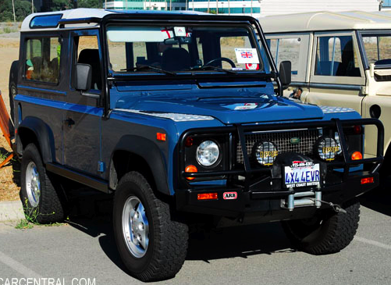
Get To Know Your Professor
1997 Jaguar xk8
1997 Land Rover Defender 90
British Car Enthusiast: Glutton for Punishment!

Slide 41
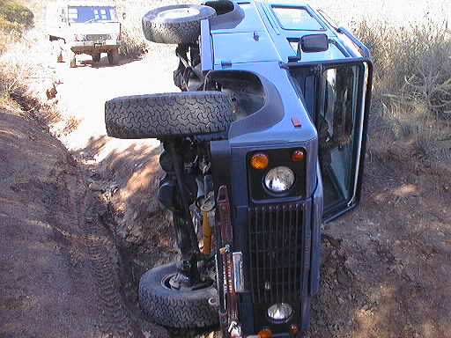
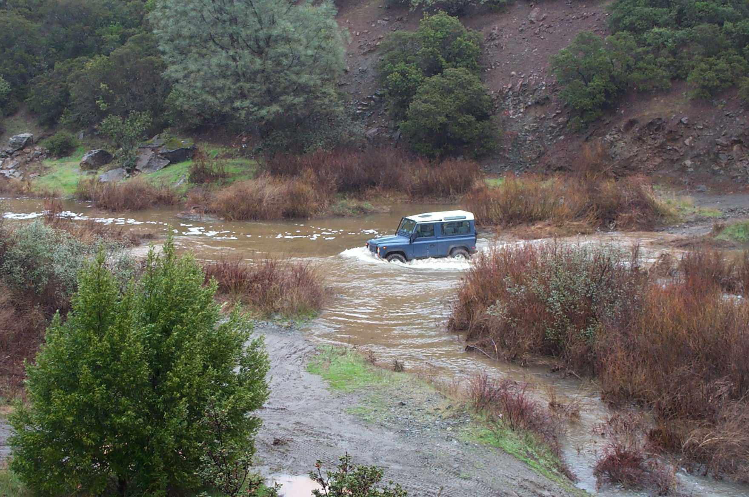
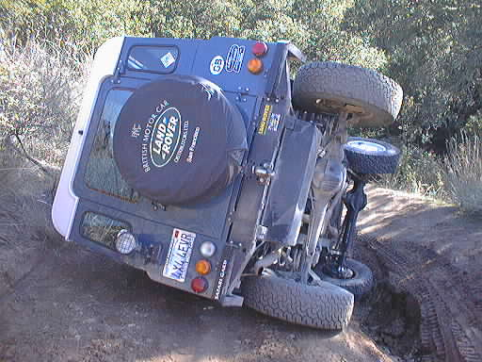
Don’t Go Driving with Randy!

Slide 42
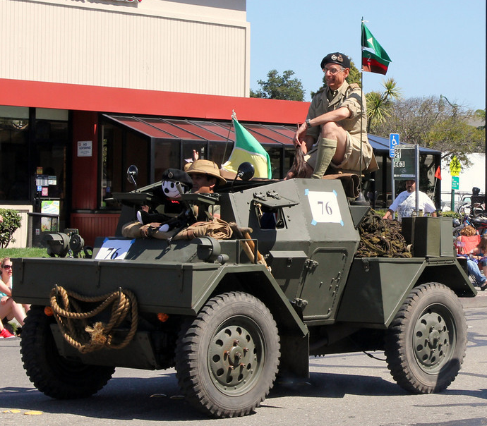
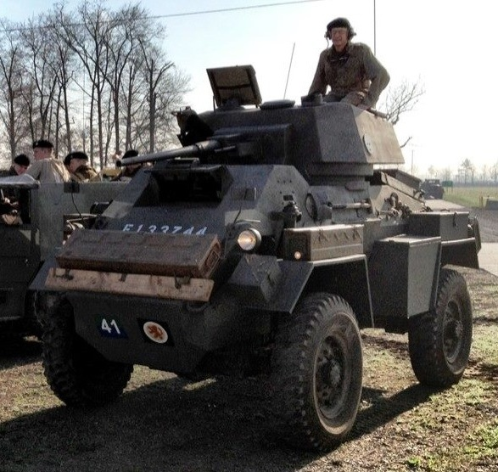
Get To Know Your Professor
1942 Daimler Dingo Mk III SC
1943 Humber Mk VI AC

Slide 43
Agenda
Review
Functions
Administrivia
Everything is a Number
And in Conclusion, …

Slide 44
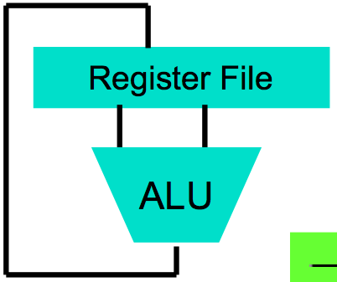
Big Idea #1: Levels of Representation/Interpretation
High Level Language Program (e.g., C)
temp = v[k];
v[k] = v[k+1];
v[k+1] = temp;
We are here!
Compiler
Anything can be represented as a number, i.e., data or instructions
lw $t0, 0($2)
lw $t1, 4($2)
sw $t1, 0($2)
sw $t0, 4($2)
Assembly Language Program (e.g., MIPS)
Assembler
0000 1001 1100 0110 1010 1111 0101 1000
1010 1111 0101 1000 0000 1001 1100 0110
1100 0110 1010 1111 0101 1000 0000 1001
0101 1000 0000 1001 1100 0110 1010 1111
Machine Language Program (MIPS)
Machine Interpretation
Hardware Architecture Description (e.g., block diagrams)
Architecture Implementation
Logic Circuit Description (Circuit Schematic Diagrams)

Slide 45
Key Concepts
Inside computers, everything is a number
But everything is of a fixed size
8-bit bytes, 16-bit half words, 32-bit words, 64-bit double words, …
Integer and floating point operations can lead to results too big to store within their representations: overflow/underflow

Slide 46
Number Representation
Value of i-th digit is d × Base^{i} where i starts at 0 and increases from right to left:
123₁₀ = 1₁₀ x 10₁₀² + 2₁₀ x 10₁₀¹ + 3₁₀ x 10₁₀⁰
= 1x100₁₀ + 2x10₁₀ + 3x1₁₀ = 100₁₀ + 20₁₀ + 3₁₀
= 123₁₀
Binary (Base 2), Hexadecimal (Base 16), Decimal (Base 10) different ways to represent an integer
We use 1_{two}, 5_{ten}, 10_{hex} to be clearer (vs. 1₂, 4₈, 5₁₀, 10₁₆ )

Slide 47
Number Representation
Hexadecimal digits: 0,1,2,3,4,5,6,7,8,9,A,B,C,D,E,F
FFF_{hex} = 15_{ten}x 16_{ten}² + 15_{ten}x 16_{ten}¹ + 15_{ten}x 16_{ten}⁰ = 3840_{ten} + 240_{ten} + 15_{ten} = 4095_{ten}
1111 1111 1111_{two} = FFF_{hex} = 4095_{ten}
May put blanks every group of binary, octal, or hexadecimal digits to make it easier to parse, like commas in decimal

Slide 48
Signed and Unsigned Integers
C, C++, and Java have signed integers, e.g., 7, -255:
int x, y, z;
C, C++ also have unsigned integers, which are used for addresses
32-bit word can represent 2³² binary numbers
Unsigned integers in 32 bit word represent 0 to 2³²-1 (4,294,967,295)

Slide 49
Unsigned Integers
0000 0000 0000 0000 0000 0000 0000 0000_{two} = 0_{ten}
0000 0000 0000 0000 0000 0000 0000 0001_{two} = 1_{ten}
0000 0000 0000 0000 0000 0000 0000 0010_{two} = 2_{ten}
... ...
0111 1111 1111 1111 1111 1111 1111 1101_{two} = 2,147,483,645_{ten}
0111 1111 1111 1111 1111 1111 1111 1110_{two} = 2,147,483,646_{ten}
0111 1111 1111 1111 1111 1111 1111 1111_{two} = 2,147,483,647_{ten}
1000 0000 0000 0000 0000 0000 0000 0000_{two} = 2,147,483,648_{ten}
1000 0000 0000 0000 0000 0000 0000 0001_{two} = 2,147,483,649_{ten}
1000 0000 0000 0000 0000 0000 0000 0010_{two} = 2,147,483,650_{ten}
... ...
1111 1111 1111 1111 1111 1111 1111 1101_{two} = 4,294,967,293_{ten}
1111 1111 1111 1111 1111 1111 1111 1110_{two} = 4,294,967,294_{ten}
1111 1111 1111 1111 1111 1111 1111 1111_{two} = 4,294,967,295_{ten}

Slide 50
Signed Integers and Two’s Complement Representation
Signed integers in C; want ½ numbers <0, want ½ numbers >0, and want one 0
Two’s complement treats 0 as positive, so 32-bit word represents 2³² integers from -2³¹ (–2,147,483,648) to 2³¹-1 (2,147,483,647)
Note: one negative number with no positive version
Book lists some other options, all of which are worse
Every computers uses two’s complement today
Most significant bit (leftmost) is the sign bit, since 0 means positive (including 0), 1 means negative
Bit 31 is most significant, bit 0 is least significant

Slide 51
Two’s Complement Integers
Sign Bit
0000 0000 0000 0000 0000 0000 0000 0000_{two} = 0_{ten}
0000 0000 0000 0000 0000 0000 0000 0001_{two} = 1_{ten}
0000 0000 0000 0000 0000 0000 0000 0010_{two} = 2_{ten}
... ...
0111 1111 1111 1111 1111 1111 1111 1101_{two} = 2,147,483,645_{ten}
0111 1111 1111 1111 1111 1111 1111 1110_{two} = 2,147,483,646_{ten}
0111 1111 1111 1111 1111 1111 1111 1111_{two} = 2,147,483,647_{ten}
1000 0000 0000 0000 0000 0000 0000 0000_{two} = –2,147,483,648_{ten}
1000 0000 0000 0000 0000 0000 0000 0001_{two} = –2,147,483,647_{ten}
1000 0000 0000 0000 0000 0000 0000 0010_{two} = –2,147,483,646_{ten}
... ...
1111 1111 1111 1111 1111 1111 1111 1101_{two} = –3_{ten}
1111 1111 1111 1111 1111 1111 1111 1110_{two} = –2_{ten}
1111 1111 1111 1111 1111 1111 1111 1111_{two} = –1_{ten}

Slide 52
Suppose we had a 5 bit word. What integers can be represented in two’s complement?
☐
-32 to +31
☐
0 to +31
☐
-16 to +15
☐
-15 to +16
Notes:
VertLeftWhiteCheck1
B: Print 4 …because ints in this system are 4-bytes long and the actual address increments by 4 even though it appears to only incrememt 1.

Slide 53
Suppose we had a 5 bit word. What integers can be represented in two’s complement?
☐
-32 to +31
☐
0 to +31
☐
-16 to +15
☐
-15 to +16
Notes:
VertLeftWhiteCheck1
B: Print 4 …because ints in this system are 4-bytes long and the actual address increments by 4 even though it appears to only incrememt 1.

Slide 54
MIPS Logical Instructions
Useful to operate on fields of bits within a word
e.g., characters within a word (8 bits)
Operations to pack /unpack bits into words
Called logical operations
Logical operations | C operators | Java operators | MIPS instructions
Bit-by-bit AND | & | & | and
Bit-by-bit OR | | | | | or
Bit-by-bit NOT | ~ | ~ | nor
Shift left | << | << | sll
Shift right | >> | >>> | srl

Slide 55
Bit-by-bit Definition
Operation | Input | Input | Output
AND | 0 | 0 | 0
AND | 0 | 1 | 0
AND | 1 | 0 | 0
AND | 1 | 1 | 1
OR | 0 | 0 | 0
OR | 0 | 1 | 1
OR | 1 | 0 | 1
OR | 1 | 1 | 1
NOR | 0 | 0 | 1
NOR | 0 | 1 | 0
NOR | 1 | 0 | 0
NOR | 1 | 1 | 0

Slide 56
Examples
If register $t2 contains and
0000 0000 0000 0000 0000 1101 1100 0000_{two}
Register $t1 contains
0000 0000 0000 0000 0011 1100 0000 0000_{two}
What is value of $t0 after:
and $t0,$t1,$t2 # reg $t0 = reg $t1 & reg $t2
Student Roulette?
Notes:
and $t0,$t1,$t2 # reg $t0 = reg $t1 & reg $t2
the value of register $t0 would be
0000 0000 0000 0000 0000 1100 0000 0000_{two}
Called a mask
or $t0,$t1,$t2 # reg $t0 = reg $t1 | reg $t2
is this value in register $t0:
0000 0000 0000 0000 0011 1101 1100 0000_{two}
has the value 0, the result of the MIPS instruction
nor $t0,$t1,$zero # reg $t0 = ~ (reg $t1 | 0)
is this value in register $t0:
1111 1111 1111 1111 1100 0011 1111 1111_{two}

Slide 57
Examples
If register $t2 contains and
0000 0000 0000 0000 0000 1101 1100 0000_{two}
Register $t1 contains
0000 0000 0000 0000 0011 1100 0000 0000_{two}
What is value of $t0 after:
and $t0,$t1,$t2 # reg $t0 = reg $t1 & reg $t2
0000 0000 0000 0000 0000 1100 0000 0000_{two}
Notes:
and $t0,$t1,$t2 # reg $t0 = reg $t1 & reg $t2
the value of register $t0 would be
0000 0000 0000 0000 0000 1100 0000 0000_{two}
Called a mask
or $t0,$t1,$t2 # reg $t0 = reg $t1 | reg $t2
is this value in register $t0:
0000 0000 0000 0000 0011 1101 1100 0000_{two}
has the value 0, the result of the MIPS instruction
nor $t0,$t1,$zero # reg $t0 = ~ (reg $t1 | 0)
is this value in register $t0:
1111 1111 1111 1111 1100 0011 1111 1111_{two}

Slide 58
Examples
If register $t2 contains and
0000 0000 0000 0000 0000 1101 1100 0000_{two}
Register $t1 contains
0000 0000 0000 0000 0011 1100 0000 0000_{two}
What is value of $t0 after:
or $t0,$t1,$t2 # reg $t0 = reg $t1 | reg $t2
Student Roulette?
Notes:
or $t0,$t1,$t2 # reg $t0 = reg $t1 | reg $t2
is this value in register $t0:
0000 0000 0000 0000 0011 1101 1100 0000_{two}
has the value 0, the result of the MIPS instruction
nor $t0,$t1,$zero # reg $t0 = ~ (reg $t1 | 0)
is this value in register $t0:
1111 1111 1111 1111 1100 0011 1111 1111_{two}

Slide 59
Examples
If register $t2 contains and
0000 0000 0000 0000 0000 1101 1100 0000_{two}
Register $t1 contains
0000 0000 0000 0000 0011 1100 0000 0000_{two}
What is value of $t0 after:
or $t0,$t1,$t2 # reg $t0 = reg $t1 | reg $t2
0000 0000 0000 0000 0011 1101 1100 0000_{two}
Notes:
or $t0,$t1,$t2 # reg $t0 = reg $t1 | reg $t2
is this value in register $t0:
0000 0000 0000 0000 0011 1101 1100 0000_{two}
has the value 0, the result of the MIPS instruction
nor $t0,$t1,$zero # reg $t0 = ~ (reg $t1 | 0)
is this value in register $t0:
1111 1111 1111 1111 1100 0011 1111 1111_{two}

Slide 60
Examples
If register $t2 contains and
0000 0000 0000 0000 0000 1101 1100 0000_{two}
Register $t1 contains
0000 0000 0000 0000 0011 1100 0000 0000_{two}
What is value of $t0 after:
nor $t0,$t1,$zero # reg $t0 = ~ (reg $t1 | 0)
Student Roulette?
Notes:
and $t0,$t1,$t2 # reg $t0 = reg $t1 & reg $t2
the value of register $t0 would be
0000 0000 0000 0000 0000 1100 0000 0000_{two}
Called a mask
or $t0,$t1,$t2 # reg $t0 = reg $t1 | reg $t2
is this value in register $t0:
0000 0000 0000 0000 0011 1101 1100 0000_{two}
has the value 0, the result of the MIPS instruction
nor $t0,$t1,$zero # reg $t0 = ~ (reg $t1 | 0)
is this value in register $t0:
1111 1111 1111 1111 1100 0011 1111 1111_{two}

Slide 61
Examples
If register $t2 contains and
0000 0000 0000 0000 0000 1101 1100 0000_{two}
Register $t1 contains
0000 0000 0000 0000 0011 1100 0000 0000_{two}
What is value of $t0 after:
nor $t0,$t1,$zero # reg $t0 = ~ (reg $t1 | 0)
1111 1111 1111 1111 1100 0011 1111 1111_{two}
Notes:
has the value 0, the result of the MIPS instruction
nor $t0,$t1,$zero # reg $t0 = ~ (reg $t1 | 0)
is this value in register $t0:
1111 1111 1111 1111 1100 0011 1111 1111_{two}

Slide 62
Shifting
Shift left logical moves n bits to the left (insert 0s into empty bits)
Same as multiplying by 2^{n} for two’s complement number
For example, if register $s0 contained
0000 0000 0000 0000 0000 0000 0000 1001_{two}= 9_{ten}
If executed sll $s0, $s0, 4, result is:
0000 0000 0000 0000 0000 0000 1001 0000_{two}= 144_{ten}
And 9_{ten} × 2_{ten}⁴ = 9_{ten} × 16_{ten} = 144_{ten}
Shift right logical moves n bits to the right (insert 0s into empty bits)
NOT same as dividing by 2n (negative numbers fail)
Notes:
-2
0010 → 1101 + 1 → 1110

Slide 63
Shifting
Shift right arithmetic moves n bits to the right (insert high order sign bit into empty bits)
For example, if register $s0 contained
0000 0000 0000 0000 0000 0000 0001 1001_{two}= 25_{ten}
If executed sra $s0, $s0, 4, result is:
Student Roulette?
Notes:
-2
0010 → 1101 + 1 → 1110

Slide 64
Shifting
Shift right arithmetic moves n bits to the right (insert high order sign bit into empty bits)
For example, if register $s0 contained
0000 0000 0000 0000 0000 0000 0001 1001_{two}= 25_{ten}
If executed sra $s0, $s0, 4, result is:
0000 0000 0000 0000 0000 0000 0000 0001_{two}= 1_{ten}
Notes:
-2
0010 → 1101 + 1 → 1110

Slide 65
Shifting
Shift right arithmetic moves n bits to the right (insert high order sign bit into empty bits)
For example, if register $s0 contained
1111 1111 1111 1111 1111 1111 1110 0111_{two}= -25_{ten}
If executed sra $s0, $s0, 4, result is:
Student Roulette?
Notes:
\

Slide 66
Shifting
Shift right arithmetic moves n bits to the right (insert high order sign bit into empty bits)
For example, if register $s0 contained
1111 1111 1111 1111 1111 1111 1110 0111_{two}= -25_{ten}
If executed sra $s0, $s0, 4, result is:
1111 1111 1111 1111 1111 1111 1111 1110_{two}= -2_{ten}
Unfortunately, this is NOT same as dividing by 2n
Fails for odd negative numbers
C arithmetic semantics is that division should round towards 0
Notes:
\

Slide 67
Impact of Signed and Unsigned Integers on Instruction Sets
What (if any) instructions affected?
Load word, store word?
branch equal, branch not equal?
and, or, sll, srl?
add, sub, mult, div?
slti (set less than immediate)?
Student Roulette?

Slide 68
C provides two sets of operators for AND (& and &&) and two sets of operators for OR (| and ||) while MIPS doesn’t. Why?
☐
Logical operations AND and OR do & and | while conditional branches do && and ||
☐
The previous statement has it backwards: && and || logical ops, & and | are branches
☐
They are redundant and mean the same thing: && and || are simply inherited from the programming language B, the predecessor of C
Notes:
VertLeftWhiteCheck1
B: Print 4 …because ints in this system are 4-bytes long and the actual address increments by 4 even though it appears to only incrememt 1.

Slide 69
Peer Instruction Answer
C provides two sets of operators for AND (& and &&) and two sets of operators for OR (| and ||) while MIPS doesn’t. Why?
Red:
Logical operations AND and OR implement & and | while conditional branches implement && and ||
Reason:
e.g., && is logical and: true && true is true and everything else is false
& is bitwise and: e.g., (1010_{two} & 1000_{two}) = 1000_{two}

Slide 70
“And in Conclusion, …”
C is function oriented; code reuse via functions
Jump and link (jal) invokes, jump register (jr $ra) returns
Registers $a0-$a3 for arguments, $v0-$v1 for return values
Stack for spilling registers, nested function calls, C local (automatic) variables
Program can interpret binary number as unsigned integer, two’s complement signed integer, floating point number, ASCII characters, Unicode characters, …
Integers have largest positive and largest negative numbers, but represent all in between
Two’s comp. weirdness is one extra negative number
Integer (and floating point operations) can lead to results too big to store within their representations: overflow/underflow

Slide 71
Goals for Floating Point
Standard arithmetic for reals for all computers
Like two’s complement
Keep as much precision as possible in formats
Help programmer with errors in real arithmetic
+∞, -∞, Not-A-Number (NaN), exponent overflow, exponent underflow
Keep encoding that is somewhat compatible with two’s complement
E.g., 0 in Fl. Pt. is 0 in two’s complement
Make it possible to sort without needing to do floating point comparison

Slide 72
Scientific Notation (e.g., Base 10)
Normalized scientific notation (aka standard form or exponential notation):
r x E^{i}, E is exponent (usually 10), i is a positive or negative integer, r is a real number ≥ 1.0, < 10
Normalized => No leading 0s
61 is 6.10 x 10², 0.000061 is 6.10 x10⁻⁵
r x E^{i}, E where is exponent, i is a positive or negative integer, r is a real number ≥ 1.0, < 10

Slide 73
Scientific Notation (e.g., Base 10)
(r x e^{i}) x (s x e^{j}) = (r x s) x e^{i+j}
(1.999 x 10²) x (5.5 x 10³) = (1.999 x 5.5) x 10⁵
= 10.9945 x 10⁵
= 1.09945 x 10⁶
(r x e^{i}) / (s x e^{j}) = (r / s) x e^{i-j}
(1.999 x 10²) / (5.5 x 10³) = 0.3634545… x 10⁻¹
= 3.634545… x 10⁻²
For addition/subtraction, you first must align:
(1.999 x 10²) + (5.5 x 10³) = (.1999 x 10³) + (5.5 x 10³) = 5.6999 x 10³

Slide 74
Which is Less? (i.e., closer to -∞)
0 vs. 1 x 10⁻¹²⁷?
1 x 10⁻¹²⁶ vs. 1 x 10⁻¹²⁷?
-1 x 10⁻¹²⁷ vs. 0?
-1 x 10⁻¹²⁶ vs. -1 x 10⁻¹²⁷?
Student Roulette?

Slide 75
Which is Less? (i.e., closer to -∞)
0 vs. 1 x 10⁻¹²⁷?
1 x 10⁻¹²⁶ vs. 1 x 10⁻¹²⁷?
-1 x 10⁻¹²⁷ vs. 0?
-1 x 10⁻¹²⁶ vs. -1 x 10⁻¹²⁷?

Slide 76
Floating Point: Representing Very Small Numbers
Zero: Bit pattern of all 0s is encoding for 0.000
But 0 in exponent should mean most negative exponent (want 0 to be next to smallest real)
Can’t use two’s complement (1000 0000_{two})
Bias notation: subtract bias from exponent
Single precision uses bias of 127; DP uses 1023
0 uses 0000 0000_{two} => 0-127 = -127; ∞, NaN uses 1111 1111_{two} => 255-127 = +128
Smallest SP real can represent: 1.00…00 x 2⁻¹²⁶
Largest SP real can represent: 1.11…11 x 2⁺¹²⁷

Slide 77
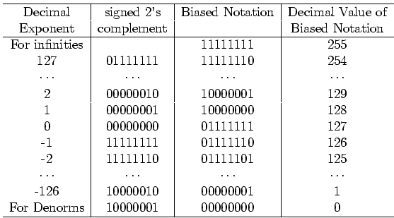
Bias Notation (+127)
How it is interpreted
How it is encoded
∞, NaN
Getting closer to zero
Zero

Slide 78
What If Operation Result Doesn’t Fit in 32 Bits?
Overflow: calculate too big a number to represent within a word
Unsigned numbers: 1 + 4,294,967,295 (2³²-1)
Signed numbers: 1 + 2,147,483,647 (2³¹-1)

Slide 79
Depends on the Programming Language
C unsigned number arithmetic ignores overflow (arithmetic modulo 2³²)
1 + 4,294,967,295 =
Student Roulette?
Notes:
=0

Slide 80
Depends on the Programming Language
C signed number arithmetic also ignores overflow
1 + 2,147,483,647 (2³¹-1) =
Student Roulette?
Notes:
-2, 147, …

Slide 81
Depends on the Programming Language
Other languages want overflow signal on signed numbers (e.g., Fortran)
What’s a computer architect to do?

Slide 82
MIPS Solution: Offer Both
Instructions that can trigger overflow:
add, sub, mult, div, addi, multi, divi
Instructions that don’t overflow are called “unsigned” (really means “no overflow”):
addu, subu, multu, divu, addiu, multiu, diviu
Given semantics of C, always use unsigned versions
Note: slt and slti do signed comparisons, while sltu and sltiu do unsigned comparisons
Nothing to do with overflow
When would get different answer for slt vs. sltu?
Student Roulette?

Slide 83
What About Real Numbers in Base 2?
r x E^{i}, E where is exponent (2), i is a positive or negative integer, r is a real number ≥ 1.0, < 2
Computers version of normalized scientific notation called Floating Point notation

Slide 84
Floating Point Numbers
32-bit word has 2³² patterns, so must be approximation of real numbers ≥ 1.0, < 2
IEEE 754 Floating Point Standard:
1 bit for sign (s) of floating point number
8 bits for exponent (E)
23 bits for fraction (F) (get 1 extra bit of precision if leading 1 is implicit)
(-1)^{s} x (1 + F) x 2E
Can represent from 2.0 x 10⁻³⁸ to 2.0 x 10³⁸

Slide 85
Floating Point Numbers
What about bigger or smaller numbers?
IEEE 754 Floating Point Standard: Double Precision (64 bits)
1 bit for sign (s) of floating point number
11 bits for exponent (E)
52 bits for fraction (F) (get 1 extra bit of precision if leading 1 is implicit)
(-1)^{s} x (1 + F) x 2E
Can represent from 2.0 x 10⁻³⁰⁸ to 2.0 x 10³⁰⁸
32 bit format called Single Precision

Slide 86
More Floating Point
What about 0?
Bit pattern all 0s means 0, so no implicit leading 1
What if divide 1 by 0?
Can get infinity symbols +∞, -∞
Sign bit 0 or 1, largest exponent, 0 in fraction
What if do something stupid? (∞ – ∞, 0 ÷ 0)
Can get special symbols NaN for Not-a-Number
Sign bit 0 or 1, largest exponent, not zero in fraction
What if result is too big? (2x10³⁰⁸ x 2x10²)
Get overflow in exponent, alert programmer!
What if result is too small? (2x10⁻³⁰⁸ ÷ 2x10²)
Get underflow in exponent, alert programmer!

Slide 87
Floating Point Add Associativity?
A = (1000000.0 + 0.000001) - 1000000.0
B = (1000000.0 - 1000000.0) + 0.000001
In single precision floating point arithmetic, A does not equal B
A = 0.000000, B = 0.000001
Floating Point Addition is not Associative!
Integer addition is associative
When does this matter?

Slide 88
MIPS Floating Point Instructions
C, Java has single precision (float) and double precision (double) types
MIPS instructions: .s for single, .d for double
Fl. Pt. Addition single precision: Fl. Pt. Addition double precision:
Fl. Pt. Subtraction single precision: Fl. Pt. Subtraction double precision:
Fl. Pt. Multiplication single precision: Fl. Pt. Multiplication double precision:
Fl. Pt. Divide single precision: Fl. Pt. Divide double precision:
Student Roulette?

Slide 89
MIPS Floating Point Instructions
C, Java has single precision (float) and double precision (double) types
MIPS instructions: .s for single, .d for double
Fl. Pt. Addition single precision: add.s Fl. Pt. Addition double precision: add.d
Fl. Pt. Subtraction single precision: sub.s Fl. Pt. Subtraction double precision: sub.d
Fl. Pt. Multiplication single precision: mul.s Fl. Pt. Multiplication double precision: mul.d
Fl. Pt. Divide single precision: div.s Fl. Pt. Divide double precision: div.d

Slide 90
MIPS Floating Point Instructions
C, Java have single precision (float) and double precision (double) types
MIPS instructions: .s for single, .d for double
Fl. Pt. Comparison single precision: Fl. Pt. Comparison double precision:
Fl. Pt. branch:
Since rarely mix integers and Floating Point, MIPS has separate registers for floating-point operations: $f0, $f1, …, $f31
Double precision uses adjacent even-odd pairs of registers:
$f0 and $f1, $f2 and $f3, $f4 and $f5, …, $f30 and $f31
Need data transfer instructions for these new registers
lwc1 (load word), swc1 (store word)
Double precision uses two lwc1 instructions, two swc1 instructions
Notes:
Floating-point comparison, single (c.x.s) and comparison, double (c.x.d),
where x may be equal (eq), not equal (neq), less than (lt), less than or equal (le), greater than (gt), or greater than or equal (ge)
Floating-point branch, true (bc1t) and branch, false (bc1f)

Slide 91
Peer Instruction Question
Suppose Big, Tiny, and BigNegative are floats in C, with Big initialized to a big number (e.g., age of universe in seconds or 4.32 x 10¹⁷), Tiny to a small number (e.g., seconds/femtosecond or 1.0 x 10⁻¹⁵), BigNegative = - Big. Here are two conditionals:
(Big * Tiny) * BigNegative == (Big * BigNegative) * Tiny
(Big + Tiny) + BigNegative == (Big + BigNegative) + Tiny
Which statement about these is correct?
Orange. I. is false and II. is false
Green. I. is false and II. is true
Pink. I. is true and II. is false
Yellow. I. is true and II. is true

Slide 92
Peer Instruction Answer
Suppose Big, Tiny, and BigNegative are floats in C, with Big initialized to a big number (e.g., age of universe in seconds or 4.32 x 10¹⁷), Tiny to a small number (e.g., seconds/femtosecond or 1.0 x 10⁻¹⁵), BigNegative = - Big. Here are two conditionals:
(Big * Tiny) * BigNegative == (Big * BigNegative) * Tiny
(Big + Tiny) + BigNegative == (Big + BigNegative) + Tiny
Which statement about these is correct?
Yellow. I. is true and II. is false (if we don’t consider overflow)—but there are cases where one side overflows while the other does not!
I. Works ok if no overflow, but because exponents add, if Big * BigNeg overflows, then result is overflow, not -1
II. Left hand side is 0, right hand side is tiny

Slide 93
Pitfalls
Floating point addition is NOT associative
Some optimizations can change order of floating point computations, which can change results
Need to ensure that floating point algorithm is correct even with optimizations

Slide 94
“And in Conclusion, …”
Program can interpret binary number as unsigned integer, two’s complement signed integer, floating point number, ASCII characters, Unicode characters, …
Integers have largest positive and largest negative numbers, but represent all in between
Two’s comp. weirdness is one extra negative numInteger and floating point operations can lead to results too big to store within their representations: overflow/underflow
Floating point is an approximation of reals

