Slide 1
CS 61C: Great Ideas in Computer Architecture Computer Components
Instructors:
Krste Asanovic, Randy H. Katz
http://inst.eecs.Berkeley.edu/~cs61c/fa12

Slide 2
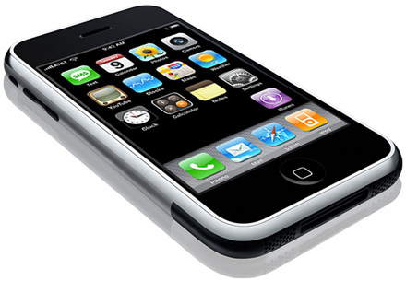
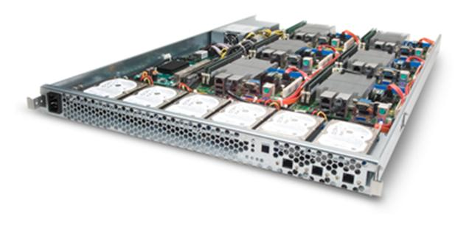
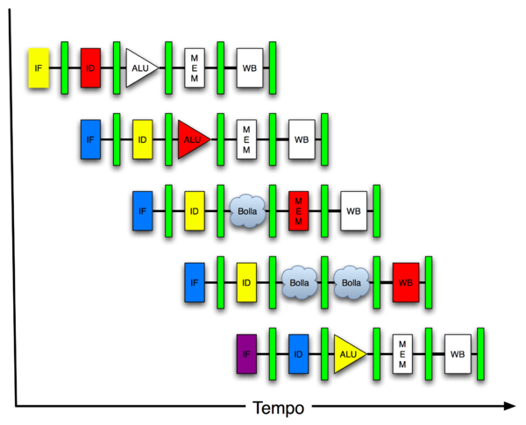
New-School Machine Structures (It’s a bit more complicated!)
Software Hardware
Parallel Requests
Assigned to computer
e.g., Search “Katz”
Parallel Threads
Assigned to core
e.g., Lookup, Ads
Parallel Instructions
>1 instruction @ one time
e.g., 5 pipelined instructions
Parallel Data
>1 data item @ one time
e.g., Add of 4 pairs of words
Hardware descriptions
All gates @ one time
Programming Languages
Warehouse Scale Computer
Smart Phone
Harness Parallelism &
Achieve High Performance
Today’s Lecture
Computer
Core
…
Core
Memory (Cache)
Input/Output
Core
Instruction Unit(s)
Functional
Unit(s)
A₀+B₀
A₁+B₁
A₂+B₂
A₃+B₃
Cache Memory
Logic Gates

Slide 3
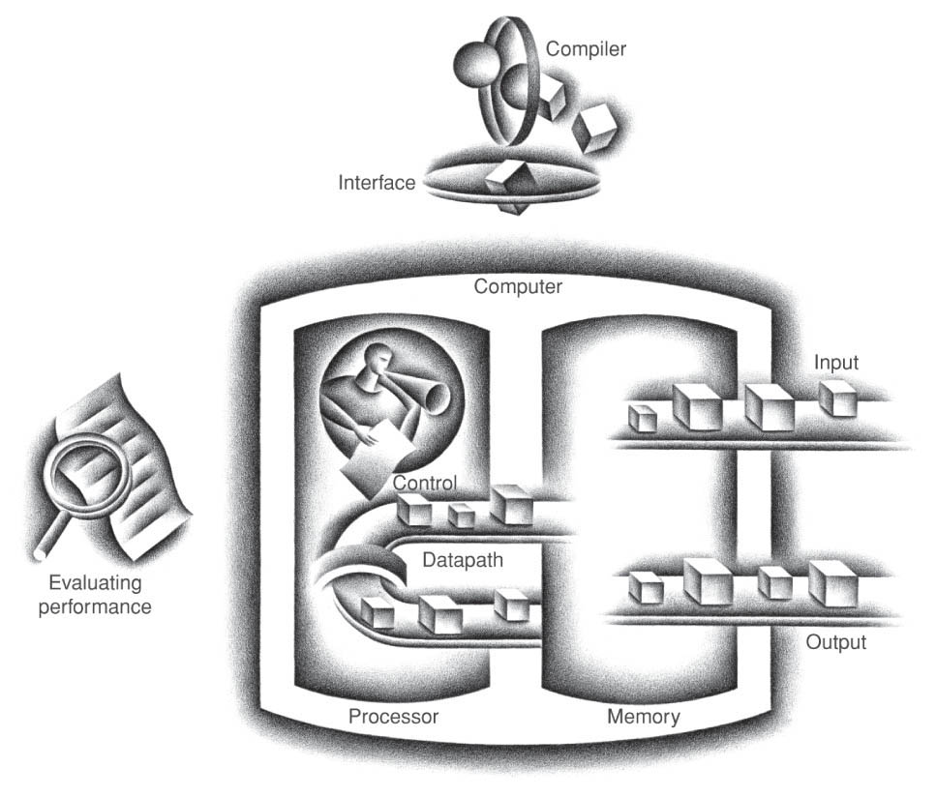
Five Components of a Computer
Control
Datapath
Memory
Input
Output
Notes:
That is, any computer, no matter how primitive or advance, can be divided into five parts:
1. The input devices bring the data from the outside world into the computer.
2. These data are kept in the computer’s memory until ...
3. The datapath request and process them.
4. The operation of the datapath is controlled by the computer’s controller.
All the work done by the computer will NOT do us any good unless we can get the data back to the outside world.
5. Getting the data back to the outside world is the job of the output devices.
The most COMMON way to connect these 5 components together is to use a network of busses.

Slide 4
Components of a Computer
Memory
Processor
Input
Enable?
Read/Write
Control
Datapath
Address
Bytes
PC
Registers
Write Data
Arithmetic & Logic Unit
(ALU)
ReadData
Output
Processor-Memory Interface
I/O-Memory Interfaces

Slide 5
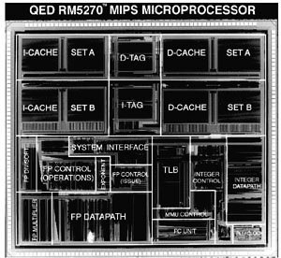
Reality Check: Typical MIPS Chip Die Photograph
Performance-
Enhancing
On-Chip
Memory
(16KB I-Cache +
16KB D-Cache)
Protection- oriented
Virtual
Memory
Support
Floating-Point
Control and
Datapath
Integer
Control and
64-bit Datapath

Slide 6
Types of Memory
Volatile (needs power to hold state)
Static RAM (SRAM), built from bistables that use local positive feedback to hold value
Dynamic RAM (DRAM), holds values on capacitors that must be periodically refreshed
Non-Volatile (holds state without power)
Read-Only Memory (ROM) – holds fixed contents
Magnetic memory – Core, plus newer MRAM
Flash memory – can be written only 10,000’s times

Slide 7
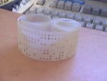
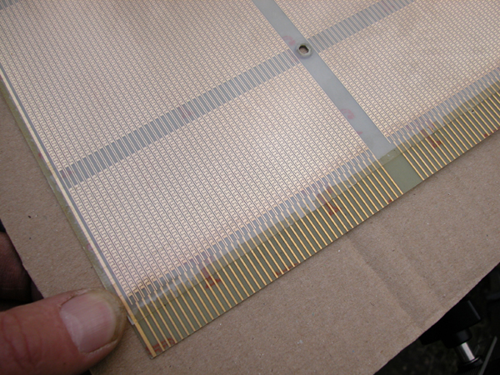
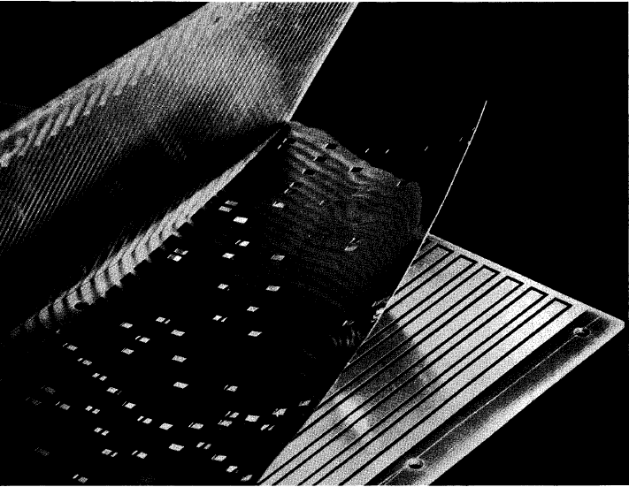
Early Read-Only Memory Technologies
Punched cards, From early 1700s through Jaquard Loom, Babbage, and then IBM
Punched paper tape, instruction stream in Harvard Mk 1
Diode Matrix, EDSAC-2 µcode store
IBM Balanced Capacitor ROS
IBM Card Capacitor ROS

Slide 8
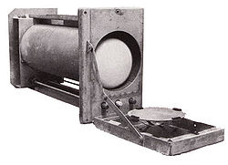
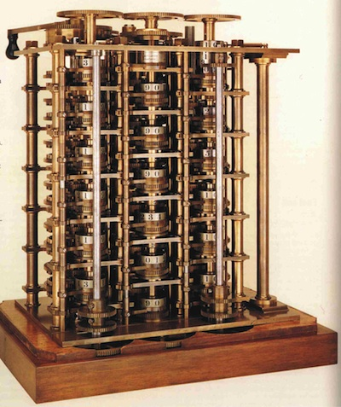
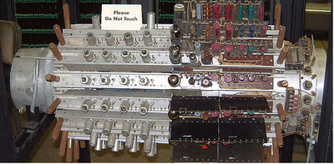
Early Read/Write Memory Technologies
Babbage, 1800s: Digits stored on mechanical wheels
Williams Tube, Manchester Mark 1, 1947
Mercury Delay Line, Univac 1, 1951

Slide 9
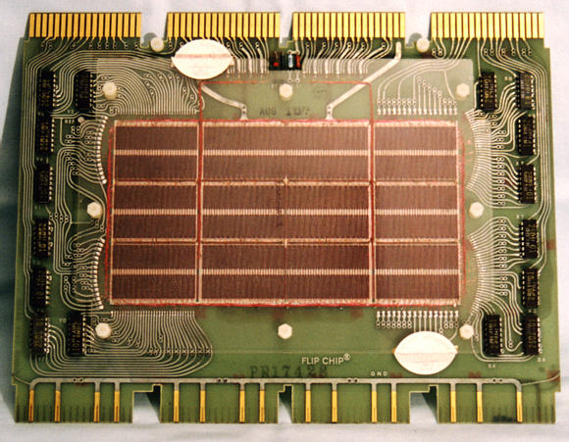
Core Memory
Core memory was first large scale reliable main memory
invented by Forrester in late 40s/early 50s at MIT for Whirlwind project
Bits stored as magnetization polarity on small ferrite cores threaded onto two-dimensional grid of wires
Coincident current pulses on X and Y wires would write cell and also sense original state (destructive reads)
Robust, non-volatile storage
Used on space shuttle computers until recently
Cores threaded onto wires by hand (25 billion a year at peak production)
Core access time ~ 1μs
DEC PDP-8/E Board,
4K words x 12 bits, (1968)
Notes:
Early machines had things like mercury delay lines (jse)
Photo from David Gesswein djg@pdp8.net

Slide 10
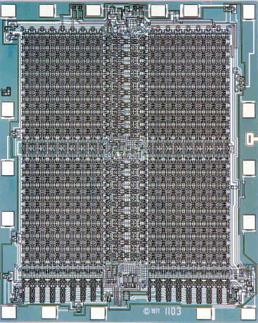
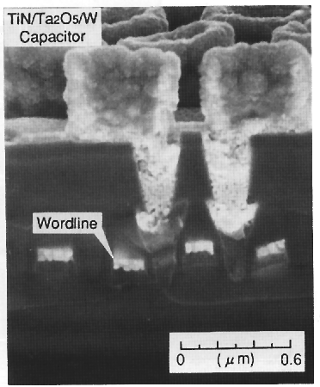
One-Transistor Dynamic RAM [Dennard, IBM]
Intel formed to exploit market for semiconductor memory
First commercial DRAM was Intel 1103, held 1Kb in 1970
1-T DRAM Cell
word
access transistor
V_{REF}
TiN top electrode (V_{REF})
Ta₂O₅ dielectric
bit
Storage
capacitor (FET gate, trench, stack)
poly
word
line
W bottom
electrode
access transistor

Slide 11
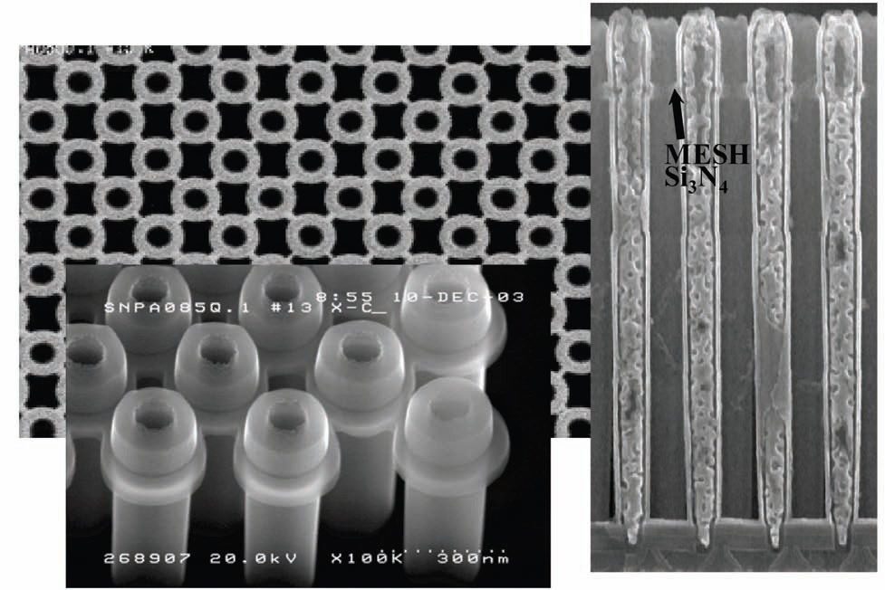
Modern DRAM Structure
[Samsung, sub-70nm DRAM, 2004]

Slide 12
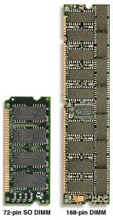
DRAM Packaging (Laptops/Desktops/Servers)
~7
Clock and control signals
DRAM chip
Address lines multiplexed row/column address
~12
Data bus
(4b,8b,16b,32b)
DIMM (Dual Inline Memory Module) contains multiple chips with clock/control/address signals connected in parallel (sometimes need buffers to drive signals to all chips)
Data pins work together to return wide word (e.g., 64-bit data bus using 16x4-bit parts)

Slide 13
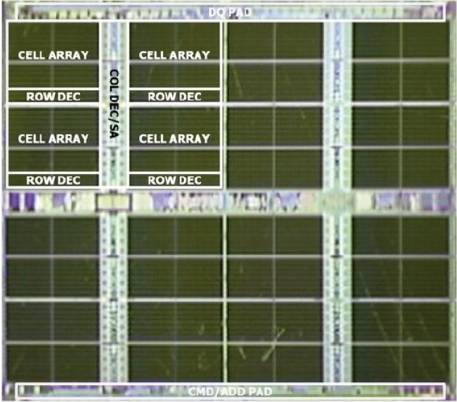
Reality Check: Samsung LPDDR2 4Gb DRAM Chip (May 2012)

Slide 14
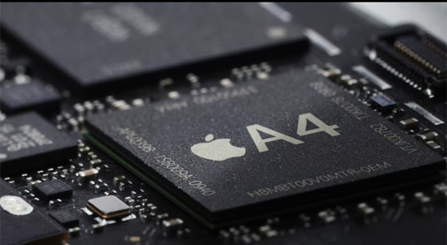
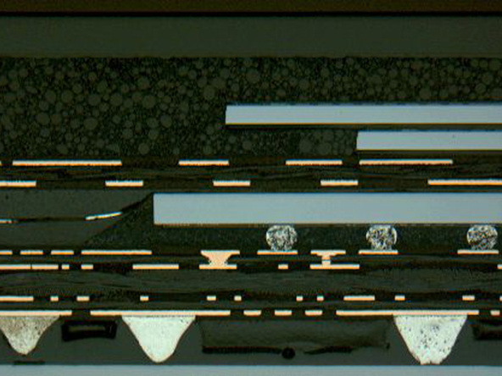
DRAM Packaging, Mobile Devices
[ Apple A4 package on circuit board]
Two stacked DRAM die
Processor plus logic die
[ Apple A4 package cross-section, iFixit 2010 ]

Slide 15
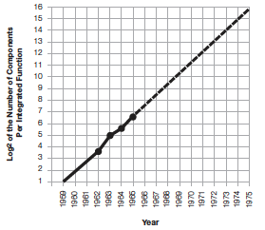
Moore’s Law
“The complexity for minimum component costs has increased at a rate of roughly a factor of two per year. …That means by 1975, the number of components per integrated circuit for minimum cost will be 65,000.” (from 50 in 1965)
Gordon Moore, “Cramming more components onto integrated circuits,” Electronics, Volume 38, Number 8, April 19, 1965
“Integrated circuits will lead to such wonders as home computers--or at least terminals connected to a central computer--automatic controls for automobiles, and personal portable communications equipment. The electronic wristwatch needs only a display to be feasible today.”

Slide 16
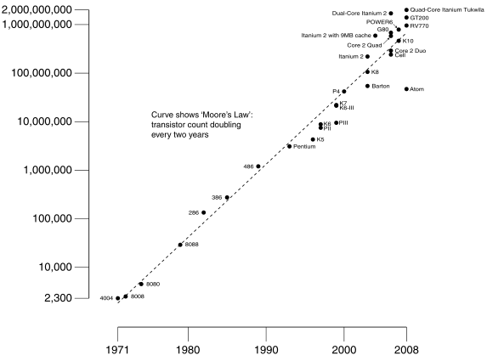
Moore’s Law
Predicts: 2X Transistors / chip every 2 years
# of transistors on an integrated circuit (IC)
Gordon Moore Intel Cofounder B.S. Cal 1950!
Year

Slide 17
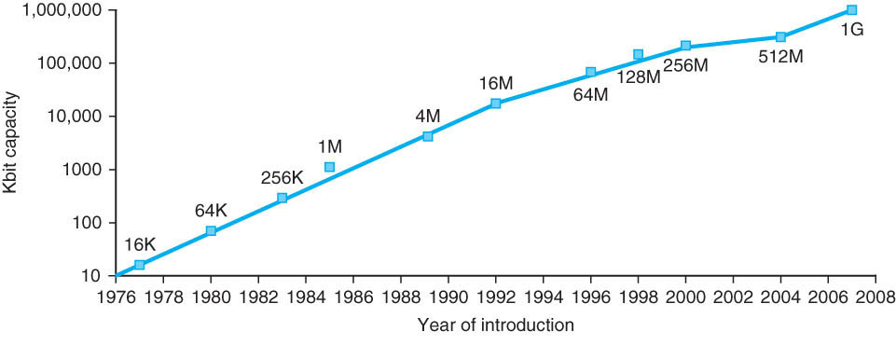
Memory Chip Size
4x in 3 years
2x in 3 years
Growth in memory capacity slowing

Slide 18
End of Moore’s Law?
It’s also a law of investment in equipment as well as increasing volume of integrated circuits that need more transistors per chip
Exponential growth cannot last forever
More transistors/chip will end during your careers
2020? 2025?
(When) will something replace it?

Slide 19
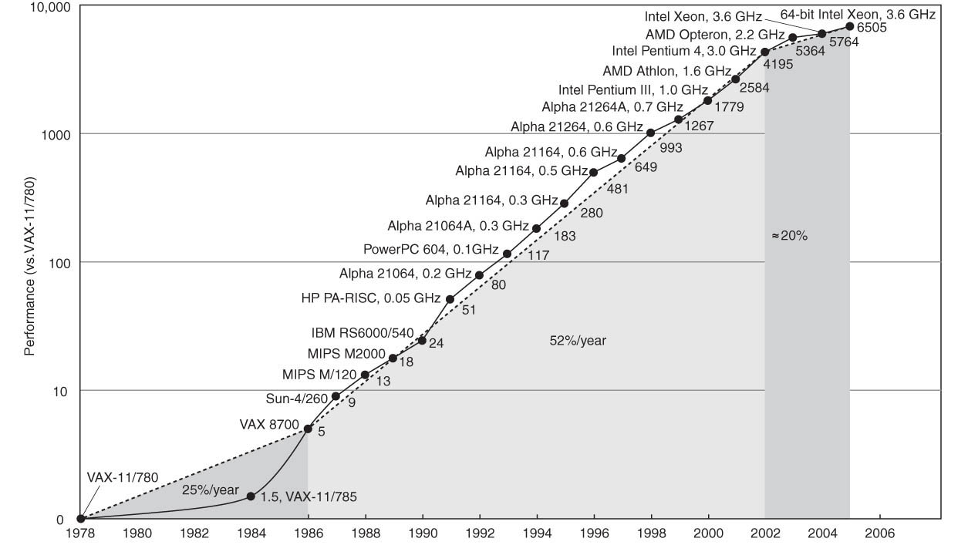
Technology Trends: Uniprocessor Performance (SPECint)
Improvements in processor performance have slowed
Why?

Slide 20
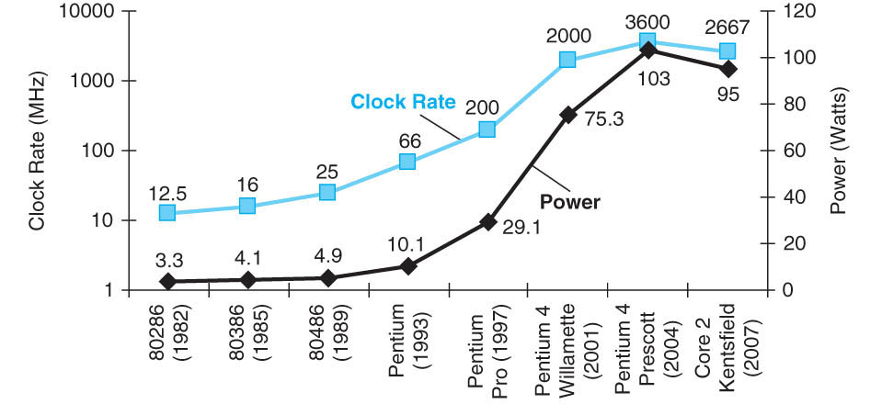
Limits to Performance: Faster Means More Power
P = CV²f

Slide 21
61C in the News
Intel Developer Forum, September 2012
Technology Update from Mark Bohr, Intel Senior Fellow:
”Confident to hit 5nm by end of decade”

Slide 22
Administrivia
Labs 4, Project 1b posted
Midterm is now on the horizon (Tues Oct 9):
No discussion sections during exam week
Small number of special consideration cases, due to class conflicts, etc.—contact Randy and me

Slide 23
Projects
Project 2 coming: MIPS ISA simulator in C
Add ~ 200 (repetitive) lines of C code to framework
Lots of Cut & Paste
Appendix B describes all MIPS instructions in detail
Make your own unit tests!

Slide 24
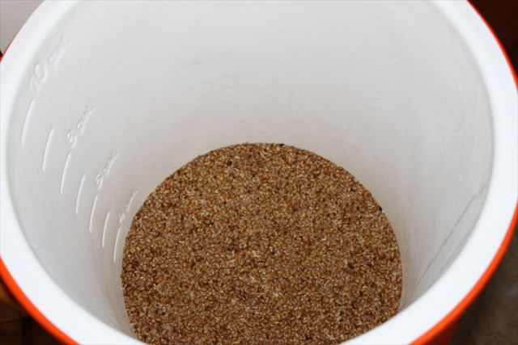
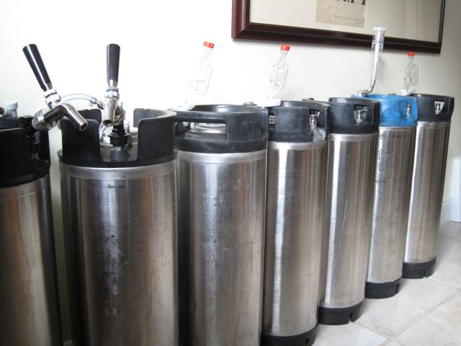
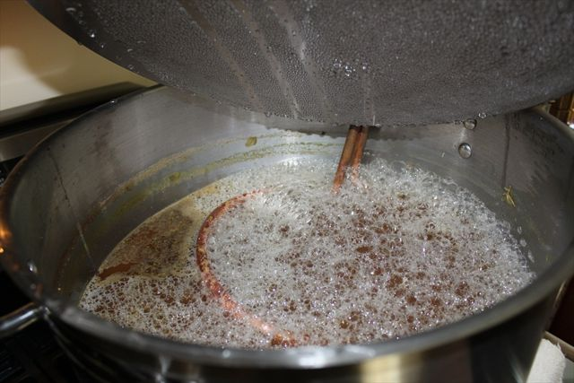
Getting to Know Your Prof
Missing the ales I grew up with in England, I learnt how to make beer.
Start from grains, about 5-10 gallons/batch
Brewed over 50 batches so far
Grains are mashed ~45-60 minutes to convert starch to sugar
Need thirsty friends to help consume experiments!
Boil extracted “wort” for 90 minutes, add hops, then cool to add yeast
ESB II ~6% ABV
ESB I ~6% ABV
Ordinary Bitter 4.1%ABV
Belgian Pale II ~5% ABV
Belgian Pale I ~5% ABV
Mixed Cider 7.2%ABV
In cellar:
Ferments for 5-7 days
Condition for 1 week to 2 years
Gravenstein Cider 7.1%ABV
British Barleywine 8% ABV
Belgian Trappist 12% ABV

Slide 25
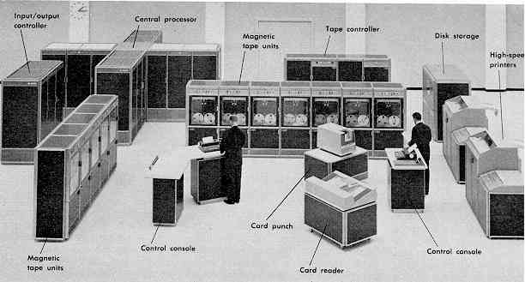
Computer Eras: Mainframe 1950s-60s
Processor (CPU)
Memory
I/O
“Big Iron”: IBM, UNIVAC, … build $1M computers for businesses => COBOL, Fortran, timesharing OS

Slide 26
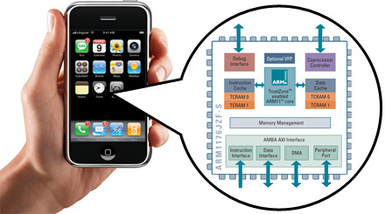
The ARM Inside the iPhone

Slide 27
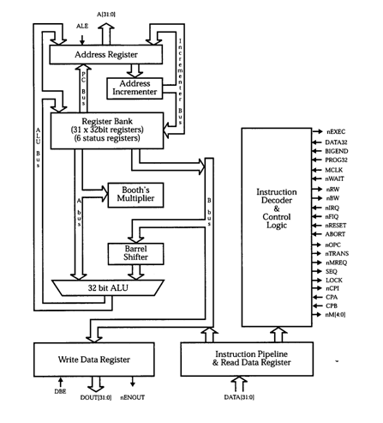
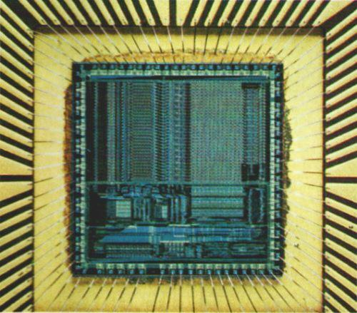
ARM Architecture
http://en.wikipedia.org/wiki/ARM_architecture

Slide 28
Flash Card Quiz
How many ARM processors in an iPhone?
One
Two
More than two, less than eight
At least eight

Slide 29
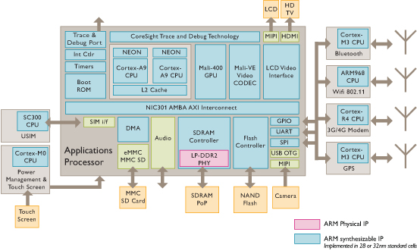
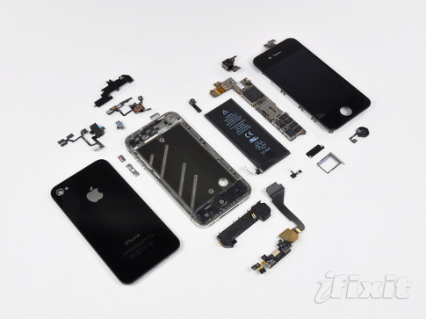
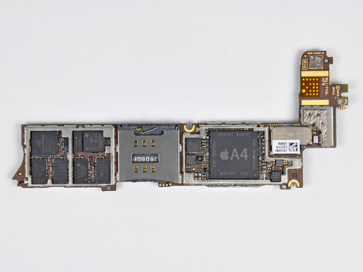
iPhone Innards
Many different ARM implementations inside a single system!
I/O
Processor
1 GHz ARM Cortex A8
I/O
I/O
Memory
You will learn about multiple processors, data level parallelism, caches in 61C

Slide 30
Flash Card Quiz
Which of following statements is true?
Need a different compiled version of C “strlen” for each ARM core in an iPhone
All processors in an iPhone execute the ARM ISA
Different ARM cores are optimized for the I/O device they control
Every ARM core can access all the memory in an iPhone

Slide 31
The Processor
Processor (CPU): the active part of the computer, which does all the work (data manipulation and decision-making)
Datapath: portion of the processor which contains hardware necessary to perform operations required by the processor (“the brawn”)
Control: portion of the processor (also in hardware) which tells the datapath what needs to be done (“the brain”)

Slide 32
Components of a Computer
Memory
Processor
Enable?
Read/Write
Control
Datapath
Address
Bytes
PC
Registers
Write Data
Arithmetic & Logic Unit
(ALU)
ReadData
Processor-Memory Interface

Slide 33
Phases of Instruction Execution
Can break up the process of “executing an instruction” into stages or phases, and then connect the phases to create the whole datapath
Smaller phases are easier to reason about and design
Easy to optimize (change) one phase without touching the others

Slide 34
Project 2 Warning
You are going to write a simulator in C for MIPS, implementing these 5 phases of execution

Slide 35
Phases of the Datapath (1/5)
There is a wide variety of MIPS instructions: so what general steps do they have in common?
Phase 1: Instruction Fetch
No matter what the instruction, the 32-bit instruction word must first be fetched from memory (the cache-memory hierarchy)
Also, this is where we Increment PC (that is, PC = PC + 4, to point to the next instruction: byte addressing so + 4)
Simulator: Instruction = Memory[PC]; PC+=4;

Slide 36
Phases of the Datapath (2/5)
Phase 2: Instruction Decode
Upon fetching the instruction, we next gather data from the fields (decode all necessary instruction data)
First, read the opcode to determine instruction type and field lengths
Second, read in data from all necessary registers
For add, read two registers
For addi, read one register
For jal, no reads necessary

Slide 37
Simulator for Decode Phase
Register1 = Register[rsfield];
Register2 = Register[rtfield];
if (opcode == 0) …
else if (opcode >5 && opcode <10) …
else if (opcode …) …
else if (opcode …) …
Better C statement for chained if statements?

Slide 38
Phases of the Datapath (3/5)
Phase 3: ALU (Arithmetic-Logic Unit)
Real work of most instructions is done here: arithmetic (+, -, *, /), shifting (<<, >>) , logic (&, |), comparisons (<, >)
What about loads and stores?
lw $t0, 40($t1)
Address we are accessing in memory = the value in $t1 PLUS the value 40
So we do this address addition in this stage
Simulator: Result = Register1 op Register2; Address = Register1 + Addressfield

Slide 39
Phases of the Datapath (4/5)
Phase 4: Memory Access
Actually only the load and store instructions do anything during this phase; the others remain idle during this phase or skip it all together
Since these instructions have a unique step, we need this extra phase to account for them
(As a result of the cache system, this phase is expected to be fast: talk about next week)
Simulator: Register[rtfield] = Memory[Address] or Memory[Address] = Register[rtfield]

Slide 40
Phases of the Datapath (5/5)
Phase 5: Register Write
Most instructions write the result of some computation into a register
E.g.,: arithmetic, logical, shifts, loads, slt
What about stores, branches, jumps?
Don’t write anything into a register at the end
These remain idle during this fifth phase or skip it all together
Simulator: Register[rdfield] = Result

Slide 41
And in Conclusion
Five Components of a Computer
Processor/Control + Datapath
Memory
Input/Output: Human interface/KB + Mouse, Display, Storage … evolving to speech, audio, video
Technology Scaling (Moore’s Law) slowing down, but not over yet. Power limits sequential performance
Architectural Family: One Instruction Set, Many Implementations
Five phases of instruction execution:
Fetch/Decode/Execute/Memory/Writeback

