Slide 1
CS 61C: Great Ideas in Computer Architecture Cache Performance
Instructors:
Krste Asanovic, Randy H. Katz
http://inst.eecs.Berkeley.edu/~cs61c/fa12

Slide 2
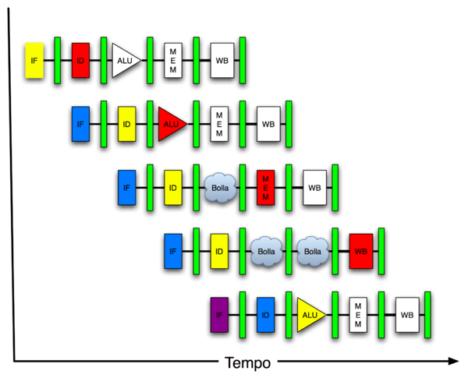
New-School Machine Structures (It’s a bit more complicated!)
Software Hardware
Parallel Requests
Assigned to computer
e.g., Search “Katz”
Parallel Threads
Assigned to core
e.g., Lookup, Ads
Parallel Instructions
>1 instruction @ one time
e.g., 5 pipelined instructions
Parallel Data
>1 data item @ one time
e.g., Add of 4 pairs of words
Hardware descriptions
All gates @ one time
Programming Languages
Warehouse Scale Computer
Smart Phone
Harness Parallelism &
Achieve High Performance
Computer
Today’s
Lecture
Core
…
Core
Memory (Cache)
Input/Output
Core
Instruction Unit(s)
Functional
Unit(s)
A₀+B₀
A₁+B₁
A₂+B₂
A₃+B₃
Cache Memory
Logic Gates

Slide 3
Review
Write-through versus write-back caches
AMAT = Hit time + Miss rate x Miss penalty
Larger caches reduce Miss rate via Temporal and Spatial Locality, but can increase Hit time
Multilevel caches help Miss penalty

Slide 4
Caches are software-invisible
Load and store instructions just access large memory (32-bit addresses in MIPS); hardware automatically moves data in and out of cache
Even if programmer writes applications not knowing about caches, we observe temporal and spatial locality in memory accesses
Performance improves (over no caches) even when programmer unaware of cache’s existence

Slide 5
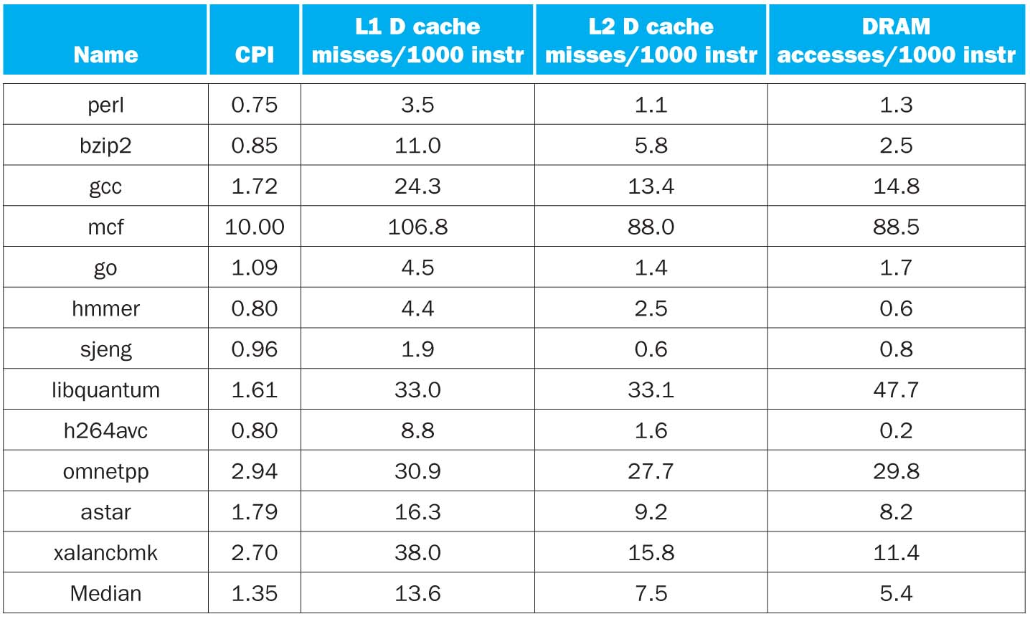
CPI/Miss Rates/DRAM Access SpecInt2006 on AMD Barcelona (64KB L1, 512KB L2)
Data Only
Data Only
Instructions and Data

Slide 6
Performance Programming: Adjust software accesses to improve miss rate
Now that understand how caches work, can revise program to improve cache utilization
“Cache-Aware” performance optimizations
but code would still work even if no caches present

Slide 7
Performance of Loops over Arrays
Array performance often limited by memory speed
OK to access memory in different order as long as get correct result
Goal: Increase performance by minimizing traffic from cache to memory
That is, reduce Miss rate by getting better reuse of data already in cache
Notes:
PICTURE HEAT FLOW
Cache-blocking algorithms “shrink” problem by PERFORMING MULTIPLE ITERATIONS WITHIN SMALLER CACHE BLOCKS

Slide 8
Alternate Matrix Layouts in Memory
A matrix is a 2-D array of elements, but memory addresses are “1-D” (0…MaximumMemoryAddress)
Conventions for matrix layout
by column, or “column major” (Fortran default); A(i,j) at A+i+j*n
by row, or “row major” (C default) A[i][j] at A+i*n+j
Column major
Row major
0
5
10
15
0
1
2
3
1
6
11
16
4
5
6
7
2
7
12
17
8
9
10
11
3
8
13
18
12
13
14
15
4
9
14
19
16
17
18
19
How a 4x5 Matrix is stored in memory, red numbers are memory addresses

Slide 9
Cache Blocks in Matrix
Column Major
(as used in FORTRAN)
Row Major
(as used in C)
Individual multi-word cache block
C
I
One row of 2D matrix
*Cache Line is alternative name for Cache Entry or Block

Slide 10
Loop Interchange: Flashcard quiz
What kind of locality does this improve?
for(j=0; j < N; j++) { for(i=0; i < M; i++) { x[i][j] = 2 * x[i][j]; }
}
for(i=0; i < M; i++) { for(j=0; j < N; j++) { x[i][j] = 2 * x[i][j]; }
}
Spatial
Temporal
Both
Neither

Slide 11
Loop Fusion: Flashcard Quiz
for(i=0; i < N; i++) a[i] = b[i] * c[i];
for(i=0; i < N; i++)
d[i] = a[i] * c[i];
What kind of locality does this improve?
Spatial
Temporal
Both
Neither
for(i=0; i < N; i++) { a[i] = b[i] * c[i]; d[i] = a[i] * c[i];
}

Slide 12
Text Book Quiz
How many have copy of P&H?
Green for yes, pink for no
How many read it?
Green for yes, pink for no

Slide 13
Administrivia
Lab #6: More MIPS
Project 2b: MIPS Emulator, due Sunday
Midterm, a week from Tuesday
In multiple rooms, 1 Pimentel and 2050 LSB
Watch for your room assignment to be posted

Slide 14
Cache Blocking (aka Cache Tiling)
“shrink” problem by performing multiple iterations within smaller cache blocks
Also known as cache tiling
Don’t confuse term “cache blocking” with:
cache blocks, i.e., individual cache entries or lines
(or later, blocking versus non-blocking caches)
Use Matrix Multiply as example: Next Lab and Project 3
Notes:
PICTURE HEAT FLOW
Cache-blocking algorithms “shrink” problem by PERFORMING MULTIPLE ITERATIONS WITHIN SMALLER CACHE BLOCKS

Slide 15
Matrix Multiplication
a
b
c
*
=

Slide 16
The simplest algorithm
Assumption: the matrices are stored as 2-D NxN arrays
for (i=0;i<N;i++)
for (j=0;j<N;j++)
for (k=0;k<N;k++) c[i][j] += a[i][k] * b[k][j];
Advantage: code simplicity
Disadvantage: Marches through memory and caches

Slide 17
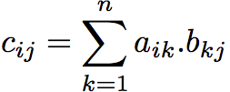
Matrix Multiplication
a
b
c
c_{ij}
*
=
a_{i*}
b_{*j}
Simple Matrix Multiply - www.youtube.com/watch?v=yl0LTcDIhxc
100 x 100 Matrix, Cache 1000 blocks, 1 word/block

Slide 18
Improving reuse via Blocking: 1st “Naïve” Matrix Multiply
{implements C = C + A*B}
for i = 1 to n
{read row i of A into cache}
for j = 1 to n
{read c(i,j) into cache}
{read column j of B into cache}
for k = 1 to n
c(i,j) = c(i,j) + a(i,k) * b(k,j)
{write c(i,j) back to main memory}
C(i,j)
C(i,j)
A(i,:)
=
+
*
B(:,j)

Slide 19
Linear Algebra to the Rescue!
Instead of Multiplying two, say, 6 x 6 matrices
Thus, can get same result as multiplication of a set of submatricies

Slide 20
Blocked Matrix Multiply
Consider A,B,C to be N-by-N matrices of b-by-b subblocks where b=n / N is called the block size
for i = 1 to N
for j = 1 to N
{read block C(i,j) into cache}
for k = 1 to N
{read block A(i,k) into cache}
{read block B(k,j) into cache}
C(i,j) = C(i,j) + A(i,k) * B(k,j) {do a matrix multiply on blocks}
{write block C(i,j) back to main memory}
C(i,j)
C(i,j)
A(i,k)
=
+
*
B(k,j)
Blocked Matrix Multiply - www.youtube.com/watch?v=IFWgwGMMrh0
100 x 100 Matrix, 1000 cache blocks, 1 word/block, block 30x30

Slide 21
Blocked Algorithm
The blocked version of the i-j-k algorithm is written simply as (A,B,C are submatricies of a, b, c)
for (i=0;i<N/r;i++)
for (j=0;j<N/r;j++)
for (k=0;k<N/r;k++)
C[i][j] += A[i][k]*B[k][j]
r = block (sub-matrix) size (Assume r divides N)
X[i][j] = a sub-matrix of X, defined by block row i and block column j
r x r matrix addition
r x r matrix multiplication

Slide 22
Another View of Blocked Matrix Multiply
B
16x16 Matrices, with 4x4 blocks
A
C

Slide 23
Maximum Block Size
The blocking optimization works only if the blocks fit in cache.
That is, 3 blocks of size r x r must fit in memory (for A, B, and C)
M = size of cache (in elements/words)
We must have: 3r² ≈ M, or r ≈ √(M/3)
Ratio of cache misses blocked vs. unblocked up to ≈ √M
Simple Matrix Multiply Whole Thing - www.youtube.com/watch?v=f3-z6t_xIyw
1x1 blocks: 1,020,000 misses: read A once, read B 100 times, read C once
Blocked Matrix Multiply Whole Thing - www.youtube.com/watch?v=tgpmXX3xOrk
30x30 blocks: 90,000 misses = read A and B four times, read C once
“Only” 11X vs 30X Matrix small enough that row of A in simple version fits completely in cache (+ few odds and ends)

Slide 24
Sources of Cache Misses (3 C’s)
Compulsory (cold start, first reference):
1st access to a block, “cold” fact of life, not a lot you can do about it.
If running billions of instructions, compulsory misses are insignificant
Capacity:
Cache cannot contain all blocks accessed by the program
Misses that would not occur with infinite cache
Conflict (collision):
Multiple memory locations mapped to the same cache location
Misses that would not occur with ideal fully associative cache
Notes:
(Capacity miss) That is the cache misses are due to the fact that the cache is simply not large enough to contain all the blocks that are accessed by the program.
The solution to reduce the Capacity miss rate is simple: increase the cache size.
Here is a summary of other types of cache miss we talked about.
First is the Compulsory misses. These are the misses that we cannot avoid. They are caused when we first start the program.
Then we talked about the conflict misses. They are the misses that caused by multiple memory locations being mapped to the same cache location.
There are two solutions to reduce conflict misses. The first one is, once again, increase the cache size. The second one is to increase the associativity.
For example, say using a 2-way set associative cache instead of directed mapped cache.
But keep in mind that cache miss rate is only one part of the equation. You also have to worry about cache access time and miss penalty. Do NOT optimize miss rate alone.
Finally, there is another source of cache miss we will not cover today. Those are referred to as invalidation misses caused by another process, such as IO , update the main memory so you have to flush the cache to avoid inconsistency between memory and cache.
+2 = 43 min. (Y:23)

Slide 25
Flashcard Quiz: With a fixed cache capacity, what effect does a larger block size have on the 3Cs?
Decreases compulsory, increases conflicts
Increases conflicts
Increases compulsory, decreases conflicts
Decreases conflicts

Slide 26
Flashcard Quiz: With a fixed cache block size, what effect does a larger cache capacity have on the 3Cs?
Increases compulsory, decreases conflicts
Increases conflicts, decreases capacity misses
Decreases compulsory, decreases conflicts
Decreases conflicts, decreases capacity misses

Slide 27
Sources of Cache Misses (3 C’s)
Compulsory (cold start, first reference):
1st access to a block, “cold” fact of life, not a lot you can do about it.
If running billions of instructions, compulsory misses are insignificant
Solution: increase block size (increases miss penalty; very large blocks could increase miss rate)
Capacity:
Cache cannot contain all blocks accessed by the program
Solution: increase cache size (may increase access time)
Or structure software so reuse data in cache before fetching new data
Conflict (collision):
Multiple memory locations mapped to the same cache location
Solution 1: increase cache size (may increase hit time)
Solution 2: (later in semester) increase associativity (may increase hit time)
Notes:
(Capacity miss) That is the cache misses are due to the fact that the cache is simply not large enough to contain all the blocks that are accessed by the program.
The solution to reduce the Capacity miss rate is simple: increase the cache size.
Here is a summary of other types of cache miss we talked about.
First is the Compulsory misses. These are the misses that we cannot avoid. They are caused when we first start the program.
Then we talked about the conflict misses. They are the misses that caused by multiple memory locations being mapped to the same cache location.
There are two solutions to reduce conflict misses. The first one is, once again, increase the cache size. The second one is to increase the associativity.
For example, say using a 2-way set associative cache instead of directed mapped cache.
But keep in mind that cache miss rate is only one part of the equation. You also have to worry about cache access time and miss penalty. Do NOT optimize miss rate alone.
Finally, there is another source of cache miss we will not cover today. Those are referred to as invalidation misses caused by another process, such as IO , update the main memory so you have to flush the cache to avoid inconsistency between memory and cache.
+2 = 43 min. (Y:23)

Slide 28
…and in Conclusion
Although caches are software-invisible, a “cache-aware” performance programmer can improve performance by large factors by changing order of memory accesses
Three C’s of cache misses
Compulsory
Capacity
Conflict

