Slide 1
CS 61C: Great Ideas in Computer Architecture OpenMP, Part I
Instructor:
Krste Asanovic, Randy H. Katz
http://inst.eecs.Berkeley.edu/~cs61c/fa12

Slide 2
Review
Sequential software is slow software
SIMD and MIMD only path to higher performance
Multiprocessor/Multicore uses Shared Memory
Cache coherency implements shared memory even with multiple copies in multiple caches
False sharing a concern; watch block size!
Multithreading increases utilization, Multicore more processors (MIMD)

Slide 3
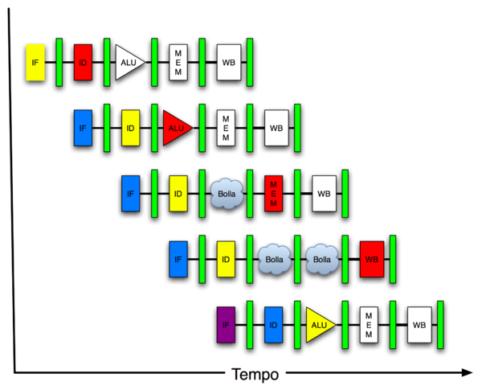
New-School Machine Structures (It’s a bit more complicated!)
Software Hardware
Parallel Requests
Assigned to computer
e.g., Search “Katz”
Parallel Threads
Assigned to core
e.g., Lookup, Ads
Parallel Instructions
>1 instruction @ one time
e.g., 5 pipelined instructions
Parallel Data
>1 data item @ one time
e.g., Add of 4 pairs of words
Hardware descriptions
All gates @ one time
Programming Languages
Warehouse Scale Computer
Smart Phone
Harness Parallelism &
Achieve High Performance
Computer
Core
…
Core
Memory (Cache)
Project 3
Input/Output
Core
Instruction Unit(s)
Functional
Unit(s)
A₀+B₀
A₁+B₁
A₂+B₂
A₃+B₃
Cache Memory
Logic Gates

Slide 4
100s of (mostly dead) Parallel Programming Languages
ActorScript | Concurrent Pascal | JoCaml | Orc
Ada | Concurrent ML | Join | Oz
Afnix | Concurrent Haskell | Java | Pict
Alef | Curry | Joule | Reia
Alice | CUDA | Joyce | SALSA
APL | E | LabVIEW | Scala
Axum | Eiffel | Limbo | SISAL
Chapel | Erlang | Linda | SR
Cilk | Fortan 90 | MultiLisp | Stackless Python
Clean | Go | Modula-3 | SuperPascal
Clojure | Io | Occam | VHDL
Concurrent C | Janus | occam-π | XC

Slide 5
OpenMP
OpenMP is an API used for multi-threaded, shared memory parallelism
Compiler Directives (inserted into source code)
Runtime Library Routines (called from your code)
Environment Variables (set in your shell)
Portable
Standardized
Easy to compile: cc –fopenmp name.c

Slide 6
Simple Parallelization
for (i=0; i<max; i++) zero[i] = 0;
For loop must have canonical shape for OpenMP to parallelize it
Necessary for run-time system to determine loop iterations
No premature exits from the loop allowed
i.e., No break, return, exit, goto statements

Slide 7
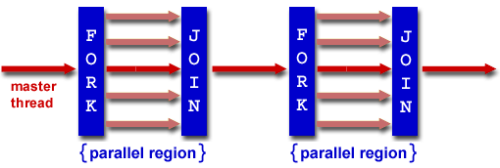
Fork/Join Parallelism
Start out executing the program with one master thread
Master thread forks worker threads as enter parallel code
Worker threads join (die or suspend) at end of parallel code
Image courtesy of http://www.llnl.gov/computing/tutorials/openMP/

Slide 8
OpenMP Extends C with Pragmas
Pragmas are a mechanism C provides for non-standard language extensions
#pragma description
Commonly implemented pragmas: structure packing, symbol aliasing, floating-point exception modes
Good mechanism for OpenMP because compilers that don't recognize a pragma are supposed to ignore them
Runs on sequential computer even with embedded pragmas

Slide 9
The parallel for pragma
#pragma omp parallel for
for (i=0; i<max; i++) zero[i] = 0;
Master thread creates additional threads, each with a separate execution context
Master thread becomes part of team of parallel threads inside parallel block

Slide 10
Controlling Number of Threads
How many threads will OpenMP create?
Can set via clause in parallel pragma:
#pragma omp parallel for num_threads(NUM_THREADS)
or can set via explicit call to runtime function:
#include <omp.h> /* OpenMP header file. */
omp_set_num_threads(NUM_THREADS);
or via NUM_THREADS an environment variable, usually set in your shell to the number of processors in computer running program
NUM_THREADS includes the master thread

Slide 11
What kind of threads?
OpenMP threads are operating system threads.
OS will multiplex requested OpenMP threads onto available hardware threads.
Hopefully each get a real hardware thread to run on, so no OS-level time-multiplexing.
But other tasks on machine can also use hardware threads!
Be careful when timing results for project 3!

Slide 12
Invoking Parallel Threads
#include <omp.h>
#pragma omp parallel
{
int ID = omp_get_thread_num();
foo(ID);
}
Each thread executes a copy of the code within the structured block
OpenMP intrinsic to get Thread ID number:
omp_get_thread_num()

Slide 13
Data Races and Synchronization
2 memory accesses form a data race if from different threads to same location, and at least one is a write, and they occur one after another
If there is a data race, result of program can vary depending on chance (which thread first?)
Avoid data races by synchronizing writing and reading to get deterministic behavior
Synchronization done by user-level routines that rely on hardware synchronization instructions
(more later)

Slide 14
Controlling Sharing of Variables
Variables declared outside parallel block are shared by default.
private(x) statement makes new private version of variable x for each thread.
int i, temp, A[], B[];
#pragma omp parallel for private(temp)
for (i=0; i<N; i++)
{ temp = A[i]; A[i] = B[i]; B[i] = temp; }

Slide 15
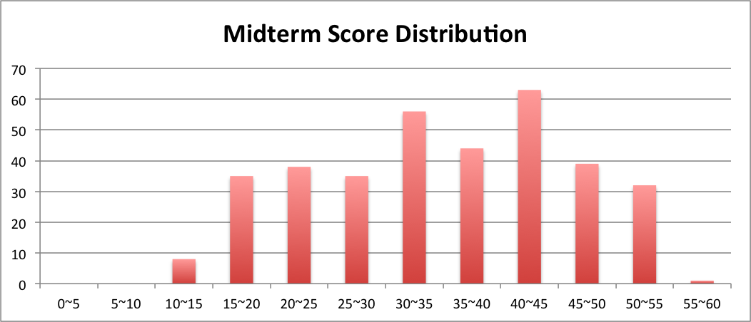
Administrivia
Midterm results
Only 2/3rd of grades included above

Slide 16
Regrade Request Policy
NO REQUESTS ACCEPTED UNTIL LECTURE WED OCTOBER 17, i.e., we’ll simply delete any that come before
Must attend discussion section to learn solutions and grading process – TA signoff needed for regrade request!
Regrade requests must be accompanied by written request explaining rationale for regrade.
Modifying your copy of exam punishable by F and letter in your University record
We reserve right to regrade whole exam

Slide 17
π
3. 141592653589793238462643383279502884197169399375105820974944592307816406286208998628034825342117067982148086513282306647093844609550582231725359408128481117450284102…
Pi Day is 3-14 (started at SF Exploratorium)

Slide 18
Calculating π

Slide 19
Sequential Calculation of π in C
#include <stdio.h>/* Serial Code */
static long num_steps = 100000; double step;
void main ()
{ int i; double x, pi, sum = 0.0;
step = 1.0/(double) num_steps;
for (i=1;i<= num_steps; i++){
x = (i-0.5)*step;
sum = sum + 4.0/(1.0+x*x);
}
pi = sum/num_steps;
printf ("pi = %6.12f\n", pi);
}

Slide 20
OpenMP Version (with bug)
#include <omp.h>
static long num_steps = 100000; double step;
#define NUM_THREADS 2
void main ()
{ int i; double x, pi, sum[NUM_THREADS];
step = 1.0/(double) num_steps;
#pragma omp parallel private (x)
{ int id = omp_get_thread_num();
for (i=id, sum[id]=0.0; i< num_steps; i=i+NUM_THREADS)
{
x = (i+0.5)*step;
sum[id] += 4.0/(1.0+x*x);
}
}
for(i=0, pi=0.0; i<NUM_THREADS; i++)
pi += sum[i] ;
printf ("pi = %6.12f\n", pi / num_steps);
}

Slide 21
Experiment
Run with NUM_THREADS = 1 multiple times
Run with NUM_THREADS = 2 multiple times
What happens?

Slide 22
OpenMP Version (with bug)
#include <omp.h>
static long num_steps = 100000; double step;
#define NUM_THREADS 2
void main ()
{ int i; double x, pi, sum[NUM_THREADS];
step = 1.0/(double) num_steps;
#pragma omp parallel private (x)
{ int id = omp_get_thread_num();
for (i=id, sum[id]=0.0; i< num_steps; i=i+NUM_THREADS)
{
x = (i+0.5)*step;
sum[id] += 4.0/(1.0+x*x);
}
}
for(i=0, pi=0.0; i<NUM_THREADS; i++)
pi += sum[i] ;
printf ("pi = %6.12f\n", pi / num_steps);
}
Note: loop index variable i is shared between threads

Slide 23
OpenMP Version 2 (with bug)
#include <omp.h>
static long num_steps = 100000; double step;
#define NUM_THREADS 2
void main ()
{ int i; double x, sum, pi=0.0;
step = 1.0/(double) num_steps;
#pragma omp parallel private (x, sum)
{ int id = omp_get_thread_num();
for (i=id, sum=0.0; i< num_steps; i=i+NUM_THREADS
{
x = (i+0.5)*step;
sum += 4.0/(1.0+x*x);
}
#pragma omp critical
pi += sum;
}
printf ("pi = %6.12f,\n”,pi/num_steps);
}

Slide 24
OpenMP Reduction
Reduction: specifies that 1 or more variables that are private to each thread are subject of reduction operation at end of parallel region: reduction(operation:var) where
Operation: operator to perform on the variables (var) at the end of the parallel region
Var: One or more variables on which to perform scalar reduction.
#pragma omp for reduction(+ : nSum) for (i = START ; i <= END ; ++i) nSum += i;

Slide 25
OpenMP Reduction Version
#include <omp.h>
#include <stdio.h>
/static long num_steps = 100000;
double step;
void main ()
{ int i; double x, pi, sum = 0.0;
step = 1.0/(double) num_steps;
#pragma omp parallel for private(x) reduction(+:sum)
for (i=1; i<= num_steps; i++){
x = (i-0.5)*step;
sum = sum + 4.0/(1.0+x*x);
}
pi = sum / num_steps;
printf ("pi = %6.8f\n", pi);
}
Note: Don’t have to declare for loop index variable i private, since that is default

Slide 26
And in Conclusion, …
OpenMP as simple parallel extension to C
Threads, Parallel for, private, critical sections, …
≈ C: small so easy to learn, but not very high level and its easy to get into trouble

