Slide 1
CS 61C: Great Ideas in Computer Architecture Datapath Building Blocks
Instructors:
Krste Asanovic, Randy H. Katz
http://inst.eecs.Berkeley.edu/~cs61c/fa12

Slide 2
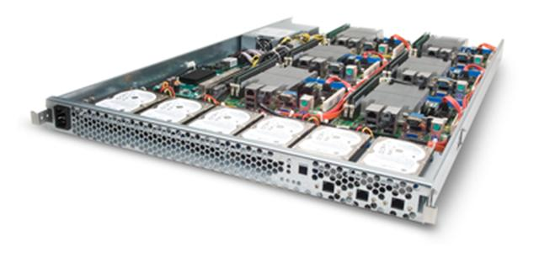
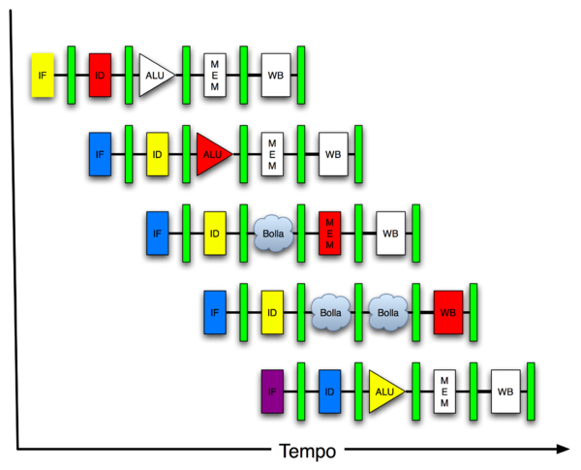
You are Here!
Software Hardware
Parallel Requests
Assigned to computer
e.g., Search “Katz”
Parallel Threads
Assigned to core
e.g., Lookup, Ads
Parallel Instructions
>1 instruction @ one time
e.g., 5 pipelined instructions
Parallel Data
>1 data item @ one time
e.g., Add of 4 pairs of words
Hardware descriptions
All gates @ one time
Programming Languages
Warehouse Scale Computer
Smart Phone
Harness Parallelism &
Achieve High Performance
Computer
Core
…
Core
Memory (Cache)
Input/Output
Core
Instruction Unit(s)
Functional
Unit(s)
A₀+B₀
A₁+B₁
A₂+B₂
A₃+B₃
Cache Memory
Today
Logic Gates

Slide 3
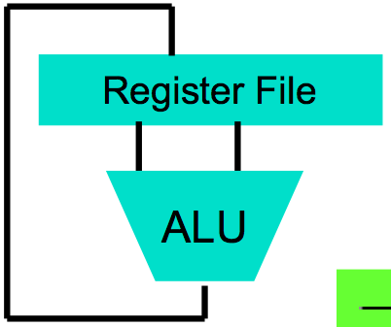
Levels of Representation/Interpretation
High Level Language Program (e.g., C)
temp = v[k];
v[k] = v[k+1];
v[k+1] = temp;
Compiler
Anything can be represented as a number, i.e., data or instructions
lw $t0, 0($2)
lw $t1, 4($2)
sw $t1, 0($2)
sw $t0, 4($2)
Assembly Language Program (e.g., MIPS)
Assembler
0000 1001 1100 0110 1010 1111 0101 1000
1010 1111 0101 1000 0000 1001 1100 0110
1100 0110 1010 1111 0101 1000 0000 1001
0101 1000 0000 1001 1100 0110 1010 1111
Machine Language Program (MIPS)
Machine Interpretation
Hardware Architecture Description (e.g., block diagrams)
Architecture Implementation
Logic Circuit Description (Circuit Schematic Diagrams)

Slide 4
Review
Truth table can be mapped to gates for combinational logic design
Boolean algebra allows minimization of gates
Sequential vs. Combinational Logic
Unique configurations of a digital system: State and State Machines

Slide 5
Design Hierarchy
system
datapath
control
code registers
state registers
combinational logic
multiplexer
comparator
register
logic
switching networks

Slide 6
Type of Circuits
Synchronous Digital Systems consist of two basic types of circuits:
Combinational Logic (CL) circuits
Output is a function of the inputs only, not the history of its execution
E.g., circuits to add A, B (ALUs)
Sequential Logic (SL)
Circuits that “remember” or store information
aka “State Elements”
E.g., memories and registers (Registers)

Slide 7
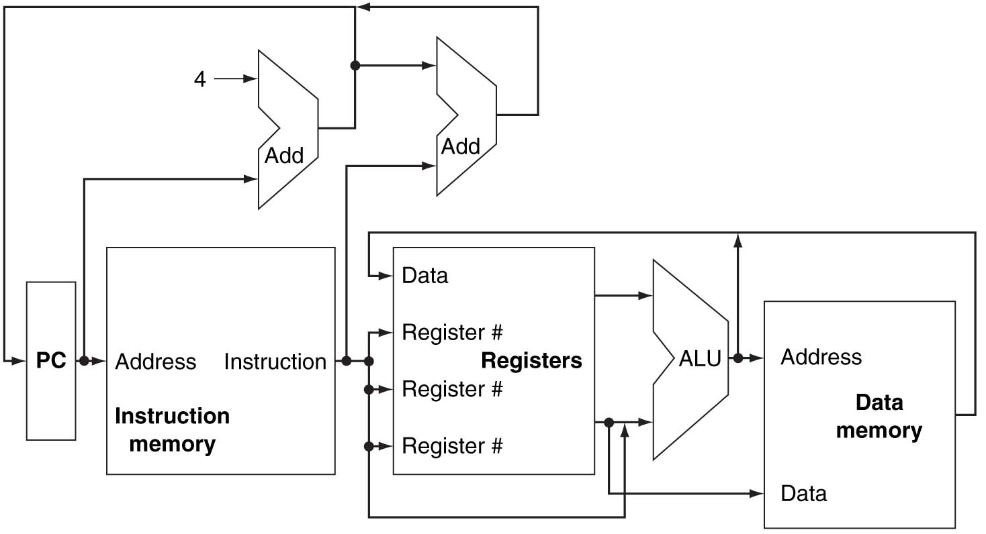
Conceptual MIPS Datapath

Slide 8
Agenda
Multiplexer
ALU Design
And in Conclusion, …

Slide 9
Agenda
Multiplexer
ALU Design
And in Conclusion, …

Slide 10
Data Multiplexer (e.g., 2-to-1 x n-bit-wide)
“mux”
Notes:
Go to Logisim and do design from mux

Slide 11
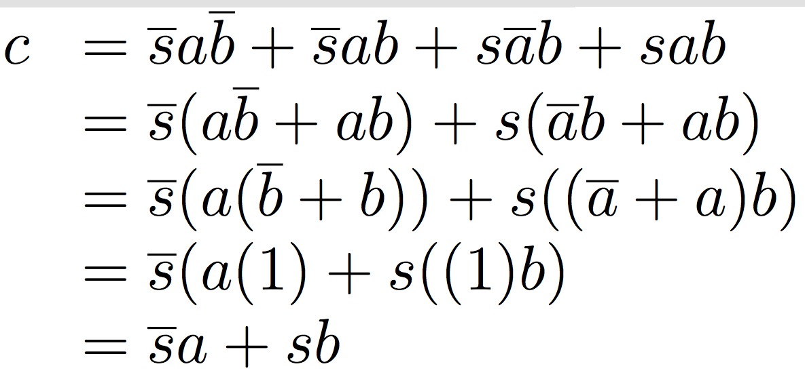
N Instances of 1-bit-Wide Mux
How many rows in TT?

Slide 12
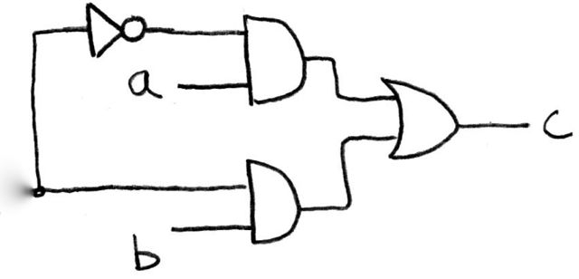
How Do We Build a 1-bit-Wide Mux (in Logisim)?
s
Notes:
Draw on Board, Build in Logisim, create as subcircuit my mux
Make s north facing

Slide 13
4-to-1 Multiplexer
How many rows in TT?

Slide 14
Alternative Hierarchical Approach (in Logisim)

Slide 15
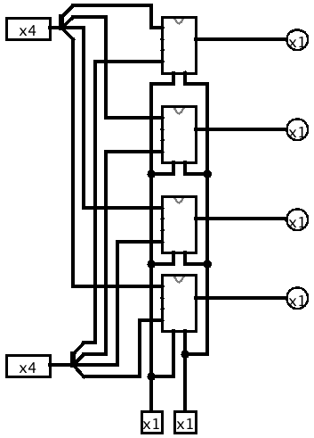
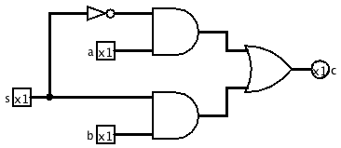
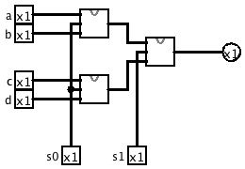
Logisim

Slide 16
Subcircuits
Subcircuit: Logisim equivalent of procedure or method
Every project is a hierarchy of subcircuits

Slide 17
N-bit-wide Data Multiplexer (in Logisim + tunnel)
“mux”
Notes:
Go to Logisim and do design from mux

Slide 18
Administrivia

Slide 19
Agenda
Multiplexer
ALU Design
And, in Conclusion, …

Slide 20
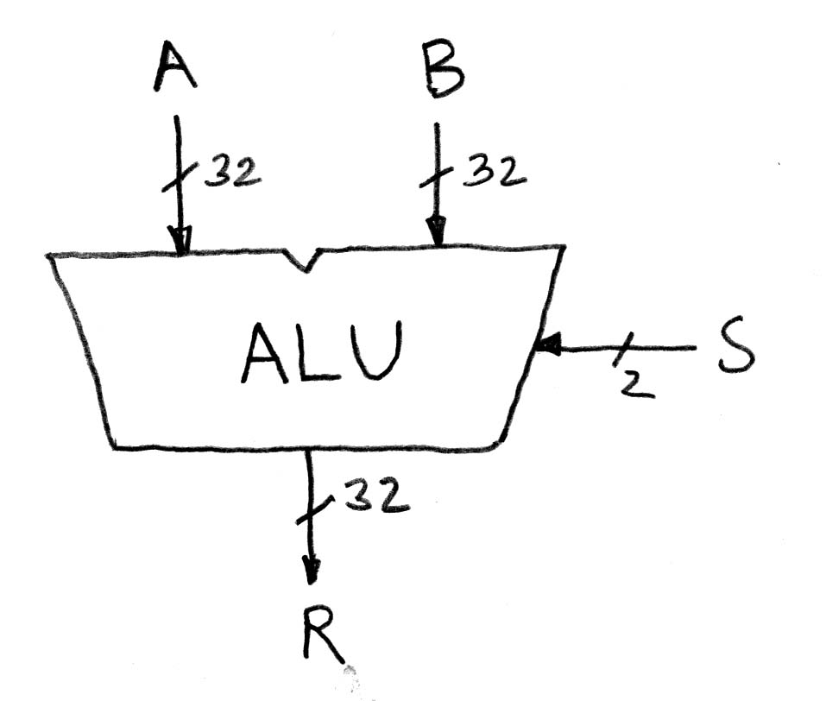
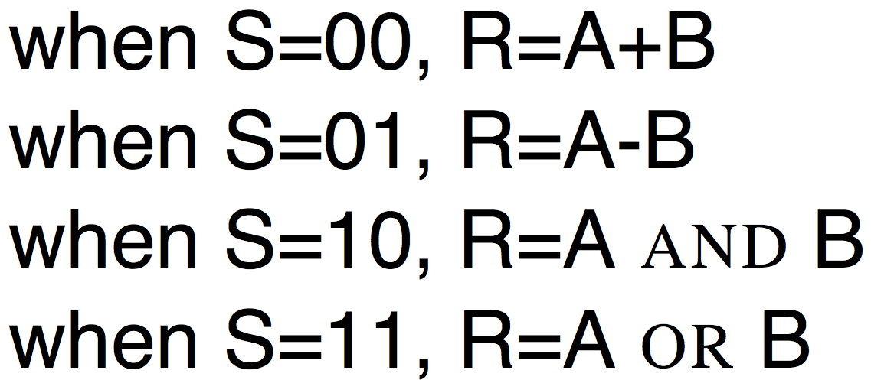
Arithmetic and Logic Unit
Most processors contain a special logic block called “Arithmetic and Logic Unit” (ALU)
We’ll show you an easy one that does ADD, SUB, bitwise AND, bitwise OR

Slide 21
Simple ALU

Slide 22
Adder/Subtractor: One-bit adder Least Significant Bit

Slide 23
Adder/Subtractor: One-bit adder (1/2) …

Slide 24
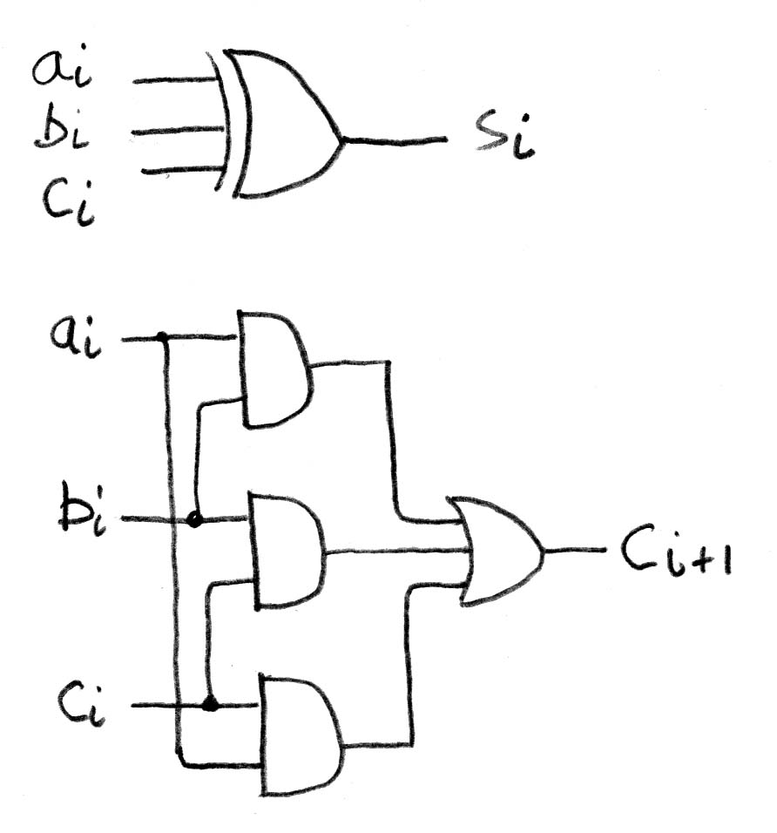
Adder/Subtractor: One-bit Adder (2/2) …

Slide 25
N x 1-bit Adders ⇒ 1 N-bit Adder
Connect Carry Out i-1 to Carry in i:
b₀
+
+
+

Slide 26
Twos Complement Adder/Subtractor

Slide 27
Critical Path
When setting clock period in synchronous systems, must allow for worst case
Path through combinational logic that is worst case called “critical path”
Can be estimated by number of “gate delays”: Number of gates must go through in worst case
Idea: Doesn’t matter if speedup other paths if don’t improve the critical path
What might critical path of ALU?

Slide 28
And, in Conclusion, …
Use muxes to select among input
S input bits selects 2^{S} inputs
Each input can be n-bits wide, indep of S
Can implement muxes hierarchically
Arithmetic circuits are a kind of combinational logic

