Slide 1
If the Internet is the answer, then what was the question?
EE122 Fall 2012
Scott Shenker
http://inst.eecs.berkeley.edu/~ee122/
Materials with thanks to Jennifer Rexford, Ion Stoica, Vern Paxson and other colleagues at Princeton and UC Berkeley

Slide 2
Administrivia
Participation: administrivia questions don’t count
And don’t send your email during class (duh!)
Math: 340 students/ 27 lectures ~ 12.5 comments/lecture
Sections start this week
If you asked about a switch, should have heard from me
Instructional account forms sent by email
Should have them by now
Midterm clash:
Is Oct 11th ok?

Slide 3
Outline for today’s class
The telephone network
Taxonomy of networks
Some basics of packet switching
Statistical multiplexing
This is something you should know deep in your soul…

Slide 4
Review of Telephone Network

Slide 5
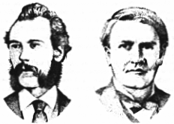
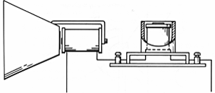
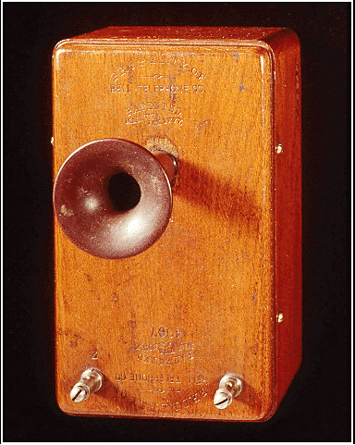
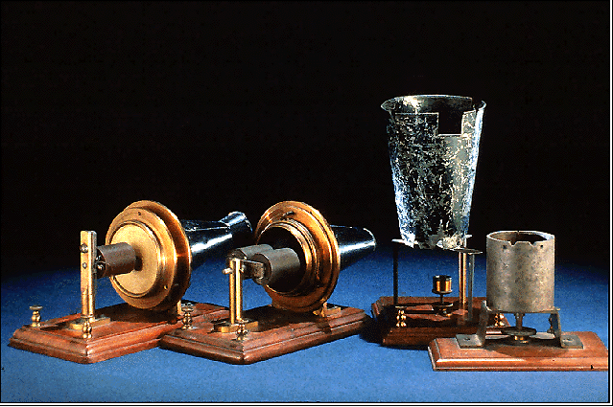
Telephones
Alexander Graham Bell
1876: Demonstrates the telephone at US Centenary Exhibition in Philadelphia

Slide 6
Telephone was an app, not a network!
The big technological breakthrough was to turn voice into electrical signals and vice versa.
Great achievement
One of the nastiest patent battles in history
The demonstration of this new device involved two phones connected by a single dedicated wire.

Slide 7
What about the phone “network”?
You can’t have a dedicated wire between every two telephones
Doesn’t scale
Most wires will go unused….
You need a “shared network” of wires
Much like the highway is shared by cars going to different destinations
The telephone network grew into the first large-scale electronic network

Slide 8
Telephone network uses circuit switching
Establish: source creates circuit to destination
Nodes along the path store connection info
And reserve resources for the connection
If circuit not available: “Busy signal”
Transfer: source sends data over the circuit
No destination address in msg, since nodes know path
Continual stream of data
Teardown: source tears down circuit when done

Slide 9
The switch in “circuit switching”
incoming links
Node
outgoing links
How does the node connect the incoming link to the outgoing link?

Slide 10
Circuit Switching With Human Operator

Slide 11
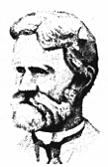
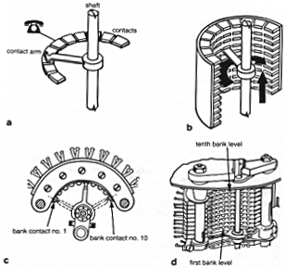
“Modern” switches
Almon Brown Strowger (1839 - 1902)
1889: Invents the “girl-less, cuss-less” telephone system -- the mechanical switching system

Slide 12
Timing in Circuit Switching
Host 1
Host 2
Switch 1
Switch 2
time

Slide 13
Timing in Circuit Switching
Host 1
Host 2
Switch 1
Switch 2
propagation delay
between Host 1
and Switch1
Circuit Establishment
time

Slide 14
Timing in Circuit Switching
Host 1
Host 2
Switch 1
Switch 2
Transmission delay
propagation delay
between Host 1
and Switch1
Circuit Establishment
time

Slide 15
Timing in Circuit Switching
Host 1
Host 2
Switch 1
Switch 2
Transmission delay
propagation delay
between Host 1
and Switch1
Circuit Establishment
time

Slide 16
Timing in Circuit Switching
Host 1
Host 2
Switch 1
Switch 2
Transmission delay
propagation delay
between Host 1
and Switch1
Circuit Establishment
propagation delay
between Host 1
and Host 2
time

Slide 17
Timing in Circuit Switching
Host 1
Host 2
Switch 1
Switch 2
Information
Transmission delay
propagation delay
between Host 1
and Switch1
Circuit Establishment
propagation delay
between Host 1
and Host 2
Transfer
time

Slide 18
Timing in Circuit Switching
Host 1
Host 2
Switch 1
Switch 2
Information
Transmission delay
propagation delay
between Host 1
and Switch1
Circuit Establishment
propagation delay
between Host 1
and Host 2
Transfer
time
Circuit Teardown
Notes:
Why the delays in the first pass of the establishment, but not in subsequent passes (or in teardown)?

Slide 19
Sharing a link
incoming links
Node
outgoing links
How do the black and orange circuits share the outgoing link?

Slide 20
Circuit Switching: Multiplexing a Link
Time-division
Each circuit allocated certain time slots
Frequency-division
Each circuit allocated certain frequencies
frequency
time
time

Slide 21
Time-Division Multiplexing/Demultiplexing
Frames
Slots =
0
1
2
3
4
5
0
1
2
3
4
5
Time divided into frames; frames into slots
Relative slot position inside a frame determines to which conversation data belongs
E.g., slot 0 belongs to orange conversation
Requires synchronization between sender and receiver
Need to dynamically bind a slot to a conversation
If a conversation does not use its circuit capacity is lost!

Slide 22
Strengths of phone system
Predictable performance
Known delays
No drops
Easy to control
Centralized management of how calls are routed
Easy to reason about
Supports a crucial service
What about weaknesses?

Slide 23
Weakness #1: Not resilient to failure
Any failure along the path prevents transmission
Entire transmission has to be restarted
“All or nothing” delivery model

Slide 24
All-or-Nothing Delivery
Host 1
Host 2
Switch 1
Switch 2
Information
Must restart from beginning after failure

Slide 25
Weakness #2: Wastes bandwidth
Consider a network application with:
Peak bandwidth P
Average bandwidth A
How much does the network have to reserve for the application to work?
The peak bandwidth
What is the resulting level of utilization?
Ratio of A/P

Slide 26
Smooth vs Bursty Applications
Some applications have relatively small P/A ratios
Voice might have a ratio of 3:1 or so
Data applications tend to be rather bursty
Ratios of 100 or greater are common
Circuit switching too inefficient for bursty apps
Generally:
Don’t care about factors of two in performance
But when it gets to several orders of magnitude….

Slide 27
Statistical Multiplexing
Will delve into this in more detail later
But this is what drives the use of a shared network
And it is how we could avoid wasting bandwidth

Slide 28
Weakness #3: Designed Tied to App
Design revolves around the requirements of voice
Not general feature of circuit switching
But definitely part of the telephone network design
Switches are where functionality was implemented

Slide 29
Weakness #4: Setup Time
Every connection requires round-trip time to set up
Slows down short transfers
In actuality, may not be a big issue
TCP requires round-trip time for handshake
No one seems to mind….
This was a big issue in the ATM vs IP battle
But I think it is overemphasized as a key factor

Slide 30
How to overcome these weaknesses?
There were two independent threads that led to a different networking paradigm….

Slide 31
What if we wanted a resilient network?
How would we design it?
This is the question Paul Baran asked….

Slide 32
Paul Baran
Baran investigated survivable networks for USAF
Network should withstand almost any degree of destruction to individual components without loss of end-to-end communications.
“On Distributed Communications” (1964)
Distributed control
Message blocks (packets)
Store-and-forward delivery

Slide 33
What about a less wasteful network?
How would we design it?
This is the question Len Kleinrock asked…..
Analyzed packet switching and statistical multiplexing

Slide 34
Returning to title of lecture
If the Internet is the answer, then what was the question?
There were two questions:
How can we build a more reliable network?
How can we build a more efficient network?
Before considering nature of Internet, let’s consider the broader design space for networks
Term “network” already implies we are sharing a communications infrastructure (i.e. not dedicated links)

Slide 35
Taxonomy of Networks

Slide 36
Taxonomy of Communication Networks
Communication networks can be classified based on the way in which the nodes exchange information:
Communication Network

Slide 37
Taxonomy of Communication Networks
Communication networks can be classified based on the way in which the nodes exchange information:
Communication Network
Broadcast Communication Network

Slide 38
Broadcast Communication Networks
Information transmitted by any node is received by every other node in the network
Usually only in LANs (Local Area Networks)
E.g., WiFi, Ethernet (classical, but not current)
E.g., lecture!
What problems does this raise?
Problem #1: limited range
Problem #2: coordinating access to the shared communication medium
Multiple Access Problem
Problem #3: privacy of communication
Notes:
Do Multiaccess problem for: smoke signals, radio, ethernet
When can I tell there is a collision?
Does everyone know there is a collision? [if not, I might get screwed]

Slide 39
Taxonomy of Communication Networks
Communication networks can be classified based on the way in which the nodes exchange information:
Communication Network
Switched Communication Network
Broadcast Communication Network

Slide 40
Taxonomy of Communication Networks
Communication networks can be classified based on the way in which the nodes exchange information:
Communication Network
Switched Communication Network
Broadcast Communication Network
The term “switched” means that communication is directed to specific destinations
The question is how that “switching” is done

Slide 41
Taxonomy of Communication Networks
Communication networks can be classified based on the way in which the nodes exchange information:
Communication Network
Switched Communication Network
Broadcast Communication Network
Circuit-Switched Communication Network

Slide 42
Taxonomy of Communication Networks
Communication networks can be classified based on the way in which the nodes exchange information:
Communication Network
Switched Communication Network
Broadcast Communication Network
Circuit-Switched Communication Network
Packet-Switched Communication Network

Slide 43
Packet Switching
Data sent as chunks of formatted bit-sequences (Packets)
Packets have following structure:
Header and Trailer carry control information (e.g., destination address, checksum)
Each packet traverses the network from node to node along some path (Routing) based on header info.
Usually, once a node receives the entire packet, it stores it (hopefully briefly) and then forwards it to the next node (Store-and-Forward Networks)
Header
Data
Trailer (sometimes)

Slide 44
Packet Switching
Node in a packet switching network
incoming links
Node
outgoing links
Memory

Slide 45
Packet Switching: Multiplexing/Demultiplexing
How to tell packets apart?
Use meta-data (header) to describe data
No reserved resources; dynamic sharing
Single flow can use the entire link capacity if it is alone
This leads to increased efficiency

Slide 46
Taxonomy of Communication Networks
Communication networks can be classified based on the way in which the nodes exchange information:
Communication Network
Switched Communication Network
Broadcast Communication Network
Circuit-Switched Communication Network
Packet-Switched Communication Network
Datagram Network

Slide 47
Datagram Packet Switching
Each packet is independently switched
Each packet header contains full destination address
Routers/switches make independent routing decisions
No resources are pre-allocated (reserved) in advance
Leverages “statistical multiplexing”
Gambling that packets from different conversations won’t all arrive at the same time, so we don’t need enough capacity for all of them at their peak transmission rate
Assuming independence of traffic sources, can compute probability that there is enough capacity

Slide 48
Datagram Packet Switching
Host C
Host A
Host D
Node 1
Node 2
Node 3
Node 5
Host B
Node 7
Host E
Node 6
Node 4

Slide 49
Datagram Packet Switching
Host C
Host A
Host D
Node 1
Node 2
Node 3
Node 5
Host B
Node 7
Host E
Node 6
Node 4

Slide 50
Datagram Packet Switching
Host C
Host A
Host D
Node 1
Node 2
Node 3
Node 5
Host B
Node 7
Host E
Node 6
Node 4

Slide 51
Taxonomy of Communication Networks
Communication networks can be classified based on the way in which the nodes exchange information:
Communication Network
Switched Communication Network
Broadcast Communication Network
A hybrid of circuits and packets; headers include a “circuit identifier” established during a setup phase
Circuit-Switched Communication Network
Packet-Switched Communication Network
Datagram Network
Virtual Circuit Network

Slide 52
5 Minute Break
Questions Before We Proceed?

Slide 53
Basics of Datagram Networks

Slide 54
Nodes and Links
Link: transmission technology
Twisted pair, optical, radio, whatever
Node: computational devices on end of links
Host: general-purpose computer
Network node: switch or router
Link
Node
Node

Slide 55
Properties of Links
Latency (delay)
Propagation time for data sent along the link
Corresponds to the “length” of the link
Bandwidth (capacity)
Amount of data sent (or received) per unit time
Corresponds to the “width” of the link
Bandwidth-delay product: (BDP)
Amount of data that can be “in flight” at any time
Propagation delay × bits/time = total bits in link
bandwidth
delay x bandwidth
latency

Slide 56
Examples of Bandwidth-Delay
Same city over slow link:
B~100mbps
L~.1msec
BDP ~ 10000bits ~ 1.25MBytes
Cross-country over fast link:
B~10Gbps
L~10msec
BDP ~ 10⁸bits ~ 12.5GBytes

Slide 57
Examples of Transmission Times
1500 byte packet over 14.4k modem: ~1 sec
1500 byte packet over 10Gbps link: ~10⁻⁶sec

Slide 58
Utilization
Fraction of time link is busy transmitting
Often denoted by ρ
Ratio of arrival rate to bandwidth
Arrival: A bits/sec on average
Utilization = A/B = Arrival/Bandwidth

Slide 59
Packets
Payload (Body)
Data being transferred
Header
Instructions to the network for how to handle packet
Think of the header as an interface!

Slide 60
The Lifecycle of Packets
Packet Currently
Being Transmitted
Link
Packet Buffer
Packet Arriving
at Switch
Packet
Being
Transmitted
Excess Packets
Stored in Buffer

Slide 61
The Delays of Their Lives
Transmission
Delay
Queueing
Delay
Round-Trip Time (RTT) is the time it takes
a packet to reach the destination and
the response to return to the sender
Propagation Delay is how long it takes
to reach the next switch after transmission

Slide 62
Timing of Datagram Packet Switching
Host 1
Host 2
Node 1
Node 2
Packet 1
propagation
delay between
Host 1 and
Node 1

Slide 63
Timing of Datagram Packet Switching
Host 1
Host 2
Node 1
Node 2
Packet 1
propagation
delay between
Host 1 and
Node 1
transmission
time of Packet 1
at Host 1

Slide 64
Timing of Datagram Packet Switching
Host 1
Host 2
Node 1
Node 2
Packet 1
propagation
delay between
Host 1 and
Node 1
transmission
time of Packet 1
at Host 1
Packet 1
processing delay of Packet 1 at Node 2
Packet 1

Slide 65
Timing of Datagram Packet Switching
Host 1
Host 2
Node 1
Node 2
Packet 1
propagation
delay between
Host 1 and
Node 1
transmission
time of Packet 1
at Host 1
Packet 2
Packet 1
Packet 3
processing delay of Packet 1 at Node 2
Packet 2
Packet 3
Packet 1
Packet 2
Packet 3

Slide 66
Review of Networking Delays
Propagation delay: latency
Time spent in traversing the link
“speed of propagation” delay
Transmission delay:
Time spent being transmitted
Ratio of packet size to bandwidth
Queueing delay:
Time spent waiting in queue
Ratio of total packet bits ahead in queue to bandwidth
Roundtrip delay (RTT)
Total time for a packet to reach destination and a response to return to the sender

Slide 67
Trends
Propagation delay?
No change
Transmission delay?
Getting smaller!
Queueing delay?
Usually smaller
How does this affect applications?
CDNs work very hard to move data near clients
Reduces backbone bandwidth requirements
But also decreases latency
Google: time is money!

Slide 68
Queueing Delay
Does not happen if packets are evenly spaced
And arrival rate is less than service rate

Slide 69
Smooth Arrivals = No Queueing Delays

Slide 70
Queueing Delay
Does not happen if packets are evenly spaced
And arrival rate is less than service rate
Queueing delay caused by “packet interference”
Burstiness of arrival schedule
Variations in packet lengths

Slide 71
Bursty Arrivals = Queueing Delays
There is substantial queueing delay even though link is underutilized

Slide 72
Queueing Delay Review
Does not happen if packets are evenly spaced
And arrival rate is less than service rate
Queueing delay caused by “packet interference”
Burstiness of arrival schedule
Variations in packet lengths
Made worse at high load
Less “idle time” to absorb bursts
Think about traffic jams in rush hour….

Slide 73
Jitter
Difference between minimum and maximal delay
Latency plays no role in jitter
Nor does transmission delay for same sized packets
Jitter typically just differences in queueing delay
Why might an application care about jitter?

Slide 74
Packet Losses: Buffers Full

Slide 75
Packet Losses: Corruption

Slide 76
Basic Queueing Theory Terminology
Arrival process: how packets arrive
Average rate A
Peak rate P
Service process: transmission times
Average transmission time
For networks, function of packet size
W: average time packets wait in the queue
W for “waiting time”
L: average number of packets waiting in the queue
L for “length of queue”
Two different quantities

Slide 77
Little’s Law (1961)
L = A x W
Compute L: count packets in queue every second
How often does a single packet get counted? W times
Could compute L differently
On average, every packet will be counted W times
The average arrival rate determines how frequently this total queue occupancy should be added to the total
Why do you care?
Easy to compute L, harder to compute W
Notes:
Row vs column

Slide 78
Statistical Multiplexing

Slide 79
Three Flows with Bursty Arrivals
Data Rate 1
Time
Data Rate 2
Capacity
Time
Data Rate 3
Time

Slide 80
When Each Flow Gets 1/3rd of Capacity
Frequent Overloading
Data Rate 1
Time
Data Rate 2
Time
Data Rate 3
Time

Slide 81
When Flows Share Total Capacity
Time
No Overloading
Time
Statistical multiplexing relies on the assumption
that not all flows burst at the same time.
Very similar to insurance, and has same failure case
Time

Slide 82
Classroom Demonstration of Stat Mux

Slide 83
I need 8 volunteers!
One group of 4:
Each generates either 0, 1, or 2 packets per cycle
But your link only handles 1 packet per cycle
How much of your link do you use (on average)?
Other group of 4:
Each generates either 0, 1, or 2 packets per cycle
You share your links, so you can handle 4 packets/cycle
How much of your combined link do you use (average)?
Which team will win?

Slide 84
Another Take on “Stat Mux”
Assume time divided into frames
Frames divided into slots
Flows generate packets during each frame
Peak number of packets/frame P
Average number of packets/frame A
Single flow: must allocate P slots to avoid drops
But P might be much bigger than A
Very wasteful!
Use the “Law of Large Numbers”….
Frame
Slots

Slide 85
Law of Large Numbers (~1713)
Consider any probability distribution
Can be highly variable, such as varying from 0 to P
Take N samples from probability distribution
In this case, one set of packets from each flow
Thm: the sum of the samples is very close to N×A
And gets percentage-wise closer as N increases
Sharing between many flows (high aggregation), means that you only need to allocate slightly more than average A slots per frame.
Sharing smooths out variations

Slide 86
Simple Example: M/M/1 Queue
Consider n flows sharing a single queue
Flow: random (Poisson) arrivals at rate λ
Random (Exponential) service with average 1/μ
Utilization factor: ρ = nλ/μ
If ρ >1, system is unstable
Case 1: Flows share bandwidth
Delay = 1/(μ - nλ)
Case 2: Flows each have 1/n^{th} share of bandwidth
No sharing
Delay = n/(μ - nλ) Not sharing increases delay by n

Slide 87
If you still don’t understand stat mux
Will cover in section….

Slide 88
Recurrent theme in computer science
Greater efficiency through “sharing”
Statistical multiplexing
Phone network rather than dedicated lines
Ancient history
Packet switching rather than circuits
Today’s lecture
Cloud computing
Shared datacenters, rather than single PCs

Slide 89
General Lesson: scaling involves
How you share resources
How you deal with failures
…..

Slide 90
Thursday’s lecture….
Layering, principles, the “good stuff”
Read K&R 1.4-1.8 (mostly for context)

