Slide 1
The Fundamentals of Routing
EE122 Fall 2012
Scott Shenker
http://inst.eecs.berkeley.edu/~ee122/
Materials with thanks to Jennifer Rexford, Ion Stoica, Vern Paxson and other colleagues at Princeton and UC Berkeley

Slide 2
Announcements
Participation numbers: we have a problem….
30 have sent mail about participation
330 are enrolled in the course
Homework #1 due in a week
Get it done soon, so you can focus on project
Reminder: work on homework by yourself…..
Project 1 is out today!
Due in two weeks, get started soon!
Colin will give a quick introduction

Slide 3
Project 1
Goal: implement reliable transport protocol
Structure of project:
We give you the receiver
You implement the sender
Receiver sends back cumulative ACKs
You must figure out how to use these effectively

Slide 5
Grading Policy
The grades will be based on correctness and performance, not adherence to a specified algorithm.
Do you reliably deliver the file?
Is it accomplished in a timely manner?
And with a reasonable number of packets?

Slide 6
Grading Policy
We provide you with a testing framework, including one test case
You need to implement further tests!
We will run our own tests on your code to generate a grade

Slide 7
Extra Credit
You can implement optional “bells and whistles” for extra credit
Extra credit can boost your grade by up to 10%: 5% for the first bell/whistle, 5% for the second

Slide 8
Collaboration Policy
Projects are designed to be solved independently, but you may work with a partner if you wish (but at most two people can work together). Grading will remain the same whether you choose to work alone or with a partner; both partners will receive the same grade regardless of the distribution of work between the two partners (so choose a partner wisely!).

Slide 9
Collaboration Policy (continued)
You may not share code with any classmates other than your partner. You may discuss the assignment requirements or general programming decisions (e.g., what data structures were used to store routing tables) - away from a computer and without sharing code - but you should not discuss the detailed nature of your solution (e.g., what algorithm was used to compute the routing table).

Slide 10
Colin is in charge of project 1
General questions
Ask your TA
Detailed questions about the project code
Ask Colin (cs@cs.berkeley.edu)

Slide 11
Questions on Project 1?

Slide 12
Outline
Review of reliable transport
Basics of routing and forwarding
Correctness condition for routing
Routing on spanning trees
Preview of next lecture

Slide 13
Review of Reliable Transport

Slide 14
Review of Reliable Transport
Restatement of correctness condition:
A transport mechanism is “reliable” if and only if it resends all dropped or corrupted packets.
Sufficient (“if”): algorithm will always keep trying to deliver undelivered packets
Necessary (“only if”): if it ever lets a packet go undelivered without trying again, it isn’t reliable
Note: a transport mechanism can “give up”, but must announce this to application

Slide 15
Many Implementation Choices
Feedback from receiver: ACKs vs NACKs
Can NACKs alone achieve “correctness”?
Can ACKs alone achieve “correctness”?
Variations on ACKs
Full information
Individual packets
Cumulative (project; TCP)
When to resend
Timeout
Duplicate ACKs
NACKs

Slide 16
Implementation Choices
These implementation choices affect:
Timeliness
Efficiency
Fairness
….
These are important concerns
but correctness is more fundamental
Design must start with correctness
Can then “engineer” its performance with various hacks
These hacks can be “fun” but don’t let them distract you

Slide 17
Routing

Slide 18
The Traditional Routing Curriculum
Learning switches
Link-state routing
Dijkstra’s Algorithm
Distance-vector routing
Bellman-Ford

Slide 19
I have some bad news…..
Don’t have anything interesting to say about routing
Will follow standard curriculum
Much of it covered in the text
But will focus more on principles than details
Will continue routing on Thursday…

Slide 20
Basics of Routing and Forwarding

Slide 21
Addressing (at a conceptual level)
Assume all hosts have unique IDs (addresses)
No particular structure to those IDs
Later in course will talk about real IP addressing

Slide 22
Packets (at a conceptual level)
Routing occurs at network and datalink layers
Assume network/datalink packet headers contain:
Source ID, Destination ID, and perhaps other information
Destination
Identifier
Why include
this?
Source
Identifier
Payload

Slide 23
Layering Diagram
Why would you have return address in network layer (or datalink layer)?
Historical and network-level reasons….
Application
Application
Transport
Transport
Network
Network
Network
Datalink
Datalink
Datalink
Physical
Physical
Physical
Host A
Router
Host B

Slide 24
Example of Network Graph
Router with 6 attached links
Router with 4 attached links

Slide 25
A Variety of Networks
ISPs: carriers
Backbone
Edge (connecting to customers)
Border (to other ISPs)
Enterprises: companies, universities
Core
Edge (connecting to hosts)
Border (to outside)
Datacenters: massive collections of machines
Aggregation and Core
Top-of-Rack
Border (to outside)

Slide 26
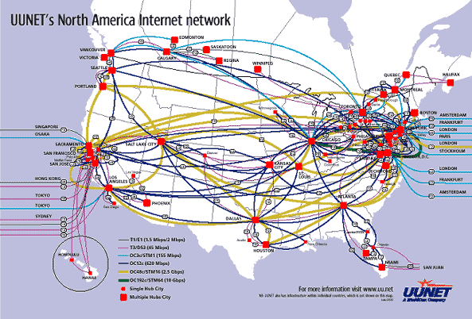
UUNET’s North American Network
Notes:
Very irregular

Slide 27
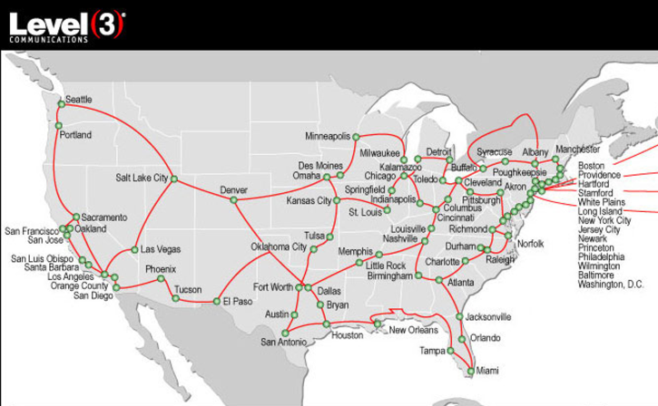
Level3’s American Network

Slide 28
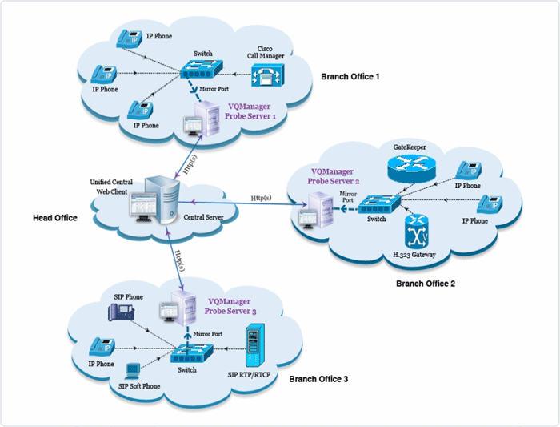
Enterprise Network
Notes:
Not very detailed, couldn’t get a better one….

Slide 29
Berkeley’s Campus Network

Slide 30
Partial Datacenter Network
Notes:
Only a part of the network, but the takeaway is that the network is very regular, involving levels of hierarchy.

Slide 31
Switches
Enterprise/Edge: typically 24 to 48 attached links
Aggregation switches: 192 or more
Backbone: typically fewer attached links
Border: typically very few attached links

Slide 32
Switches/Routers
Multiple attached links, often called “ports”
Ports are typically duplex (incoming and outgoing)
But in this picture will show them separately
(Don’t confuse this notion of “port” with transport “ports”)
incoming links
Switch
outgoing links

Slide 33
Forwarding Decisions
When packet arrives, must choose outgoing port
Decision is based on routing state (table) in switch
incoming links
Switch
outgoing links
Consider
packet header
and routing
table

Slide 34
Forwarding Decisions
Switches and routers make the following mapping:
PacketState + RoutingState ➔ OutgoingPort
Most do so in single transmission time
Forwarding decisions must be simple
Assume forwarding decisions are deterministic
Packets with same state always routed to same port

Slide 35
Packet State
Destination ID
Source ID
Incoming Port (from switch, not packet header)
Other packet header information?
Ignore for now…

Slide 36
Forwarding Decision Dependencies
Must depend on destination
Could also depend on :
Source: requires n² state
Input port: not clear what this buys you
Other header information: ignore for now
We will focus only on destination-based routing
But first consider the alternative

Slide 37
Source/Destination-Based Routing
Paths from two different sources (to same destination) can be very different

Slide 38
Destination-Based Routing
Paths from two different sources (to same destination) must coincide once they overlap
Notes:
Why coincide?

Slide 39
Destination-Based Routing
Paths to same destination never cross
Once paths to destination meet, they never split
Set of paths to destination create a “delivery tree”
Must cover every node exactly once
Spanning Tree rooted at destination
Notes:
You all know what a spanning tree is?

Slide 40
A “Delivery Tree” for a Destination

Slide 41
Assume Destination-Based Routing
For rest of lecture (and course)…..

Slide 42
5 Minute Break

Slide 43
Validity of Routing State

Slide 44
Local and Global Routing State
Local routing state is the state in a single router
By itself, the state in a single router can’t be evaluated
It must be evaluated in terms of the global context
Global routing state means collection of routing state in each of the routers
Global state determines which paths packets take
Will discuss later where this routing state comes from

Slide 45
“Valid” Routing State
Global routing state is “valid” if it produces forwarding decisions that always deliver packets to their destinations
Valid is my terminology, not standard
Goal of routing protocols: compute valid state
But how can you tell if routing state if valid?
Need a succinct correctness condition for routing
Suggestions?
Notes:
What could go wrong?

Slide 46
Necessary and Sufficient Condition
Global routing state is valid if and only if:
There are no dead ends (other than destination)
There are no loops
A dead end is when there is no outgoing port
A packet arrives, but the forwarding decision does not yield any outgoing port
A loop is when a packet cycles around the same set of nodes forever

Slide 47
Wandering Packets
Packet reaches deadend and stops
Packet falls into loop and never reaches destination

Slide 48
Necessary and Sufficient Condition
Global routing state is valid if and only if:
There are no dead ends (other than destination)
There are no loops

Slide 49
Necessary (“only if”): Obvious
If you run into a deadend before hitting destination, you’ll never reach the destination
If you run into a loop, you’ll never reach destination
With deterministic forwarding, once you loop, you’ll loop forever (assuming routing state is static)

Slide 50
Sufficient (“if”): Easy
Assume no deadends, no loops
Packet must keep wandering, without repeating
If ever enter same switch from same port, will loop
Because forwarding decisions are deterministic
Only a finite number of possible ports for it to visit
It cannot keep wandering forever without looping
Must eventually hit destination
Notes:
Destination is only safe deadend

Slide 51
Checking Validity of Routing State
Focus only on a single destination
Ignore all other routing state
Mark outgoing port with arrow
There can only be one at each node
Eliminate all links with no arrows
Look at what’s left….

Slide 52
Example 1

Slide 53
Pick Destination

Slide 54
Put Arrows on Outgoing Ports

Slide 55
Remove Unused Links
Leaves Spanning Tree: Valid

Slide 56
Second Example

Slide 57
Second Example
Is this valid?

Slide 58
Lesson….
Very easy to check validity of routing state for a particular destination
Deadends are obvious
Node without outgoing arrow
Loops are obvious
Disconnected from rest of graph

Slide 59
Computing Routing State

Slide 60
Forwarding vs Routing
Forwarding: “data plane”
Directing a data packet to an outgoing link
Individual router using routing state
Routing: “control plane”
Computing paths the packets will follow
Routers talking amongst themselves
Jointly creating the routing state
Two very different timescales….
Forwarding: single packet transmission times: μs
Routing: can be seconds
6 orders of magnitude!

Slide 61
The “Secret” of Routing
Avoiding deadends is easy
Avoiding loops is hard
The key difference between routing protocols is how they avoid loops!
Don’t focus on details of mechanisms
Just ask “how are loops avoided?”
Notes:
Most modern routing research is about how to make the loop-freeness a more fundamental part of the algorithm. In what I’m going to present today, it is only loop-free AFTER convergence. That’s not good enough

Slide 62
How Can You Avoid Loops?
Easiest way: Restrict topology to spanning tree
If the topology has no loops, packets can’t loop!
(without making a u-turn, which can be locally prevented)

Slide 63
Routing on Spanning Tree

Slide 64
Easiest Way to Avoid Loops
Use a topology where loops are impossible!
Take arbitrary topology
Build spanning tree (algorithm covered later)
Ignore all other links (as before)
Only one path to destinations on spanning trees
So don’t have to worry about loops!

Slide 65
Consider previous graph

Slide 66
A Spanning Tree

Slide 67
Another Spanning Tree

Slide 68
Yet Another Spanning Tree

Slide 69
Routing on a Spanning Tree
There is only one path from source to destination
How do you find that path?
Why bother? Just send packets along all paths
No packets will loop, but some will hit deadends
But one (and exactly one) will reach destination

Slide 70
Flooding on a Spanning Tree
If you want to send a packet that will reach all nodes, then switches can use the following rule:
Ignoring all ports not on spanning tree!
Originating switch sends “flood” packet out all ports
When a “flood” packet arrives on one incoming port, send it out all other ports

Slide 71
Flooding on Spanning Tree

Slide 72
Flooding on Spanning Tree (Again)

Slide 73
Flooding on a Spanning Tree
This works because the lack of loops prevents the flooding from cycling back on itself
Eventually all nodes will be covered, exactly once

Slide 74
But isn’t flooding wasteful?
Yes, but you can watch the packets going by, and learn from that
There is a single path between any two nodes
If node A sees a packet from node B come in on a particular port, what can it conclude?
It knows what port to use to reach B!

Slide 75
Nodes can “learn” routing tables
Switch can learn how to reach nodes by remembering where flooding packets came from!
If flood packet from Node A entered switch from port 4, then switch uses port 4 to reach Node A

Slide 76
Learning from Flood Packets
Node A can be reached
through this port
Node A can be reached
through this port
Node B
Node A
Once a node has sent a flood message, all other switches know how to reach it….

Slide 77
Node B Responds
Node B can be reached
through this port
Node B can be reached
through this port
Node B can be reached
through this port
Node B can be reached
through this port
Node B
Node A
When a node responds, some of the switches learn where it is

Slide 78
General Approach
Flood first packet to node you are trying to reach
All switches learn where you are
When destination responds, some switches learn where it is…
Only some switches, because packet to you follows direct path, and is not flooded
The decision to flood or not is done on a switch-by-switch basis….

Slide 79
Self-Learning Switch
When a packet arrives
Inspect source ID, associate with incoming port
Store mapping in the switch table
Use time-to-live field to eventually forget mapping
Packet tells switch how to reach A.
B
A
C
D

Slide 80
Self Learning: Handling Misses
When packet arrives with unfamiliar destination
Forward packet out all other ports
Response will teach switch about that destination
B
A
C
D

Slide 81
General Rule
When switch receives a packet:
index the switch table using destination ID
if entry found for destination {
if dest on port from which packet arrived then drop packet
else forward packet on port indicated
}
else flood
Why do this?
forward on all but the interface
on which the frame arrived

Slide 82
Summary of Learning Approach
Avoids loop by restricting to spanning tree
This makes flooding possible
Flooding allows packet to reach destination
And in the process switches learn how to reach source of flood
No route “computation”

Slide 83
Weaknesses of This Approach?
Requires loop-free topology (Spanning Tree)
Must eliminate many links from physical topology
Reducing bisection bandwidth (jargon)
Very little control over paths (traffic engineering)
Slow to react to failures
Tree must be recomputed
Slow to react to host movement
Entries must time out
Spanning Trees suck (just ask an operator)

Slide 84
On to other routing techniques…
How do we compute loop-free routes in arbitrary topologies?
Suggestions?

Slide 85
Avoiding Loops
Central computation
Can make sure no loops
Minimizing metric in distributed computation
Loops are never the solution to a minimization problem
(for well-behaved metrics)

