Slide 1

Interdomain Routing
EE122 Fall 2012
Scott Shenker
http://inst.eecs.berkeley.edu/~ee122/
Materials with thanks to Jennifer Rexford, Ion Stoica, Vern Paxson
and other colleagues at Princeton and UC Berkeley

Slide 2
Gautam will answer questions…..

Slide 3
Announcements
Don’t worry about the curve,
  Don’t worry about your midterm grade
We have a long way to go,
  And we will work with you
But do figure out what you got wrong,
  And remember it for next time

Slide 4
Announcements
Over 200 people will flunk this course….
  Only 120 people have “participated”
I’m not kidding about this.
  You will flunk if you don’t participate.
Do the math: ~10 more lectures, ~200 people

Slide 5
Routing
Provides paths between networks
  Prefixes refer to the “network” portion of the address
So far, only considered routing within a domain
  All routers have same routing metric (shortest path)
Many issues can be ignored in this setting because there is central administrative control over routers
  No autonomy, privacy, policy issues for individual routers
But we can’t ignore those issues any more!

Slide 6
Internet is more than a single domain…
Internet not just unstructured collection of networks
  “Networks” in the sense of prefixes
Internet is comprised of a set of “autonomous systems” (ASes)
  Independently run networks, some are commercial ISPs
  Currently over 30,000 Ases
  Think AT&T, France Telecom, UCB, IBM, Intel, etc.
ASes are sometimes called “domains”
  Hence “interdomain routing”

Slide 7
Internet: a large number of ASes
Large ISP
Large ISP
Stub
Small ISP
Dial-Up
ISP
Access
Network
Stub
Stub
Notes:
Stub AS
Multihomed AS
Trnsit AS

Slide 8
Three levels in routing hierarchy
Within a single network: to reach individual hosts
  Learning switches (L2)
Intradomain: routes between networks (L3)
  Covered in previous routing lectures (DS, LS)
Interdomain: routes between ASes (L3)
  Today’s lecture
Need a protocol to route between domains
  BGP is current standard
Aside: using IP addresses for both intradomain
and interdomain routing is Internet’s biggest mistake

Slide 9
Internet Needed New Routing Paradigm
The idea of routing through networks was well-known before the Internet
  Dijkstra's algorithm 1956
  Bellman-Ford 1958
The notion of “autonomous systems” which could implement their own private policies was new
  BGP was hastily designed in response to this need
  Developed 1989-1995
It has mystified us ever since…..

Slide 10
Design Exercise

Slide 11
Design exercise
Unit of routing is a domain (treat as logical switch)
ISP ii
ISP i
ISP
ISP iii
ISP iv

Slide 12
Design-It-Yourself!
Domains can pick whatever routes they want
  No need for it to be shortest path
Domains can choose who they offer their routes to
  No need to let every peer route through them
What does the resulting design look like?
Take five minutes, and then describe your design

Slide 13
One proposal
Domains exchange “path vectors”
  To get to domain D, take path Hop1:Hop2:Hop3:Hop4….
Pick best vector for each destination domain
  According to own private policy
  Path vector prevents loops
Advertise those vectors to whomever they choose
Problems?
  Loops? No
  Quality of paths? Let’s see….
  Convergence? Let’s see…..

Slide 14
Why doesn’t Internet use our design?
Two relatively minor quibbles:
  BGP implemented on routers, not domains
  Paths are to individual networks, not domains
Otherwise, this is essentially BGP….
For the rest of lecture, keep repeating to yourself
  This is simple
  This is simple
  This is simple
  ….

Slide 15
Back to Reality

Slide 16
Who speaks BGP?
AS2
AS1
BGP
R2
R3
R1
R
border router
internal router
Two types of routers
  Border router (Edge), Internal router (Core)

Slide 17
Purpose of BGP
you can reach
net A via me
AS2
AS1
BGP
R2
R3
traffic to A
R1
A
table at R1:
dest next hop
A R2
border router
R
internal router
Share connectivity information across ASes

Slide 18
I-BGP and E-BGP
I-BGP
IGP: Intradomain routing
Example: OSPF
IGP
R3
R2
A
AS1
E-BGP
announce B
AS2
R1
AS3
R5
R4
R
border router
internal router
B
Notes:
I-BGP also carries routes to internal nodes!!!
IGP: internal routing
I-BGP: carrying interdomain routers

Slide 19
In more detail
3
2
2
6
4
9
3
1
Border router
Internal router
Provide internal reachability (IGP)
Learn routes to external destinations (eBGP)
Distribute externally learned routes internally (iBGP)
Select closest egress (IGP)
Notes:
Say “There are four parts to internet routing” (don’t say in route selection)

Slide 20
Joining BGP and IGP Information
Border Gateway Protocol (BGP)
  Announces reachability to external destinations
  Maps a destination prefix to an egress point
    128.112.0.0/16 reached via 192.0.2.1
Interior Gateway Protocol (IGP)
  Used to compute paths within the AS
  Maps an egress point to an outgoing link
    192.0.2.1 reached via 10.1.1.1
10.1.1.1
192.0.2.1

Slide 21
Some Routers Don’t Need BGP
Customer that connects to a single upstream ISP
  The ISP can introduce the prefixes into BGP
  … and the customer can simply default-route to the ISP
Qwest
Nail up routes 130.132.0.0/16
pointing to Yale
Nail up default routes 0.0.0.0/0
pointing to Qwest
Yale University
130.132.0.0/16

Slide 22
Rest of lecture...
Motivate why BGP is the way it is
  Two key issues…..
Discuss some problems with interdomain routing
Explain some of BGP’s details
  Not fundamental, just series of specific design decisions
  Try hard to keep me from reaching this portion….

Slide 23
Factors Shaping Interdomain Routing
There are two main factors that explain why we can’t use previous routing solutions

Slide 24
1. ASes are autonomous
Want to choose their own internal routing protocol
  Different algorithms and metrics
Want freedom to route externally based on policy
  “My traffic can’t be carried over my competitor’s network”
  “I don’t want to carry transit traffic through my network”
  Not expressible as Internet-wide “shortest path”!
Want to keep their connections and policies private
  Would reveal business relationships, network structure

Slide 25
2. ASes have business relationships
Three basic kinds of relationships between ASes
  AS A can be AS B’s customer
  AS A can be AS B’s provider
  AS A can be AS B’s peer
Business implications
  Customer pays provider
  Peers don’t pay each other
    Exchange roughly equal traffic
Policy implications: packet flow follows money flow
  “When sending traffic, I prefer to route through customers over peers, and peers over providers”
  “I don’t carry traffic from one provider to another provider”
Notes:
Ehy???

Slide 26

Business Relationships
Relations between ASes
Business Implications
Customers pay provider
Peers don’t pay each other
provider
customer
peer
peer

Slide 27
Routing Follows the Money!
traffic allowed
traffic not allowed
Peers provide transit between their customers
Peers do not provide transit to each other

Slide 28
AS-level topology
  Destinations are IP prefixes (e.g., 12.0.0.0/8)
  Nodes are Autonomous Systems (ASes)
    Internals are hidden
  Links: connections and business relationships
4
3
5
2
7
6
1
Client
Web server
Notes:
Arrows are routing message

Slide 29
What routing algorithm can we use?
Key issues are policy and privacy
Can’t use shortest path
  domains don’t have any shared metric
  policy choices might not be shortest path
Can’t use link state
  would have to flood policy preferences and topology
  would violate privacy

Slide 30
Basic requirements of routing
Avoid loops and deadends
How to do this while allowing policy freedom?
Easiest way to avoid loops?
  Path vector!

Slide 31
Path-Vector Routing
Extension of distance-vector routing
  Support flexible routing policies
  Faster loop detection (no count-to-infinity)
Key idea: advertise the entire path
  Distance vector: send distance metric per dest d
  Path vector: send the entire path for each dest d
“d: path (2,1)”
“d: path (1)”
3
2
1
data traffic
data traffic
d

Slide 32
Faster Loop Detection
Node can easily detect a loop
  Look for its own node identifier in the path
  E.g., node 1 sees itself in the path “3, 2, 1”
Node can simply discard paths with loops
  E.g., node 1 simply discards the advertisement
“d: path (2,1)”
“d: path (1)”
3
2
1
“d: path (3,2,1)”

Slide 33
Flexible Policies
Each node can apply local policies
  Path selection: Which path to use?
  Path export: Which paths to advertise?
Examples
  Node 2 may prefer the path “2, 3, 1” over “2, 1”
  Node 1 may not let node 3 hear the path “1, 2”
2
3
1

Slide 34
Selection vs Export
Selection policies
  determines which paths I want my traffic to take
Export policies
  determines whose traffic I am willing to carry
Notes:
  any traffic I carry will follow the same path my traffic takes, so there is a connection between the two
  from a protocol perspective, decisions can be arbitrary
    can depend on entire path (advantage of PV approach)

Slide 35
Illustration of Route Advertisements
Route export
Route selection
Customer
Primary
Competitor
Backup
Selection: controls traffic out of the network
Export: controls traffic into the network
Data flows in opposite direction to route advertisement
Notes:
Arrows: routing messages!

Slide 36
Iterative process
Domains offer routes to peers
  Only one route per destination (why?)
  And they can choose which peers they offer the route to
Domains choose single route among those offered
  Using own criteria
Domains offer routes again…
ISP ii
ISP i
ISP
ISP iii
ISP iv

Slide 37
Examples of Standard Policies
Transit network:
  Selection: prefer customer to peer to provider
  Export:
    Let customers use any of your routes
    Let anyone route through you to your customer
    Don’t export route to someone on that route (poison reverse)
    Block everything else
Multihomed (nontransit) network:
  Export: Don’t export routes for other domains
  Selection: pick primary over backup
    send directly to peers
Notes:
Draw multihomed

Slide 38
World of Policies Changing
ISPs are now “eyeball” and/or “content” ISPs
Less focus on “transit”, more on nature of customers
No systematic policy practices yet
Details of peering arrangements are private

Slide 39
Issues with Path-Vector Policy Routing
Reachability
Security
Performance
Lack of isolation
Policy oscillations

Slide 40
Reachability
In normal routing, if graph is connected then reachability is assured
With policy routing, this does not always hold
Provider
AS 1
AS 3
Provider
AS 2
Customer

Slide 41
Security
An AS can claim to serve a prefix that they actually don’t have a route to (blackholing traffic)
  Problem not specific to policy or path vector
  Important because of AS autonomy
  Fixable: make ASes “prove” they have a path
Note: AS can also have incentive to forward packets along a route different from what is advertised
  Tell customers about fictitious short path…
  Much harder to fix!

Slide 42
Performance Nonissues
Internal routing (non)
  Domains typically use “hot potato” routing
  Not always optimal, but economically expedient
Policy not about performance (non)
  So policy-chosen paths aren’t shortest
Choosing among policy-compliant paths (non)
  Pick based on Fewest AS hops, which has little to do with actual delay
  20% of paths inflated by at least 5 router hops
Notes:
Lesson: not being optimal: who cares
Not being connected: we all care!!

Slide 43
Performance (example)
AS path length can be misleading
  An AS may have many router-level hops
BGP says that
path 4 1 is better
than path 3 2 1
AS 4
AS 3
AS 2
AS 1

Slide 44
Real Performance Issue
Convergence times:
  BGP outages are biggest source of Internet problems
Largely due to lack of isolation
Notes:
Lesson: not being optimal: who cares
Not being connected: we all care!!

Slide 45
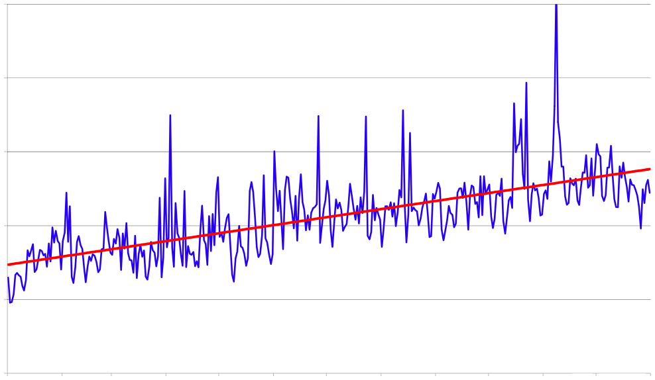
Lack of Isolation: dynamics
If there is a change in the path, the path must be re-advertised to every node upstream of the change
  Why isn’t this a problem for DV routing?
“Route Flap Damping” supposed to help here, (but ends up causing more problems)
BGP updates per day
(100,000s)
10
8
6
4
2
0
Date (Jan - Dec 2005)
Fig. from [Huston & Armitage 2006]

Slide 46
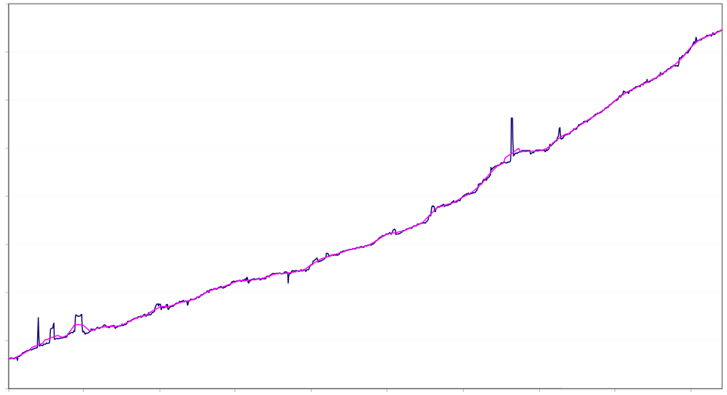
Lack of isolation: routing table size
Each BGP router must know path to every other IP prefix
  but router memory is expensive and thus constrained
Number of prefixes growing more than linearly
Subject of current research
Number of prefixes in BGP table
180000
Fig. from
[Huston &
Armitage 2006]
100000
Jan ’02
Jan ’06

Slide 47
Five Minute Break
Any questions?

Slide 48
What can go wrong?
Routing state is valid iff no loops or deadends
  BGP has neither
So what can go wrong?
There is no guarantee that the algorithm converges!

Slide 49
Persistent Oscillations due to Policies
Depends on the interactions of policies
“1” prefers “1 3 0”
over “1 0” to reach “0”
1 3 0
1 0
1
0
2 1 0
2 0
3 2 0
3 0
2
3

Slide 50
Persistent Oscillations due to Policies
Initially: nodes “1”, “2”, and “3” know only shortest path to “0”
1 3 0
1 0
1
0
2 1 0
2 0
3 2 0
3 0
2
3

Slide 51
Persistent Oscillations due to Policies
“1” advertises its path “1 0” to “2”
1 3 0
1 0
1
advertise: 1 0
0
2 1 0
2 0
3 2 0
3 0
2
3

Slide 52
Persistent Oscillations due to Policies
1 3 0
1 0
1
0
2 1 0
2 0
3 2 0
3 0
2
3

Slide 53
Persistent Oscillations due to Policies
“3” advertises its path “3 0” to “1”
1 3 0
1 0
1
advertise: 3 0
0
2 1 0
2 0
3 2 0
3 0
2
3

Slide 54
Persistent Oscillations due to Policies
1 3 0
1 0
1
0
2 1 0
2 0
3 2 0
3 0
2
3

Slide 55
Persistent Oscillations due to Policies
“1” withdraws its path “1 0” from “2” since is no longer using it
1 3 0
1 0
1
withdraw: 1 0
0
2 1 0
2 0
3 2 0
3 0
2
3

Slide 56
Persistent Oscillations due to Policies
1 3 0
1 0
1
0
2 1 0
2 0
3 2 0
3 0
2
3

Slide 57
Persistent Oscillations due to Policies
“2” advertises its path “2 0” to “3”
1 3 0
1 0
1
0
2 1 0
2 0
3 2 0
3 0
2
3
advertise: 2 0

Slide 58
Persistent Oscillations due to Policies
1 3 0
1 0
1
0
2 1 0
2 0
3 2 0
3 0
2
3

Slide 59
Persistent Oscillations due to Policies
“3” withdraws its path “3 0” from “1” since is no longer using it
1 3 0
1 0
1
withdraw: 3 0
0
2 1 0
2 0
3 2 0
3 0
2
3

Slide 60
Persistent Oscillations due to Policies
1 3 0
1 0
1
0
2 1 0
2 0
3 2 0
3 0
2
3

Slide 61
Persistent Oscillations due to Policies
“1” advertises its path “1 0” to “2”
1 3 0
1 0
1
0
2 1 0
2 0
3 2 0
3 0
2
3

Slide 62
Persistent Oscillations due to Policies
1 3 0
1 0
1
0
2 1 0
2 0
3 2 0
3 0
2
3

Slide 63
Persistent Oscillations due to Policies
“2” withdraws its path “2 0” from “3” since is no longer using it
1 3 0
1 0
1
0
2 1 0
2 0
3 2 0
3 0
2
3
withdraw: 2 0

Slide 64
Persistent Oscillations due to Policies
Depends on the interactions of policies
1 3 0
1 0
1
0
2 1 0
2 0
3 2 0
3 0
2
3
We are back to where we started!

Slide 65
Policy Oscillations (cont’d)
Policy autonomy vs network stability
  Policy oscillations possible with even small degree of autonomy
  focus of much recent research
Not an easy problem
  PSPACE-complete to decide whether given policies will eventually converge!
However, if policies follow normal business practices, stability is guaranteed
  “Gao-Rexford conditions”

Slide 66
Theoretical Results (in more detail)
If preferences obey Gao-Rexford, BGP is safe
  Safe = guaranteed to converge
If there is no “dispute wheel”, BGP is safe
  But converse is not true
If there are two stable states, BGP is unsafe
  But converse is not true
If domains can’t lie about routes, and there is no dispute wheel, BGP is incentive compatible

Slide 67
Rest of lecture....
BGP details
Stay awake as long as you can.....

Slide 68
Border Gateway Protocol (BGP)
Interdomain routing protocol for the Internet
  Prefix-based path-vector protocol
  Policy-based routing based on AS Paths
  Evolved during the past 20 years
1989 : BGP-1 [RFC 1105]
  Replacement for EGP (1984, RFC 904)
1990 : BGP-2 [RFC 1163]
1991 : BGP-3 [RFC 1267]
1995 : BGP-4 [RFC 1771]
  Support for Classless Interdomain Routing (CIDR)

Slide 69
BGP Routing Table
ner-routes>show ip bgp
BGP table version is 6128791, local router ID is 4.2.34.165
Status codes: s suppressed, d damped, h history, * valid, > best, i - internal
Origin codes: i - IGP, e - EGP, ? - incomplete
Network Next Hop Metric LocPrf Weight Path
* i3.0.0.0 4.0.6.142 1000 50 0 701 80 i
* i4.0.0.0 4.24.1.35 0 100 0 i
* i12.3.21.0/23 192.205.32.153 0 50 0 7018 4264 6468 ?
* e128.32.0.0/16 192.205.32.153 0 50 0 7018 4264 6468 25 e

Slide 70
BGP Operations
Establish session on
TCP port 179
AS1
BGP session
Exchange all
active routes
AS2
While connection
is ALIVE exchange
route UPDATE messages
Exchange incremental
updates

Slide 71
BGP Route Processing
Open ended programming.
Constrained only by vendor configuration language
Receive
BGP
Updates
Apply Policy =
filter routes &
tweak attributes
Based on
Attribute
Values
Best
Routes
Apply Policy =
filter routes &
tweak attributes
Transmit
BGP
Updates
Apply Import
Policies
Best Route
Selection
Best Route
Table
Apply Export
Policies
Install forwarding
Entries for best
Routes.
IP Forwarding Table

Slide 72
Selecting the best route
Attributes of routes set/modified according to operator instructions
Routes compared based on attributes using (mostly) standardized rules
  Highest local preference (all equal by default…
  Shortest AS path length …so default = shortest paths)
  Lowest origin type (IGP < EGP < incomplete)
  Lowest MED
  eBGP- over iBGP-learned
  Lowest IGP cost
  Lowest next-hop router ID

Slide 73
Attributes
Destination prefix (e.g,. 128.112.0.0/16)
Routes have attributes, including
  AS path (e.g., “7018 88”)
  Next-hop IP address (e.g., 12.127.0.121)
192.0.2.1
12.127.0.121
AS 7018
AT&T
AS 88
AS 12654
Princeton
RIPE NCC
RIS project
128.112.0.0/16
AS path = 88
Next Hop = 192.0.2.1
128.112.0.0/16
AS path = 7018 88
Next Hop = 12.127.0.121

Slide 74
ASPATH Attribute
AS 1129
128.112.0.0/16
AS Path = 1755 1239 7018 88
Global Access
AS 1755
128.112.0.0/16
AS Path = 1239 7018 88
128.112.0.0/16
AS Path = 1129 1755 1239 7018 88
Ebone
AS 12654
AS 1239
128.112.0.0/16
AS Path = 7018 88
RIPE NCC
RIS project
Sprint
AS7018
128.112.0.0/16
AS Path = 3549 7018 88
128.112.0.0/16
AS Path = 88
AT&T
AS 88
AS 3549
128.112.0.0/16
AS Path = 7018 88
Princeton
Global Crossing
128.112.0.0/16
Prefix Originated

Slide 75
Local Preference attribute
140.20.1.0/24
Policy choice between different AS paths
The higher the value the more preferred
Carried by IBGP, local to the AS.
AS1
AS2
AS3
AS4
BGP table at AS4:
Notes:
Because communicated to all IBGP routers within AS, all routers have a common view of how to exit the AS.
This differs from MED in 2 ways: (1) the destination prefix can be anywhere in the internet, not just in the next AS (as in the case for MED). (2) the AS that sets Local_Pref, is also the one that uses it. This allows one node to tell everyone locally what the best way out is.
MED can’t be used in this example because there is exactly one connection between any pair of AS’s.

Slide 76
Internal BGP and Local Preference
Example
  Both routers prefer the path through AS 100 on the left
  … even though the right router learns an external path
AS 200
AS 100
AS 300
Local Pref = 100
Local Pref = 90
I-BGP
AS 256

Slide 77
Origin attribute
Who originated the announcement?
Where was a prefix injected into BGP?
IGP, BGP or Incomplete (often used for static routes)

Slide 78
Multi-Exit Discriminator (MED) attr.
When ASes interconnected via 2 or more links
AS announcing prefix sets MED (AS2 in picture)
AS receiving prefix uses MED to select link
A way to specify how close a prefix is to the link it is announced on
AS1
Link B
Link A
MED=50
MED=10
AS2
AS4
AS3

Slide 79

IGP cost attribute
Used in BGP for hot-potato routing
  Each router selects the closest egress point
  … based on the path cost in intradomain protocol
Somewhat in conflict with MED
dst
9
B
A
B
A
D
4
3
8
10
4
3
G
F
5
8
E
C
hot potato

Slide 80
Lowest Router ID
Last step in route selection decision process
“Arbitrary” tiebreaking
But we do sometimes reach this step, so how ties are broken matters

Slide 81
Summary
BGP is essential to the Internet
  ties different organizations together
Poses fundamental challenges....
  leads to use of path vector approach
...and myriad details
What to know:
  fundamentals, oscillations, standard policies

