Slide 1

Multiple Access and Spanning Tree
EE122 Fall 2012
Scott Shenker
http://inst.eecs.berkeley.edu/~ee122/
Materials with thanks to Jennifer Rexford, Ion Stoica, Vern Paxson
and other colleagues at Princeton and UC Berkeley

Slide 2
Give it up for Gautam!
“Thanks for being so unbelievably generous with your time and energy on this project! We all really appreciated your almost instantaneous responses on Piazza, your extra office hours, your endless amount of patience with answering the same questions over and over again, and especially all your help today up until the deadline. You are amazing! ”

Slide 3
…And to Jamie!
“Also, shout-out to Jamie for being so generous with his test-cases yet again, and being so awesome about working out the problems that arose.”

Slide 4

Today is Panda’s Birthday!

Slide 5
Good News!
Only half of you will flunk this course!
Participation count now at roughly half the class
Simple question:
  What the hell are the other half of you thinking?
The facts:
  Not enough time for all of you to ask questions in class
  Cannot just pop your head in OH and have that count.
  So start participating now….

Slide 6
Upcoming lectures
Congestion Control
Advanced Topics in Congestion Control
Wireless (Yahel Ben-David)
Multicast/QoS/ReverseTR (Scott and Colin)
Security
SDN I
SDN II
Alternate Architectures
Summing up

Slide 7
Clarification from last time
Routing tables in “Routing Along DAGs” are per-destination
Each link has a direction for each destination
  The direction of the link needed to reach A may be different than the direction of the link needed to reach B
This is no different than distance vector routing
  DV has a distance for each destination
RAD has a vector of directions for each link

Slide 8
Some History
Ethernet was invented as a broadcast technology
  Each packet received by all attached hosts
Easy to set up, cheap to build
  But hosts had to share channel (multiple access)
Current Ethernets are “switched”
  No sharing
But need spanning tree to route on switches
  Everyone hates spanning tree, trying to eliminate it

Slide 9
Today
Study two algorithms that are dying out
  But both important conceptually!
Spanning Tree (endangered algorithms list)
  Still used, but alternatives being developed
Multiple Access in wired media (extinct)
  Not used at all, but useful background for wireless

Slide 10
Routing in Switched Ethernets

Slide 11
Shuttling Data at Different Layers
Different devices switch different things
  Physical layer: electrical signals or bits (hubs)
  Link layer: frames (switches)
  Network layer: packets (routers)
Transport gateway
Application gateway
Router
Frame
header
Packet
header
TCP
header
User
data
Switch
Hub

Slide 12
Switches Enable Concurrent Comm.
Host A can talk to C, while B talks to D
B
A
C
switch
D
Completely avoids collisions (if hosts directly attached)
  No need for all material we discuss later in lecture
  Change in nature of multiple access, but same framing
    Key to the success of ethernet!

Slide 13
Self Learning
Maps destination MAC to outgoing interface
Construct switch table automatically
Floods when does not have entry in table
B
A
C
switch
D

Slide 14
Flooding Can Lead to Loops
Flooding can lead to forwarding loops
  E.g., if the network contains a cycle of switches
  “Broadcast storm”

Slide 15
Solution: Spanning Trees
Ensure the forwarding topology has no loops
  Avoid using some of the links when flooding
  … to prevent loop from forming
Spanning tree
  Sub-graph that covers all vertices but contains no cycles
  Links not in the spanning tree do not forward frames
Graph Has Cycles!
Graph Has
No Cycles!

Slide 16
You: Design a Spanning Tree Algorithm
Distributed
No global information
Neighbors can exchange information
Must adapt when failures occur
  But don’t worry about that on first try…
Take 5 minutes, break into groups, report back

Slide 17
What Do We Know?
Shortest paths to (or from) a node form a tree
  No shortest path can have a cycle
But we must limit each node to one outgoing port towards destination
  Why?
Because this is not a directed graph!

Slide 18
Two Shortest Paths Create Cycle!

Slide 19
Must only choose one

Slide 20
Algorithm Has Two Aspects
Pick a root:
  This will be the destination to which all shortest paths go
  Pick the one with the smallest identifier (MAC add.)
Compute shortest paths to the root
  Only keep the links on shortest-paths
  Break ties in some way, so only keep one shortest path from each node

Slide 21
Breaking Ties
When there are multiple shortest paths to the root, choose the path that uses the neighbor switch with the lower ID.
One could use any tiebreaking system, but this is an easy one to remember and implement
In homeworks and test, remember this.

Slide 22
Constructing a Spanning Tree
Switches need to elect a root
  The switch w/ smallest identifier (MAC addr)
Each switch determines if each interface
is on the shortest path from the root
  Excludes it from the tree if not
Messages (Y, d, X)
  From node X
  Proposing Y as the root
  And the distance is d
root
One hop
Three hops

Slide 23
Steps in Spanning Tree Algorithm
Initially, each switch proposes itself as the root
  Switch sends a message out every interface
  … proposing itself as the root with distance 0
  Example: switch X announces (X, 0, X)
Switches update their view of the root
  Upon receiving message (Y, d, Z) from Z, check Y’s id
  If new id smaller, start viewing that switch as root
Switches compute their distance from the root
  Add 1 to the distance received from a neighbor
  Identify interfaces not on shortest path to the root
  … and exclude them from the spanning tree
If root or shortest distance to it changed, “flood” updated message (Y, d+1, X)

Slide 24
Example From Switch #4’s Viewpoint
Switch #4 thinks it is the root
  Sends (4, 0, 4) message to 2 and 7
Then, switch #4 hears from #2
  Receives (2, 0, 2) message from 2
  … and thinks that #2 is the root
  And realizes it is just one hop away
Then, switch #4 hears from #7
  Receives (2, 1, 7) from 7
  And realizes this is a longer path
  So, prefers its own one-hop path
  And removes 4-7 link from the tree
1
3
5
2
4
6
7

Slide 25
Example From Switch #4’s Viewpoint
Switch #2 hears about switch #1
  Switch 2 hears (1, 1, 3) from 3
  Switch 2 starts treating 1 as root
  And sends (1, 2, 2) to neighbors
Switch #4 hears from switch #2
  Switch 4 starts treating 1 as root
  And sends (1, 3, 4) to neighbors
Switch #4 hears from switch #7
  Switch 4 receives (1, 3, 7) from 7
  And realizes this is a longer path
  So, prefers its own three-hop path
  And removes 4-7 Iink from the tree
1
3
5
2
4
6
7

Slide 26
Which links are on spanning tree?
Take a few minutes, work this out
3-1?
5-1?
6-1?
2-6?
2-3?
1
3
5
2
4
6
7

Slide 27
Links on spanning tree
3-1
5-1
6-1
2-3
4-2
7-2
1
3
5
2
4
6
7

Slide 28
Now which ones are on the spanning tree?
2 is new root
3-2
6-2
4-2
7-2
5-6
3
5
2
4
6
7

Slide 29
Robust Spanning Tree Algorithm
Algorithm must react to failures
  Failure of the root node
    Need to elect a new root, with the next lowest identifier
  Failure of other switches and links
    Need to recompute the spanning tree
Root switch continues sending messages
  Periodically reannouncing itself as the root (1, 0, 1)
  Other switches continue forwarding messages
Detecting failures through timeout (soft state)
  If no word from root, time out and claim to be the root!

Slide 30
Why do people hate spanning tree?
Delay in reestablishing spanning tree
  Network is “down” until spanning tree rebuilt
  Work on rapid spanning tree algorithms…
    And multiple spanning trees
Much of the network bandwidth goes unused
  Forwarding is only over the spanning tree
  Why did you bother with all those other links?

Slide 31
Broadcast vs Point-to-Point

Slide 32
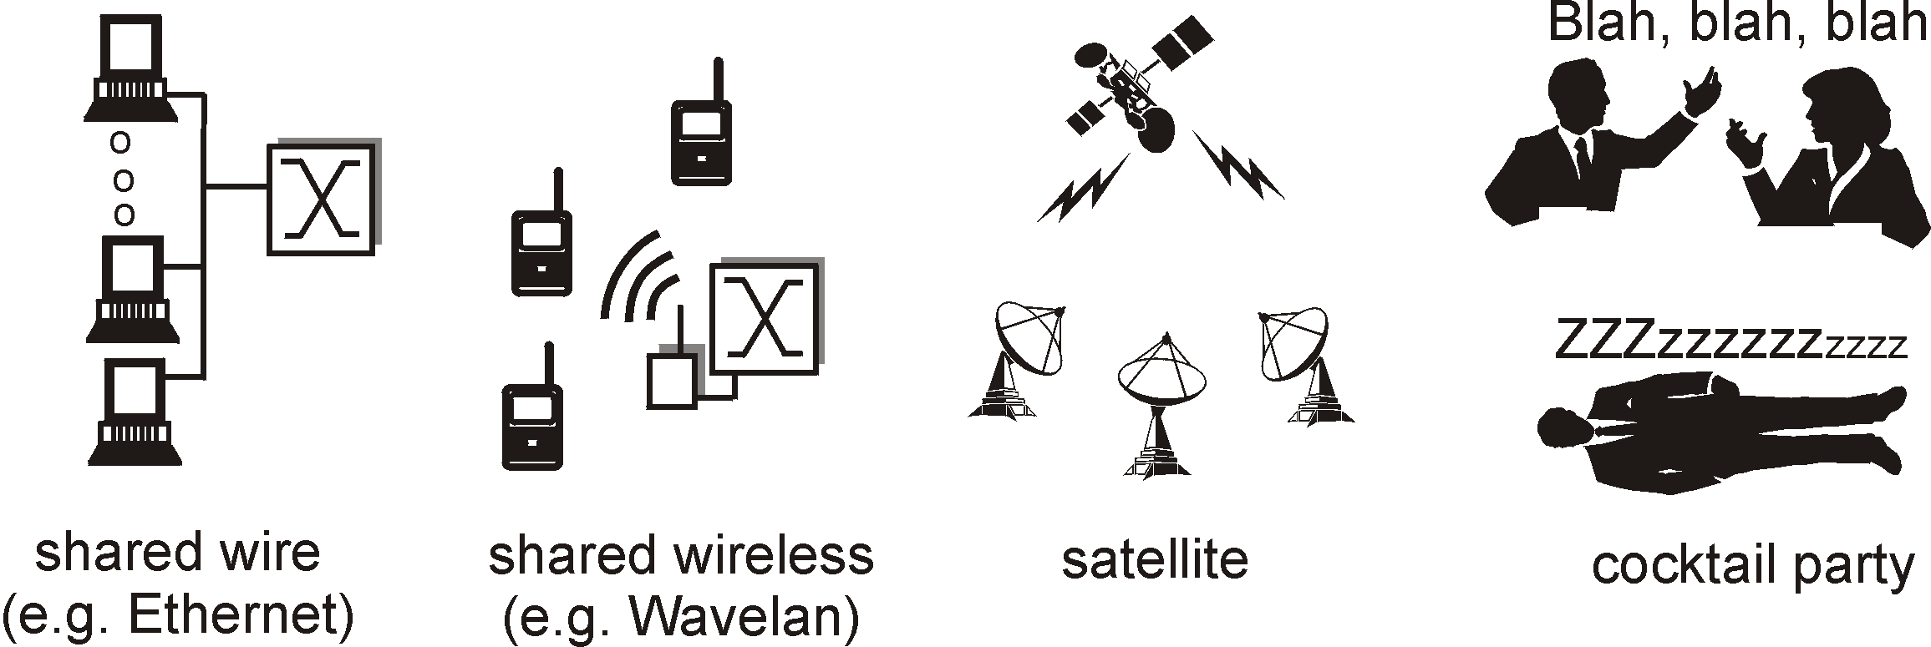
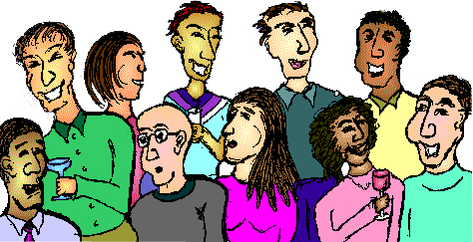
Point-to-Point vs. Broadcast Media
Point-to-point: dedicated pairwise communication
  Long-distance fiber link
  Point-to-point link between Ethernet switch and host
Broadcast: shared wire or medium
  Traditional Ethernet
  802.11 wireless LAN

Slide 33
Multiple Access Algorithm
Single shared broadcast channel
  Must avoid having multiple nodes speaking at once
  Otherwise, collisions lead to garbled data
  Need distributed algorithm for sharing the channel
  Algorithm determines which node can transmit
Classes of techniques
  Channel partitioning: divide channel into pieces
  Taking turns: scheme for trading off who gets to transmit
  Random access: allow collisions, and then recover

Slide 34
Channel Partitioning: TDMA
TDMA: Time Division Multiple Access
Access to channel in "rounds"
  Each station gets fixed length slot in each round
Time-slot length is packet transmission time
  Unused slots go idle
Example: 6-station LAN with slots 0, 3, and 4
Rounds
Slots =
0
1
2
3
4
5
0
1
2
3
4
5

Slide 35
Channel Partitioning: FDMA
FDMA: Frequency Division Multiple Access
Channel spectrum divided into frequency bands
Each station assigned fixed frequency band
Unused transmission time in frequency bands go idle
Example: 6-station LAN, 1,3,4 have pkt, frequency bands 2,5,6 idle
time
frequency bands
FDM cable

Slide 36
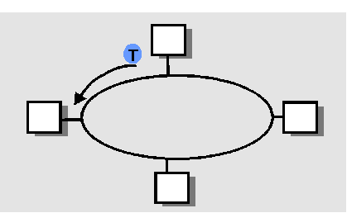
“Taking Turns” MAC protocols
Polling
Master node “invites” slave nodes to transmit in turn
Concerns:
  Polling overhead
  Latency
  Single point of failure (master)
Token passing
Control token passed from one node to next sequentially
Node must have token to send
Concerns:
  Token overhead
  Latency
  At mercy of any node
data
poll
master
data
slaves

Slide 37
None of these are the “Internet way”…
Why not?
What’s wrong with
  TDMA
  FDMA
  Polling
  Token passing
Turn to random access
  Optimize for the common case (no collision)
  Don’t avoid collisions, just recover from them….
  Sound familiar?

Slide 38
Random Access MAC Protocols

Slide 39
Random Access MAC Protocols
When node has packet to send
  Transmit at full channel data rate
  No a priori coordination among nodes
Two or more transmitting nodes ⇒ collision
  Data lost
Random access MAC protocol specifies:
  How to detect collisions
  How to recover from collisions
Examples
  ALOHA and Slotted ALOHA
  CSMA, CSMA/CD, CSMA/CA (wireless, covered later)

Slide 40
Key Ideas of Random Access
Carrier sense
  Listen before speaking, and don’t interrupt
  Checking if someone else is already sending data
  … and waiting till the other node is done
Collision detection
  If someone else starts talking at the same time, stop
    But make sure everyone knows there was a collision!
  Realizing when two nodes are transmitting at once
  …by detecting that the data on the wire is garbled
Randomness
  Don’t start talking again right away
  Waiting for a random time before trying again

Slide 41

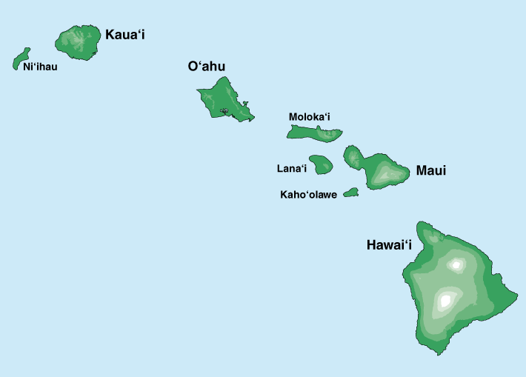
Where it all Started: AlohaNet
Norm Abramson left Stanford in 1970
So he could surf!
Set up first data communication system for Hawaiian islands
Hub at U. Hawaii, Oahu
Had two radio channels:
  Random access:
    Sites sending data
  Broadcast:
    Hub rebroadcasting data
Notes:
Who is he, and why is he my hero?

Slide 42
Aloha Signaling
Two channels: random access, broadcast
Sites send packets to hub (random)
  If received, hub sends ACK (random)
  If not received (due to collision), site resends
Hub sends packets to all sites (broadcast)
  Sites can receive even if they are also sending
Questions:
  When do you resend? Resend with probability p
  How does this perform? Need a clean model….

Slide 43
Slotted ALOHA
Assumptions
All frames same size
Time divided into equal slots (time to transmit a frame)
Nodes are synchronized
Nodes begin to transmit frames only at start of slots
If multiple nodes transmit, nodes detect collision
Operation
When node gets fresh data, transmits in next slot
No collision: success!
Collision: node retransmits with probability p until success

Slide 44
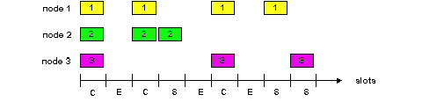
Slot-by-Slot Example

Slide 45
Efficiency of Slotted Aloha
Suppose N stations have packets to send
  Each transmits in slot with probability p
Probability of successful transmission:
by a particular node i: S_{i} = p (1-p)^{(N-1)}
by any of N nodes: S= N p (1-p)^{(N-1)}
What value of p maximizes prob. of success:
  For fixed p, S ➔ 0 as N increases
  But if p = 1/N, then S ➔ 1/e = 0.37 as N increases
Max efficiency is only slightly greater than 1/3!

Slide 46
Pros and Cons of Slotted Aloha
Pros
Single active node can continuously transmit at full rate of channel
Highly decentralized: only need slot synchronization
Simple
Cons
Wasted slots:
  Idle
  Collisions
Collisions consume entire slot
Clock synchronization
Notes:
Why is clock synchonization necessary?
It isn’t, but if we get rid of it, efficiency goes down…

Slide 47
Improving on Slotted Aloha
Fewer wasted slots
  Need to decrease collisions and empty slots
Don’t waste full slots on collisions
  Need to decrease time to detect collisions
Avoid need for synchronization
  Synchronization is hard to achieve
  And Aloha performance drops if you don’t have slots
Notes:
Which of these are the most important!

Slide 48
CSMA (Carrier Sense Multiple Access)
CSMA: listen before transmit
  If channel sensed idle: transmit entire frame
  If channel sensed busy, defer transmission
Human analogy: don’t interrupt others!
Does this eliminate all collisions?
  No, because of nonzero propagation delay

Slide 49
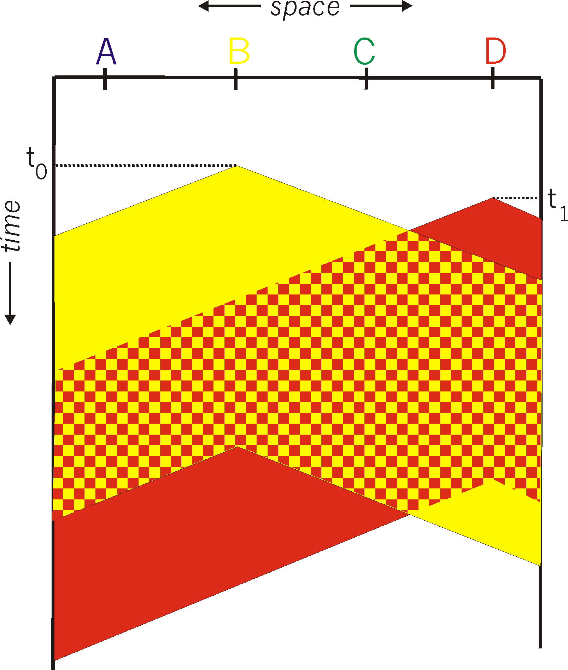
CSMA Collisions
Propagation delay: two nodes may not hear each other’s before sending.
Would slots hurt or help?
CSMA reduces but does not eliminate collisions
Biggest remaining problem?
Collisions still take full slot!
How do you fix that?
Notes:
Ask: who knows? (from knowing ethernet)?
Someone who doesn’t, how to do this?
Listen before sending to detect possible collision
Why not listen to detect current collision!

Slide 50
CSMA/CD (Collision Detection)
CSMA/CD: carrier sensing, deferral as in CSMA
  Collisions detected within short time
  Colliding transmissions aborted, reducing wastage
Collision detection easy in wired LANs:
  Compare transmitted, received signals
Collision detection difficult in wireless LANs:
  Reception shut off while transmitting (well, perhaps not)
  Not perfect broadcast (limited range) so collisions local
  Leads to use of collision avoidance instead
    Will discuss in wireless lecture

Slide 51
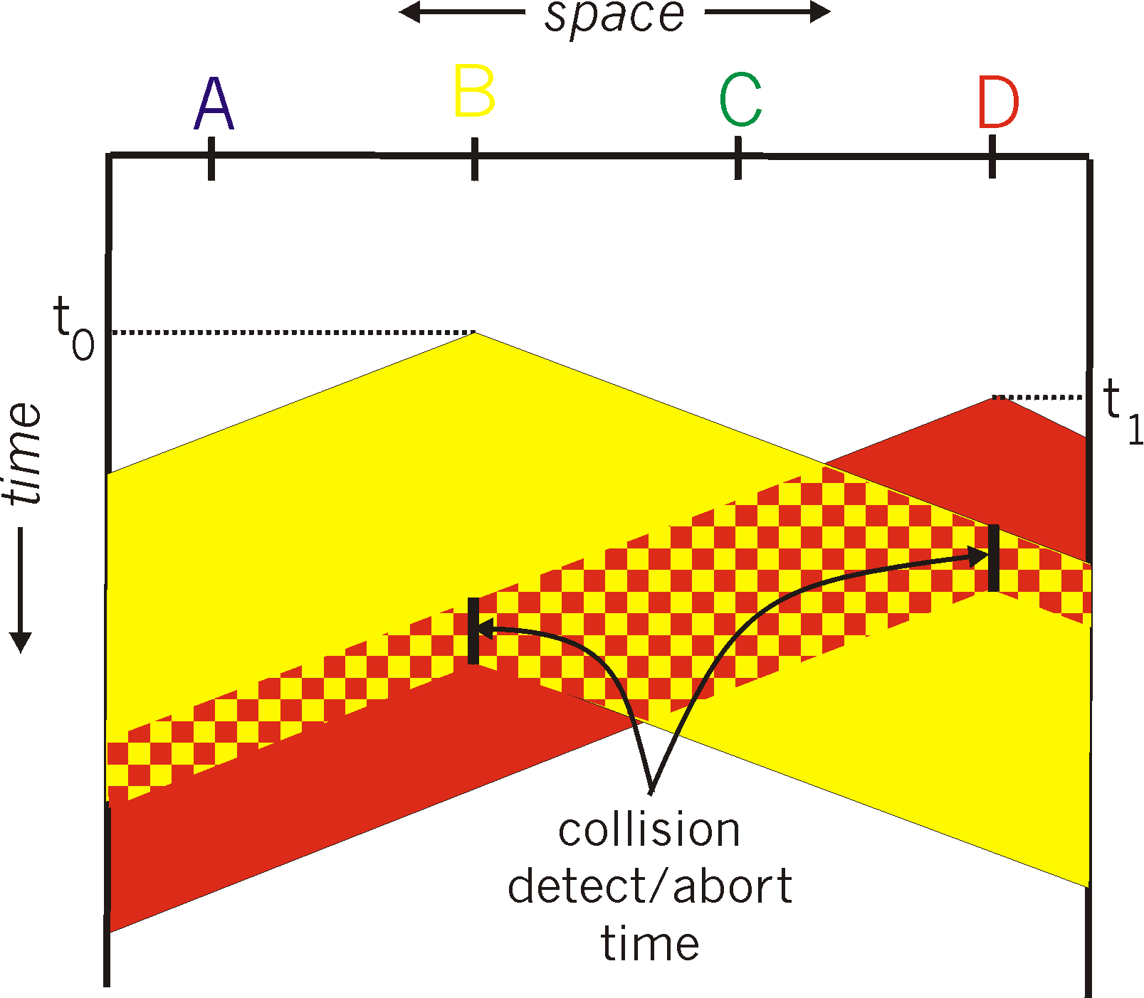
CSMA/CD Collision Detection
B and D can tell that collision occurred.
Note: for this to work, need restrictions on minimum frame size and maximum distance.
Why?
Notes:
Draw failed collision detection….

Slide 52
Limits on CSMA/CD Network Length
A
B
latency d
Latency depends on physical length of link
  Time to propagate a packet from one end to the other
Suppose A sends a packet at time t
  And B sees an idle line at a time just before t+d
  … so B happily starts transmitting a packet
B detects a collision, and sends jamming signal
  But A can’t see collision until t+2d

Slide 53
Limits on CSMA/CD Network Length
A
B
latency d
A needs to wait for time 2d to detect collision
  So, A should keep transmitting during this period
  … and keep an eye out for a possible collision
Imposes restrictions. E.g., for 10 Mbps Ethernet:
  Maximum length of the wire: 2,500 meters
  Minimum length of a frame: 512 bits (64 bytes)
    512 bits = 51.2 μsec (at 10 Mbit/sec)
    For light in vacuum, 51.2 μsec ≈ 15,000 meters
    vs. 5,000 meters “round trip” to wait for collision
  What about 10Gbps Ethernet?
Notes:
10Gbps is switched, doesn’t have this problem!!!

Slide 54

Performance of CSMA/CD
Time wasted in collisions
  Proportional to distance d
Time spend transmitting a packet
  Packet length p divided by bandwidth b
Rough estimate for efficiency (K some constant)
Note:
  For large packets, small distances, E ~ 1
  As bandwidth increases, E decreases
  That is why high-speed LANs are all switched
Notes:
K represents number of collisions per transmission….

Slide 55
Ethernet Multiple Access
First widely deployed multiple access

Slide 56
Benefits of Ethernet
Easy to administer and maintain
Inexpensive
Increasingly higher speed
Evolvable!

Slide 57
Evolution of Ethernet
Changed everything except the frame format
  From single coaxial cable to hub-based star
  From shared media to switches
  From electrical signaling to optical
Lesson #1
  The right interface can accommodate many changes
  Implementation is hidden behind interface
Lesson #2
  Really hard to displace the dominant technology
  Slight performance improvements are not enough

Slide 58
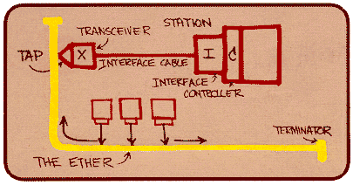
Ethernet: CSMA/CD Protocol
Carrier sense: wait for link to be idle
Collision detection: listen while transmitting
  No collision: transmission is complete
  Collision: abort transmission & send jam signal
Random access: binary exponential back-off
  After collision, wait a random time before trying again
  After m^{th} collision, choose K randomly from {0, …, 2^{m}-1}
  … and wait for K*512 bit times before trying again
    Using min packet size as “slot”
    If transmission occurring when ready to send, wait until end of transmission (CSMA)

Slide 59
Binary Exponential Backoff (BEB)
Think of time as divided in slots
After each collision, pick a slot randomly within next 2^{m} slots
  Where m is the number of collisions since last successful transmission
Questions:
  Why backoff?
  Why random?
  Why 2^{m}?
  Why not listen while waiting?
Notes:
How would listening help?

Slide 60
Behavior of BEB Under Light Load
Look at collisions between two nodes
First collision: pick one of the next two slots
  Chance of success after first collision: 50%
  Average delay 1.5 slots
Second collision: pick one of the next four slots
  Chance of success after second collision: 75%
  Average delay 2.5 slots
In general: after m^{th} collision
  Chance of success: 1-2^{-m}
  Average delay (in slots): ½ + 2^{(m-1)}

Slide 61
BEB: Theory vs Reality
In theory, there is no difference between theory and practice. But, in practice, there is.

Slide 62
BEB Reality
Performs well (far from optimal, but no one cares)
  Large packets are ~23 times as large as minimal slot
Is mostly irrelevant
  Almost all current ethernets are switched

Slide 63
BEB Theory
A very interesting algorithm
Stability for finite N only proved in 1985
  Ethernet can handle nonzero traffic load without collapse
    Greenberg et al. (AT&T)
All backoff algorithms unstable for infinite N (1985)
  Poisson model: infinite user pool, total demand is finite
    David Aldous (UCB Statistics)
Not of practical interest, but gives important insight
  Multiple access should be in your “bag of tricks”
Notes:
e.g., know most important way to spread a rumor…

Slide 64
Question
Two hosts, each with infinite packets to send
What happens under BEB?
Throughput high or low?
Bandwidth shared equally or not?

Slide 65
The BEB Game Show!
Starring two enthusiastic volunteers
Notes:
To answer this

Slide 66
MAC “Channel Capture” in BEB
Finite chance that first one to have a successful transmission will never relinquish the channel
  The other host will never send a packet
Therefore, asymptotically channel is fully utilized and completely allocated to one host

Slide 67
Example
Two hosts, each with infinite packets to send
  Slot 1: collision
  Slot 2: each resends with prob ½
    Assume host A sends, host B does not
  Slot 3: A and B both send (collision)
  Slot 4: A sends with probability ½, B with prob. ¼
    Assume A sends, B does not
  Slot 5: A definitely sends, B sends with prob. ¼
    Assume collision
  Slot 6: A sends with probability ½, B with prob. 1/8
Conclusion: if A gets through first, the prob. of B sending successfully halves with each collision

Slide 68
Another Question
Hosts now have large but finite # packets to send
What happens under BEB?
Throughput high or low?

Slide 69
Answer
Efficiency less than one, no matter how many packets
Time you wait for loser to start is proportional to time winner was sending….

Slide 70
Different Backoff Functions
Exponential: backoff ~ a^{i}
  Channel capture?
  Efficiency?
Superlinear polynomial: backoff ~ i^{p} p>1
  Channel capture?
  Efficiency?
Sublinear polynomial: backoff ~ i^{p} p≤1
  Channel capture?
  Efficiency?

Slide 71
Different Backoff Functions
Exponential: backoff ~ a^{i}
  Channel capture (loser might not send until winner idle)
  Efficiency less than 1 (time wasted waiting for loser to start)
Superlinear polynomial: backoff ~ i^{p} p>1
  Channel capture
  Efficiency is 1 (for any finite # of hosts N)
Sublinear polynomial: backoff ~ i^{p} p≤1
  No channel capture (loser not shut out)
  Efficiency is less than 1 (and goes to zero for large N)
    Time wasted resolving collisions

Slide 72
Why Do I Care?
Why do you like music?
It makes me happy….
But also, until this work was done, no one knew about capture, or what properties of the backoff enabled it.
You don’t understand something until you’ve played with it. Just getting it to work isn’t enough.
Notes:
E.g., knowing how to spread rumor

Slide 73
That’s All for Today!
Next week, congestion control

