Slide 1

Congestion Control
EE122 Fall 2012
Scott Shenker
http://inst.eecs.berkeley.edu/~ee122/
Materials with thanks to Jennifer Rexford, Ion Stoica, Vern Paxson
and other colleagues at Princeton and UC Berkeley
Notes:
No office hours on Thursday, come see me on Wednesday…..

Slide 2
Announcements
Project 3 is out!

Slide 3
A few words from Panda….

Slide 4
Congestion Control Review
Did not have slides last time
Going to review key points

Slide 5
Caveat: In this lecture
Sometimes CWND is in units of MSS’s
  Because I want to count CWND in small integers
  This is only for pedagogical purposes
Sometimes CWND is in bytes
  Because we actually are keeping track of real windows
  This is how TCP code works
Figure it out from context….

Slide 6
Load and Delay
Typical queuing system with bursty arrivals
Average
Packet delay
Average
Packet loss
Load
Load
Must balance utilization versus delay and loss

Slide 7
Not All Losses the Same
Duplicate ACKs: isolated loss
  Still getting ACKs
Timeout: possible disaster
  Not enough dupacks
  Must have suffered several losses

Slide 8
AIMD
Additive increase
  On success of last window of data, increase by one MSS
Multiplicative decrease
  On loss of packet, divide congestion window in half

Slide 9
Leads to the TCP “Sawtooth”
Window
Loss
halved
t
Notes:
Picture not realistic!!

Slide 10
Simple geometric analysis
cwnd
Timeouts
A
1
t
RTT

Slide 11
AIMD Starts Too Slowly!
Need to start with a small CWND to avoid overloading the network.
Window
It could take a long time to get started!
t

Slide 12
“Slow-Start” Phase
Start with a small congestion window
  Initially, CWND is 1 MSS
  So, initial sending rate is MSS/RTT
But want to increase quickly
  Rather than just use additive increase….
  ..we enter “slow-start” phase (actually “fast start”)
Sender starts at a slow rate (hence the name)
  but increases exponentially until first loss

Slide 13
Slow Start in Action
Double CWND per round-trip time
Simple implementation:
on each ack, CWND += MSS
1
2
3
4
8
Src
D
A
D
D
A
A
D
D
D
D
A
A
A
A
Dest

Slide 14
Slow Start and the TCP Sawtooth
Window
Loss
Exponential
“slow start”
t
Why is it called slow-start? Because TCP originally had
no congestion control mechanism. The source would just
start by sending a whole window’s worth of data.

Slide 15
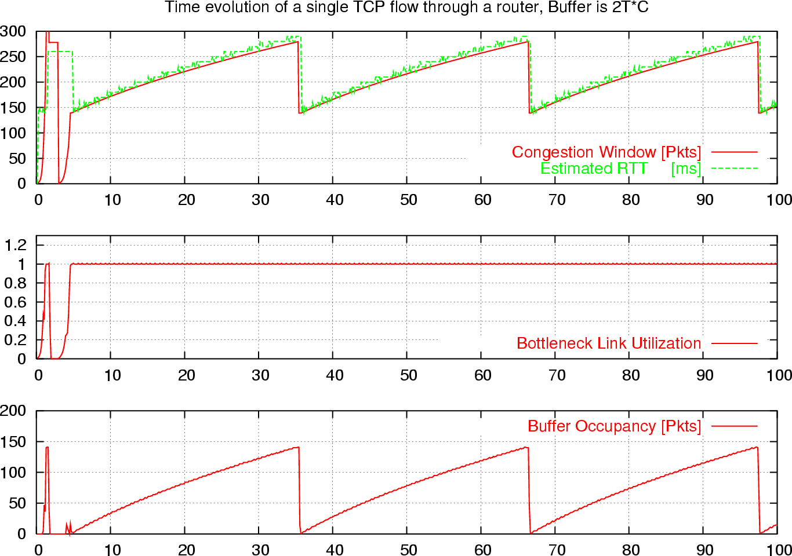
What is really looks like…

Slide 16
Congestion Control Details

Slide 17
Increasing CWND
Increase by MSS for every successful window
Increase a fraction of MSS per received ACK
# packets (thus ACKs) per window: CWND / MSS
Increment per ACK:
CWND += MSS / (CWND / MSS)
Termed: Congestion Avoidance
  Very gentle increase

Slide 18
Fast Retransmission
Sender sees 3 dupACKs
Multiplicative decrease: CWND halved

Slide 19
CWND with Fast Retransmit
cwnd = 1
segment 1
ACK 2
cwnd = 2
segment 2
segment 3
cwnd = 3
ACK 3
ACK 4
cwnd = 4
segment 4
segment 5
segment 6
ACK 4
segment 7
3 duplicate
ACKs
ACK 4
ACK 4
segment 4
cwnd = 2

Slide 20
Loss Detected by Timeout
Sender starts a timer that runs for RTO seconds
Restart timer whenever ack for new data arrives
If timer expires:
  Set SSTHRESH ← CWND / 2 (“Slow-Start Threshold”)
  Set CWND ← MSS
  Retransmit first lost packet
  Execute Slow Start until CWND > SSTHRESH
  After which switch to Additive Increase

Slide 21
Summary of Decrease
Cut CWND half on loss detected by dupacks
  “fast retransmit”
Cut CWND all the way to 1 MSS on timeout
  Set ssthresh to cwnd/2
Never drop CWND below 1 MSS

Slide 22
Summary of Increase
“Slow-start”: increase cwnd by MSS for each ack
Leave slow-start regime when either:
  cwnd > SSThresh
  Packet drop
Enter AIMD regime
  Increase by MSS for each window’s worth of acked data

Slide 23
Repeating Slow Start After Timeout
Window
Timeout
SSThresh
Set to Here
Fast Retransmission
Slow start in operation until it reaches half of previous CWND, I.e., SSTHRESH
t
Slow-start restart: Go back to CWND of 1 MSS, but take advantage of knowing the previous value of CWND.

Slide 24
More Advanced Fast Restart
Set ssthresh to cwnd/2
Set cwnd to cwnd/2 + 3
  for the 3 dup acks already seen
Increment cwnd by 1 MSS for each additional duplicate ACK
After receiving new ACK, reset cwnd to ssthresh

Slide 25
Example
Consider a TCP connection with:
  MSS=10bytes
  ISN=100
  CWND=100 bytes
  Last ACK was for seq # 110
    i.e., receiver expecting next packet to have seq. no. 110
Packets with seq. no. 110 to 200 are in flight
  What ACKs do they generate?
  And how does the sender respond?

Slide 26
History
ACK 110 (due to 120) cwnd=100 dup#1
ACK 110 (due to 130) cwnd=100 dup#2
ACK 110 (due to 140) cwnd=100 dup#3
RXMT 110 ssthresh=50 cwnd=80
ACK 110 (due to 150) cwnd=90
ACK 110 (due to 160) cwnd=100
ACK 110 (due to 170) cwnd=110 xmit 210
ACK 110 (due to 180) cwnd=120 xmit 220

Slide 27
History (cont’d)
ACK 110 (due to 190) cwnd=130 xmit 230
ACK 110 (due to 200) cwnd=140 xmit 240
ACK 210 (due to 110 rxmit) cwnd=ssthresh=50 xmit 250
ACK 220 (due to 210) cwnd=60
…..

Slide 28
Why AIMD?

Slide 29
Four alternatives
AIAD: gentle increase, gentle decrease
AIMD: gentle increase, drastic decrease
MIAD: drastic increase, gentle decrease
  too many losses: eliminate
MIMD: drastic increase and decrease
Notes:
What do you think about these options?
Which one is obviously bad?
What do you think about the other ones?

Slide 30
AIMD Sharing Dynamics
x₁
A
B
x₂
D
E
No congestion → rate increases by one packet/RTT every RTT
Congestion → decrease rate by factor 2
Rates equalize → fair share

Slide 31
AIAD Sharing Dynamics
x₁
A
B
x₂
D
E
No congestion → x increases by one packet/RTT every RTT
Congestion → decrease x by 1

Slide 32
Other Congestion Control Topics

Slide 33
TCP fills up queues
Means that delays are large for everyone
And when you do fill up queues, many packets have to be dropped (not really)
Alternative: Random Early Drop (LBL)
  Drop packets on purpose before queue is full
  Set drop probability D as a function of queue size
  Keep queue average small, but tolerate bursts

Slide 34
What if loss isn’t congestion-related?
Can use Explicit Congestion Notification (ECN)
Bit in IP packet header, that is carried up to TCP
When RED router would drop, it sets bit instead
  Congestion semantics of bit exactly like that of drop
Advantages:
  Don’t confuse corruption with congestion
  Don’t confuse recovery with rate adjustment

Slide 35
How does this work at high speed?
Throughput = (MSS/RTT) sqrt(3/2p)
  Assume that RTT = 100ms, MSS=1500bytes
What value of p is required to go 100Gbps?
  Roughly 2 x 10⁻¹²
How long between drops?
  Roughly 16.6 hours
How much data has been sent in this time?
  Roughly 6 petabits
These are not practical numbers!

Slide 36
Adapting TCP to High Speed
One approach: once speed is past some threshold, change equation to p^{-.8} rather than p^{-.5}
  Let the additive constant in AIMD depend on CWND
  At very high speeds, increase CWND by more than MSS
We will discuss other approaches next later…

Slide 37
How “Fair” is TCP?
Throughput depends inversely on RTT
If open K TCP flows, get K times more bandwidth!
What is fair, anyway?

Slide 38
What happens if hosts “cheat”?
Can get more bandwidth by being more aggressive
  Source can set CWND =+ 2MSS upon success
  Gets much more bandwidth (see forthcoming HW4)
Currently we require all congestion-control protocols to be “TCP-Friendly”
  To use no more than TCP does in similar setting
But Internet remains vulnerable to non-friendly implementations
  Need router support to deal with this…

Slide 39
Router-Assisted Congestion Control
There are two different tasks:
  Isolation/fairness
  Adjustment
Isolation/fairness:
  We would like to make sure each flow gets its “fair share”
  This protects flows from cheaters
    Safety/Security issue
  No longer requires everyone use same CC algorithm
    Innovation issue
Adjustment:
  Can routers help flows find the right sending rate?

Slide 40
Isolation: Intuition
Treat each “flow” separately
  For now, flows are packets between same Source/Dest.
Each flow has its own FIFO queue in router
Service flows in a round-robin fashion
  When line becomes free, take packet from next flow
Assuming all flows are sending MTU packets, all flows can get their fair share
  But what if not all are sending at full rate?
  And some are sending at more than their share?

Slide 41
Max-Min Fairness
Given set of bandwidth demands r_{i} and total bandwidth C, max-min bandwidth allocations are:
a_{i} = min(f, r_{i})
where f is the unique value such that Sum(a_{i}) = C
This is what round-robin service gives
  if all packets are MTUs
Property:
  If you don’t get full demand, no one gets more than you

Slide 42
Example
C = 10; r₁ = 8, r₂ = 6, r₃ = 2; N = 3
C/3 = 3.33 →
  Can service all of r₃
  Remove r₃ from the accounting: C = C – r₃ = 8; N = 2
C/2 = 4 →
  Can’t service all of r₁ or r₂
  So hold them to the remaining fair share: f = 4
8
f = 4:
min(8, 4) = 4
min(6, 4) = 4
min(2, 4) = 2
10
4
6
4
2
2

Slide 43
Fair Queuing (FQ)
Implementation of round-robin generalized to case where not all packets are MTUs
Weighted fair queueing (WFQ) lets you assign different flows different shares
WFQ is implemented in almost all routers
  Variations in how implemented
    Packet scheduling (here)
    Just packet dropping (AFD)

Slide 44
With FQ Routers
Flows can pick whatever CC scheme they want
  Can open up as many TCP connections as they want
There is no such thing as a “cheater”
  To first order…
Bandwidth share does not depend on RTT
Does require complication on router
  Cheating not a problem, so there’s little motivation
  But WFQ is used at larger granularities

Slide 45
FQ is really “processor sharing”
Every current flow gets same service
When flows end, other flows pick up extra service
FQ realizes these rates through packet scheduling
But we could just assign them directly
  This is the Rate-Control Protocol (RCP) [Stanford]
    Follow on to XCP (MIT/ICSI)

Slide 46
RCP Algorithm
Packets carry “rate field”
Routers insert “fair share” f in packet header
  Router inserts FS only if it is smaller than current value
Routers calculate f by keeping link fully utilized
  Remember basic equation: Sum(Min[f,r_{i}]) = C

Slide 47
Fair Sharing is more than a moral issue
By what metric should we evaluate CC?
One metric: average flow completion time (FCT)
Let’s compare FCT with RCP and TCP
  Ignore XCP curve….

Slide 48
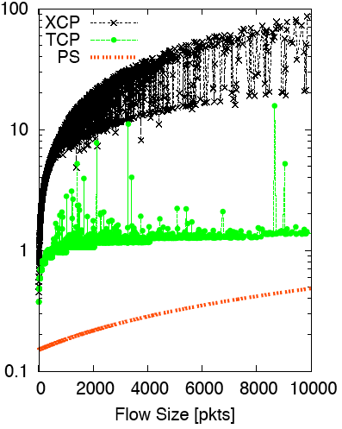
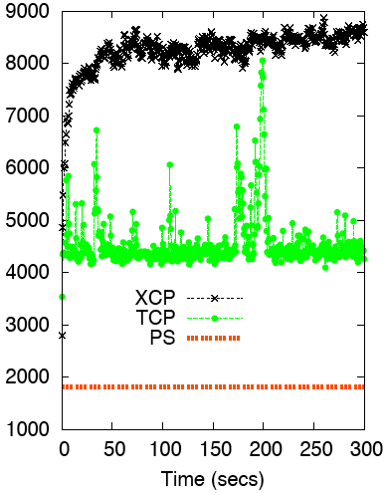
Flow Completion Time: TCP vs. PS (and XCP)
Flow Duration (secs) vs. Flow Size
# Active Flows vs. time

Slide 49
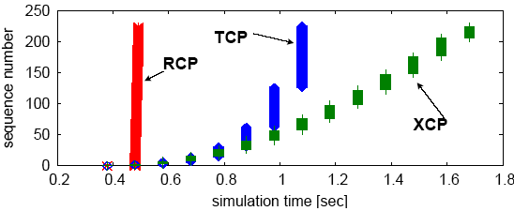
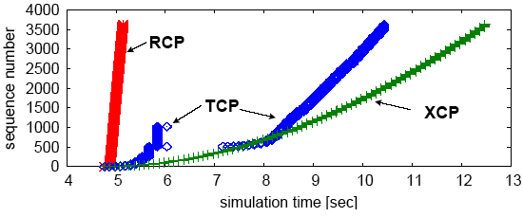
Why the improvement?

Slide 50
Why is Scott a Moron?
Or why does Bob Briscoe think so?

Slide 51
Giving equal shares to “flows” is silly
What if you have 8 flows, and I have 4?
  Why should you get twice the bandwidth
What if your flow goes over 4 congested hops, and mine only goes over 1?
  Why shouldn’t you be penalized for using more scarce bandwidth?
And what is a flow anyway?
  TCP connection
  Source-Destination pair?
  Source?

Slide 52
Charge people for congestion!
Use ECN as congestion markers
Whenever I get ECN bit set, I have to pay $$$
Now, there’s no debate over what a flow is, or what fair is…
Idea started by Frank Kelly, backed by much math
  Great idea: simple, elegant, effective
  Never going to happen…

Slide 53
Datacenter Networks

Slide 54
What makes them special?
Huge scale:
  100,000s of servers in one location
Limited geographic scope:
  High bandwidth
  Very low RTT
Extreme latency requirements
  With real money on the line
Single administrative domain
  No need to follow standards, or play nice with others
Often “green field” deployment
  So can “start from scratch”…

Slide 55
Deconstructing Datacenter Packet Transport
Mohammad Alizadeh, Shuang Yang, Sachin Katti,
Nick McKeown, Balaji Prabhakar, Scott Shenker
Stanford University U.C. Berkeley/ICSI

Slide 56
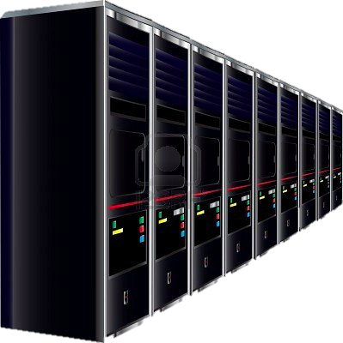







Transport in Datacenters
Who does she know?
Large-scale Web Application
Latency is King
  Web app response time depends on completion of 100s of small RPCs
But, traffic also diverse
  Mice AND Elephants
  Often, elephants are the root cause of latency
What has she done?
App
Logic
App
Logic
App
Logic
App
Logic
App
Logic
App
Logic
App
Logic
App
Logic
App
Logic
App
Logic
Alice
App Tier
Fabric
Data Tier
Eric
Minnie
Pics
Apps
Videos

Slide 57
Transport in Datacenters
Two fundamental requirements
  High fabric utilization
    Good for all traffic, esp. the large flows
  Low fabric latency (propagation + switching)
    Critical for latency-sensitive traffic
Active area of research
  DCTCP[SIGCOMM’10], D3[SIGCOMM’11]
  HULL[NSDI’11], D²TCP[SIGCOMM’12]
  PDQ[SIGCOMM’12], DeTail[SIGCOMM’12]
vastly improve performance,
but fairly complex

Slide 58
pFabric in 1 Slide
Packets carry a single priority #
e.g., prio = remaining flow size
pFabric Switches
Very small buffers (e.g., 10-20KB)
Send highest priority / drop lowest priority pkts
pFabric Hosts
Send/retransmit aggressively
Minimal rate control: just prevent congestion collapse

Slide 59

DC Fabric: Just a Giant Switch!
H1
H2
H3
H4
H5
H6
H7
H8
H9

Slide 60
DC Fabric: Just a Giant Switch!
H1
H2
H3
H4
H5
H6
H7
H8
H9

Slide 61
DC Fabric: Just a Giant Switch!
H1
H1
H1
H2
H2
H2
H3
H3
H3
H4
H4
H4
H5
H5
H5
H6
H6
H6
H7
H7
H7
H8
H8
H8
H9
TX
H9
H9
RX

Slide 62
DC Fabric: Just a Giant Switch!
H1
H1
H2
H2
H3
H3
H4
H4
H5
H5
H6
H6
H7
H7
H8
H8
TX
H9
H9
RX

Slide 63
DC transport = Flow scheduling on giant switch
Objective?
Minimize avg FCT
H1
H1
H2
H2
H3
H3
H4
H4
H5
H5
H6
H6
H7
H7
H8
H8
TX
H9
H9
RX
ingress & egress
capacity constraints

Slide 64
“Ideal” Flow Scheduling
Problem is NP-hard ☹ [Bar-Noy et al.]
  Simple greedy algorithm: 2-approximation
1
1
2
2
3
3

Slide 65
pFabric Design

Slide 66
pFabric Switch
Priority Scheduling send higher priority packets first
Priority Dropping drop low priority packets first
5
9
3
4
Switch Port
2
3
6
7
1
small “bag” of packets per-port
prio = remaining flow size

Slide 67
Near-Zero Buffers
Buffers are very small (~1 BDP)
  e.g., C=10Gbps, RTT=15µs → BDP = 18.75KB
  Today’s switch buffers are 10-30x larger
  Priority Scheduling/Dropping Complexity
  Worst-case: Minimum size packets (64B)
  51.2ns to find min/max of ~300 numbers
  Binary tree implementation takes 9 clock cycles
  Current ASICs: clock = 1-2ns

Slide 68

pFabric Rate Control
Priority scheduling & dropping in fabric also simplifies rate control
  Queue backlog doesn’t matter
One task:
Prevent congestion collapse when elephants collide
50% Loss
H1
H2
H3
H4
H5
H6
H7
H8
H9

Slide 69
pFabric Rate Control
Minimal version of TCP
  Start at line-rate
    Initial window larger than BDP
  No retransmission timeout estimation
    Fix RTO near round-trip time
  No fast retransmission on 3-dupacks
    Allow packet reordering

Slide 70
Why does this work?
Key observation:
Need the highest priority packet destined for a port available at the port at any given time.
Priority scheduling
  High priority packets traverse fabric as quickly as possible
What about dropped packets?
  Lowest priority → not needed till all other packets depart
  Buffer larger than BDP → more than RTT to retransmit

Slide 71
Evaluation
54 port fat-tree: 10Gbps links, RTT = ~12µs
Realistic traffic workloads
  Web search, Data mining
* From Alizadeh et al.
[SIGCOMM 2010]
<100KB
>10MB
55% of flows
3% of bytes
5% of flows
35% of bytes

Slide 72
Evaluation: Mice FCT
(<100KB)
Average
99th Percentile
Near-ideal: almost no jitter

Slide 73
Evaluation: Elephant FCT
(>10MB)
Congestion collapse
at high load w/o rate control

Slide 74
Summary
pFabric’s entire design:
Near-ideal flow scheduling across DC fabric
Switches
  Locally schedule & drop based on priority
Hosts
  Aggressively send & retransmit
  Minimal rate control to avoid congestion collapse

