Slide 1

Advanced Topics in
Congestion Control
EE122 Fall 2012
Scott Shenker
http://inst.eecs.berkeley.edu/~ee122/
Materials with thanks to Jennifer Rexford, Ion Stoica, Vern Paxson
and other colleagues at Princeton and UC Berkeley

Slide 2
New Lecture Schedule
T 11/6: Advanced Congestion Control
Th 11/8: Wireless (Yahel Ben-David)
T 11/13: Misc. Topics (w/Colin)
  Security, Multicast, QoS, P2P, etc.
Th 11/15: Misc. + Network Management
T 11/20: SDN
Th 11/22: Holiday!
T 11/27: Alternate Architectures
Th 11/29: Summing Up (Final Lecture)

Slide 3
Office Hours This Week
After lecture today
Thursday 3:00-4:00pm

Slide 4
Announcements
Participation emails:
  If you didn’t get one, please email Thurston.
128 students still haven’t participated yet
  Only seven lectures left
  You do the math.

Slide 5
Project 3: Ask Panda

Slide 6
Some Odds and Ends about
Congestion Control

Slide 7
Clarification about TCP “Modes”
Slow-start mode:
  CWND =+ MSS on every ACK
  [use at beginning, and after time-out]
Congestion avoidance mode:
  CWND =+ MSS/(CWND/MSS) on every ACK
  [use after CWND>SSTHRESH in slow-start]
  [and after fast retransmit]
Fast restart mode [after fast retransmit]
  CWND =+ MSS on every dupACK until hole is filled
  Then revert back to congestion avoidance mode

Slide 8
Delayed Acknowledgments (FYI)
Receiver generally delays sending an ACK
  Upon receiving a packet, sets a timer
    Typically, 200 msec; at most, 500 msec
  If application generates data, go ahead and send
    And piggyback the acknowledgment
  If the timer expires, send a (non-piggybacked) ACK
  If out-of-order segment arrives, immediately ack
  (if available window changes, send an ACK)
Limiting the wait
  Receiver supposed to ACK at least every second full-sized packet (“ack every other”)
    This is the usual case for “streaming” transfers

Slide 9
Performance Effects of Acking Policies
How do delayed ACKs affect performance?
  Increases RTT
  Window slides a bit later ⇒ throughput a bit lower
How does ack-every-other affect performance?
  If sender adjusts CWND on incoming ACKs, then CWND opens more slowly
    In slow start, 50% increase/RTT rather than 100%
    In congestion avoidance, +1 MSS / 2 RTT, not +1 MSS / RTT
What does this suggest about how a receiver might cheat and speed up a transfer?

Slide 10
ACK-splitting
Sender
Receiver
Round-
Trip
Time
(RTT)
Data 1:1461
Rule: grow window by one
full-sized packet for each
valid ACK received
Send M (distinct) ACKs for one packet
Growth factor proportional
to M
What’s the fix?
ACK 486
ACK 973
ACK 1461
Data 1461:2921
Data 2921:4381
Data 4381:5841
Data 5841:7301

Slide 11
10 line change to Linux TCP
(Courtesy of
Stefan Savage)

Slide 12
Problems with Current Approach to Congestion Control

Slide 13
Goal of Today’s Lecture
AIMD TCP is the conventional wisdom
But we know how to do much better
Today we discuss some of those approaches…

Slide 14
Problems with Current Approach?
Take five minutes….

Slide 15
TCP fills up queues
Means that delays are large for everyone
And when you do fill up queues, many packets have to be dropped
  Not always, but it does tend to increase packet drops
Alternative: Random Early Drop (LBL)
  Drop packets on purpose before queue is full

Slide 16
Random Early Drop (or Detection)
Measure average queue size A with exp. weighting
  Allows short bursts of packets without over-reacting
Drop probability is a function of A
  No drops if A is very small
  Low drop rate for moderate A’s
  Drop everything if A is too big

Slide 17
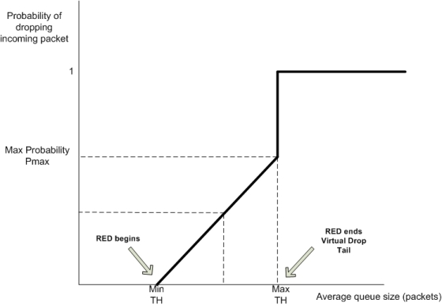
RED Dropping Probability

Slide 18
Advantages of RED
Keeps queues smaller, while allowing bursts
  Just using small buffers in routers can’t do the latter
Reduces synchronization between flows
  Not all flows are dropping packets at once

Slide 19
What if loss isn’t congestion-related?
Can use Explicit Congestion Notification (ECN)
Bit in IP packet header (actually two)
  TCP receiver returns this bit in ACK
When RED router would drop, it sets bit instead
  Congestion semantics of bit exactly like that of drop
Advantages:
  Doesn’t confuse corruption with congestion
  Doesn’t confuse recovery with rate adjustment

Slide 20
How does AIMD work at high speed?
Throughput = (MSS/RTT) sqrt(3/2p)
  Assume that RTT = 100ms, MSS=1500bytes
What value of p is required to go 100Gbps?
  Roughly 2 x 10⁻¹²
How long between drops?
  Roughly 16.6 hours
How much data has been sent in this time?
  Roughly 6 petabits
These are not practical numbers!

Slide 21
Adapting TCP to High Speed
One approach:
  Let AIMD constants depend on CWND
At very high speeds,
  Increase CWND by more than MSS in a RTT
  Decrease CWND by less than ½ after a loss
We will discuss other approaches later…

Slide 22
High-Speed TCP Proposal
Bandwidth | Avg Cwnd w (pkts) | Increase a(w) | Decrease b(w)
1.5 Mbps | 12.5 | 1 | 0.50
10 Mbps | 83 | 1 | 0.50
100 Mbps | 833 | 6 | 0.35
1 Gbps | 8333 | 26 | 0.22
10 Gbps | 83333 | 70 | 0.10

Slide 23
This changes the TCP Equation
Throughput ~ p^{-.8} (rather than p^{-.5})
Whole point of design: to achieve a high throughput, don’t need such a tiny drop rate….

Slide 24
How “Fair” is TCP?
Throughput depends inversely on RTT
If open K TCP flows, get K times more bandwidth!
What is fair, anyway?

Slide 25
What happens if hosts “cheat”?
Can get more bandwidth by being more aggressive
  Source can set CWND =+ 2MSS upon success
  Gets much more bandwidth (see forthcoming HW4)
Currently we require all congestion-control protocols to be “TCP-Friendly”
  To use no more than TCP does in similar setting
But Internet remains vulnerable to non-friendly implementations
  Need router support to deal with this…

Slide 26
Router-Assisted Congestion Control
There are two different tasks:
  Isolation/fairness
  Adjustment

Slide 27
Adjustment
Can routers help flows reach right speed faster?
  Can we avoid this endless searching for the right rate?
Yes, but we won’t get to this for a few slides….

Slide 28
Isolation/fairness
Want each flow gets its “fair share”
  No matter what other flows are doing
This protects flows from cheaters
  Safety/Security issue
Does not require everyone use same CC algorithm
  Innovation issue

Slide 29
Isolation: Intuition
Treat each “flow” separately
  For now, flows are packets between same Source/Dest.
Each flow has its own FIFO queue in router
Service flows in a round-robin fashion
  When line becomes free, take packet from next flow
Assuming all flows are sending MTU packets, all flows can get their fair share
  But what if not all are sending at full rate?
  And some are sending at more than their share?

Slide 30
Max-Min Fairness
Given set of bandwidth demands r_{i} and total bandwidth C, max-min bandwidth allocations are:
a_{i} = min(f, r_{i})
where f is the unique value such that Sum(a_{i}) = C
This is what round-robin service gives
  if all packets are MTUs
Property:
  If you don’t get full demand, no one gets more than you
  Use it or lose it: you don’t get credit for not using link

Slide 31
Example
Assume link speed C is 10mbps
Have three flows:
  Flow 1 is sending at a rate 8mbps
  Flow 2 is sending at a rate 6mbps
  Flow 3 is sending at a rate 2mbps
How much bandwidth should each get?
  According to max-min fairness?

Slide 32
Example
C = 10; r₁ = 8, r₂ = 6, r₃ = 2; N = 3
C/3 = 3.33 →
  Can service all of r₃
  Remove r₃ from the accounting: C = C – r₃ = 8; N = 2
C/2 = 4 →
  Can’t service all of r₁ or r₂
  So hold them to the remaining fair share: f = 4
8
f = 4:
min(8, 4) = 4
min(6, 4) = 4
min(2, 4) = 2
10
4
6
4
2
2

Slide 33
Fair Queuing (FQ)
Implementation of round-robin generalized to case where not all packets are MTUs
Weighted fair queueing (WFQ) lets you assign different flows different shares
WFQ is implemented in almost all routers
  Variations in how implemented
    Packet scheduling (here)
    Just packet dropping (AFD)

Slide 34
Enforcing fairness through dropping
Drop rate for flow i should be d_{i} = (1 − r_{fair}/r_{i})₊
Resulting rate for flow is r_{i}(1-d_{i})=MIN[r_{i},r_{fair}]
Estimate r_{i} with “shadow buffer” of recent packets
  Estimate is terrible for small r_{i}, but d_{i} = 0 for those
  Estimate is decent for large r_{i}, and that’s all that matters!
Implemented on much of Cisco’s product line
  Approximate Fair Dropping (AFD)

Slide 35
With Fair Queueing or AFD Routers
Flows can pick whatever CC scheme they want
  Can open up as many TCP connections as they want
There is no such thing as a “cheater”
  To first order…
Bandwidth share does not depend on RTT
Does require some complication on router
  But certainly within reason

Slide 36
FQ is really “processor sharing”
PS is really just round-robin at bit level
  Every current flow with packets gets same service rate
When flows end, other flows pick up extra service
FQ realizes these rates through packet scheduling
  AFD through packet dropping
But we could just assign them directly
  This is the Rate-Control Protocol (RCP) [Stanford]
    Follow on to XCP (MIT/ICSI)

Slide 37
RCP Algorithm
Packets carry “rate field”
Routers insert “fair share” f in packet header
  Router inserts FS only if it is smaller than current value
Routers calculate f by keeping link fully utilized
  Remember basic equation: Sum(Min[f,r_{i}]) = C

Slide 38
Fair Sharing is more than a moral issue
By what metric should we evaluate CC?
One metric: average flow completion time (FCT)
Let’s compare FCT with RCP and TCP
  Ignore XCP curve….

Slide 39
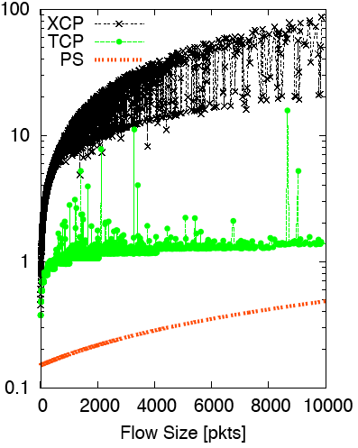
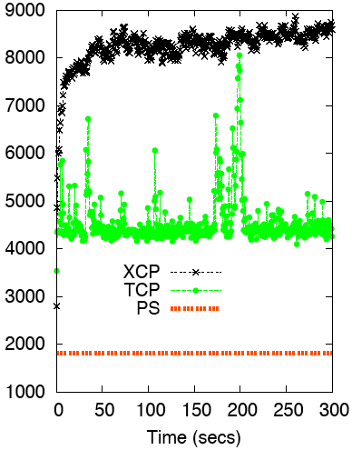
Flow Completion Time: TCP vs. PS (and XCP)
Flow Duration (secs) vs. Flow Size
# Active Flows vs. time

Slide 40
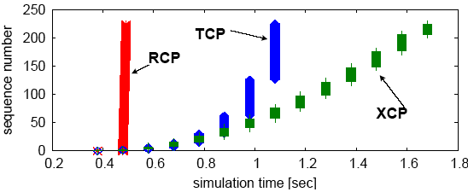
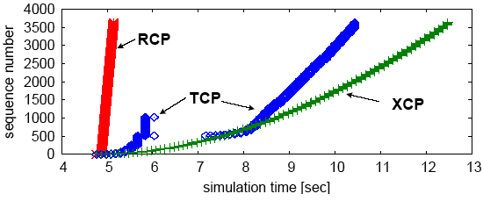
Why the improvement?

Slide 41
RCP (and similar schemes)
They address the “adjustment” question
Help flows get up to full rate in a few RTTs
Fairness is merely a byproduct of this approach
  One could have assigned different rates to flows

Slide 42
Summary of Router Assisted CC
Adjustment: helps get flows up to speed
  Huge improvement in FTC performance
Isolation: helps protect flows from cheaters
  And allows innovation in CC algorithms
FQ/AFD impose “max-min fairness”
  On each link, each flow has right to fair share

Slide 43
Why is Scott a Moron?
Or why does Bob Briscoe think so?

Slide 44
Giving equal shares to “flows” is silly
What if you have 8 flows, and I have 4…
  Why should you get twice the bandwidth?
What if your flow goes over 4 congested hops, and mine only goes over 1?
  Why not penalize for using more scarce bandwidth?
And what is a flow anyway?
  TCP connection
  Source-Destination pair?
  Source?

Slide 45
flow rate fairness dismantling a religion
<draft-briscoe-tsvarea-fair-01.pdf>
status: individual draft
final intent: informational
intent next: tsvwg WG item after (or at) next draft
Bob Briscoe
Chief Researcher, BT Group
IETF-68 tsvwg Mar 2007

Slide 46
Charge people for congestion!
Use ECN as congestion markers
Whenever I get ECN bit set, I have to pay $$$
No debate over what a flow is, or what fair is…
Idea started by Frank Kelly, backed by much math
  Great idea: simple, elegant, effective
  Never going to happen…

Slide 47
Datacenter Networks

Slide 48
What makes them special?
Huge scale:
  100,000s of servers in one location
Limited geographic scope:
  High bandwidth (10Gbps)
  Very low RTT
Extreme latency requirements
  With real money on the line
Single administrative domain
  No need to follow standards, or play nice with others
Often “green field” deployment
  So can “start from scratch”…

Slide 49
Deconstructing Datacenter Packet Transport
Mohammad Alizadeh, Shuang Yang, Sachin Katti,
Nick McKeown, Balaji Prabhakar, Scott Shenker
Stanford University U.C. Berkeley/ICSI

Slide 50








Transport in Datacenters
Who does she know?
Large-scale Web Application
Latency is King
  Web app response time depends on completion of 100s of small RPCs
But, traffic also diverse
  Mice AND Elephants
  Often, elephants are the root cause of latency
What has she done?
App
Logic
App
Logic
App
Logic
App
Logic
App
Logic
App
Logic
App
Logic
App
Logic
App
Logic
App
Logic
Alice
App Tier
Fabric
Data Tier
Eric
Minnie
Pics
Apps
Videos

Slide 51
Transport in Datacenters
Two fundamental requirements
  High fabric utilization
    Good for all traffic, esp. the large flows
  Low fabric latency (propagation + switching)
    Critical for latency-sensitive traffic
Active area of research
  DCTCP[SIGCOMM’10], D3[SIGCOMM’11]
  HULL[NSDI’11], D²TCP[SIGCOMM’12]
  PDQ[SIGCOMM’12], DeTail[SIGCOMM’12]
vastly improve performance,
but fairly complex

Slide 52
pFabric in 1 Slide
Packets carry a single priority #
e.g., prio = remaining flow size
pFabric Switches
Very small buffers (e.g., 10-20KB)
Send highest priority / drop lowest priority pkts
pFabric Hosts
Send/retransmit aggressively
Minimal rate control: just prevent congestion collapse

Slide 53

DC Fabric: Just a Giant Switch!
H1
H2
H3
H4
H5
H6
H7
H8
H9

Slide 54
DC Fabric: Just a Giant Switch!
H1
H2
H3
H4
H5
H6
H7
H8
H9

Slide 55
DC Fabric: Just a Giant Switch!
H1
H1
H1
H2
H2
H2
H3
H3
H3
H4
H4
H4
H5
H5
H5
H6
H6
H6
H7
H7
H7
H8
H8
H8
H9
TX
H9
H9
RX

Slide 56
DC Fabric: Just a Giant Switch!
H1
H1
H2
H2
H3
H3
H4
H4
H5
H5
H6
H6
H7
H7
H8
H8
TX
H9
H9
RX

Slide 57
DC transport = Flow scheduling on giant switch
Objective?
Minimize avg FCT
H1
H1
H2
H2
H3
H3
H4
H4
H5
H5
H6
H6
H7
H7
H8
H8
TX
H9
H9
RX
ingress & egress
capacity constraints

Slide 58
“Ideal” Flow Scheduling
Problem is NP-hard ☹ [Bar-Noy et al.]
  Simple greedy algorithm: 2-approximation
1
1
2
2
3
3

Slide 59
pFabric Design

Slide 60
pFabric Switch
Priority Scheduling send higher priority packets first
Priority Dropping drop low priority packets first
5
9
3
4
Switch Port
2
3
6
7
1
small “bag” of packets per-port
prio = remaining flow size

Slide 61
Near-Zero Buffers
Buffers are very small (~1 BDP)
  e.g., C=10Gbps, RTT=15µs → BDP = 18.75KB
  Today’s switch buffers are 10-30x larger
  Priority Scheduling/Dropping Complexity
  Worst-case: Minimum size packets (64B)
  51.2ns to find min/max of ~300 numbers
  Binary tree implementation takes 9 clock cycles
  Current ASICs: clock = 1-2ns

Slide 62

pFabric Rate Control
Priority scheduling & dropping in fabric also simplifies rate control
  Queue backlog doesn’t matter
One task:
Prevent congestion collapse when elephants collide
50% Loss
H1
H2
H3
H4
H5
H6
H7
H8
H9

Slide 63
pFabric Rate Control
Minimal version of TCP
  Start at line-rate
    Initial window larger than BDP
  No retransmission timeout estimation
    Fix RTO near round-trip time
  No fast retransmission on 3-dupacks
    Allow packet reordering

Slide 64
Why does this work?
Key observation:
Need the highest priority packet destined for a port available at the port at any given time.
Priority scheduling
  High priority packets traverse fabric as quickly as possible
What about dropped packets?
  Lowest priority → not needed till all other packets depart
  Buffer larger than BDP → more than RTT to retransmit

Slide 65
Evaluation
54 port fat-tree: 10Gbps links, RTT = ~12µs
Realistic traffic workloads
  Web search, Data mining
* From Alizadeh et al.
[SIGCOMM 2010]
<100KB
>10MB
55% of flows
3% of bytes
5% of flows
35% of bytes

Slide 66
Evaluation: Mice FCT
(<100KB)
Average
99th Percentile
Near-ideal: almost no jitter

Slide 67
Evaluation: Elephant FCT
(>10MB)
Congestion collapse
at high load w/o rate control

Slide 68
Summary
pFabric’s entire design:
Near-ideal flow scheduling across DC fabric
Switches
  Locally schedule & drop based on priority
Hosts
  Aggressively send & retransmit
  Minimal rate control to avoid congestion collapse

