Slide 1
The Final Lecture
EE122 Fall 2012
Scott Shenker
http://inst.eecs.berkeley.edu/~ee122/
Materials with thanks to Jennifer Rexford, Ion Stoica, Vern Paxson and other colleagues at Princeton and UC Berkeley

Slide 2
Why should we care about P2P?
Largely about stolen content
Why is that something we should teach?
Questionable ethics
And you know far more about P2P than I do….

Slide 3
Three Reasons
P2P represents new economic model for systems
P2P represents a new design model for systems
P2P is one last chance to brag

Slide 4
Outline
History of Telephony
Transitioning to the Internet
P2P as a technology
P2P as a design paradigm
Where did these ideas come from?

Slide 5
In the beginning…..
AT&T created the telephone network
1st realtime person-to-person communication system
Telegraph was station to station
Mail was asynchronous
…
Development of phone technology was complicated

Slide 6
Early History of Telephone Technology
1844 Innocenzo Manzetti: idea of a “speaking telegraph” (telephone).
1854 Charles Bourseul: article on electric transmission of speech
1861 Johann Philipp Reis: demonstrated the Reis telephone before the Physical Society of Frankfurt.
1865 “It is rumored that English technicians to whom Mr. Manzetti illustrated his method for transmitting spoken words on the telegraph wire intend to apply said invention in England on several private telegraph lines”

Slide 7
Continued History
1871 Antonio Meucci files a patent describing communication of voice by wire.
1874 Meucci, after having renewed the application for two years does not renew it again, and application lapses.
1875 A. G. Bell granted patent for “Transmitters and Receivers for Electric Telegraphs”
1876 Elisha Gray files patent for transmitting the human voice through a telegraphic circuit.
1876 Bell applies for the patent “Improvements in Telegraphy”

Slide 8
More History
1876 Gray withdraws application after notified by Patent Office of conflict with Bell’s application.
1876 Bell granted patent 174,465 “Improvement in Telegraphy”
1876 First successful telephone transmission of speech using liquid transmitter when Bell spoke into his device, “Mr. Watson, come here, I want to see you.” and Watson heard each word distinctly.
1877 Bell granted patent for an electromagnetic telephone using permanent magnets, iron diaphragms, and a call bell.

Slide 9
A new player in the game….
1877 Edison files for a patent on a carbon (graphite) transmitter.
1892 Edison granted patent after 15 years of litigation.
This is 48 years after first discussion of idea!

Slide 10
Three Things to Note
Makes Apple vs Samsung look short and sweet
This is all about the application technology
Not the network!
But this application drove the creation networking

Slide 11
History of Phone Network
1876: Bell licensed phone to local companies
Creation of local networks
1885: AT&T formed to connect local companies
Creation of a national network
1913: AT&T becomes regulated monopoly
Profits are a fixed percentage of costs
1984: AT&T decides to get into computer business
Forced to give up Regional Bell Operating Companies

Slide 12
More History
1998: AT&T buys up cable companies
Tries to enter Internet business
1999 AT&T funds ACIRI (a long story….)
2001: AT&T starts selling cable companies
At a huge loss, and AT&T starts circling the drain….
2005: AT&T bought by SBC (one of the RBOCs)
AT&T and Verizon the two dominant carriers in US

Slide 13
Implications of Regulated Monopoly
Terrible management!
Glacial innovation in novel functionality
Why spend money on features no one knows they want?
Extreme reliability and polish
Spend money improving what people notice (failures)
What else do you spend money on?

Slide 14
Technology!
Assured percentage of costs in profits
Why not support research on basic technology?
List of inventions from Bell Labs:
Transistors
Lasers
Cellular telephony
Digital data transmission
Solar cells
Communication satellites
Unix, C
Digital signal processors

Slide 15
Monopolies and Research
Greatest research centers:
Bell Labs (physics, UNIX)
Xerox PARC (invented modern computing)
IBM (databases, etc.)
Why not in academia?
Why not in regular companies?

Slide 16
Original Telephone Economic Model
Functionality controlled by network operator
They sink the money into the infrastructure
They get to decide what that infrastructure does
End-user only has “dumb terminal”
Legally restricted in its use of that terminal
AT&T had stranglehold over network until 1956
Courts gave end users limited freedom
What machine was this battle fought over?

Slide 17
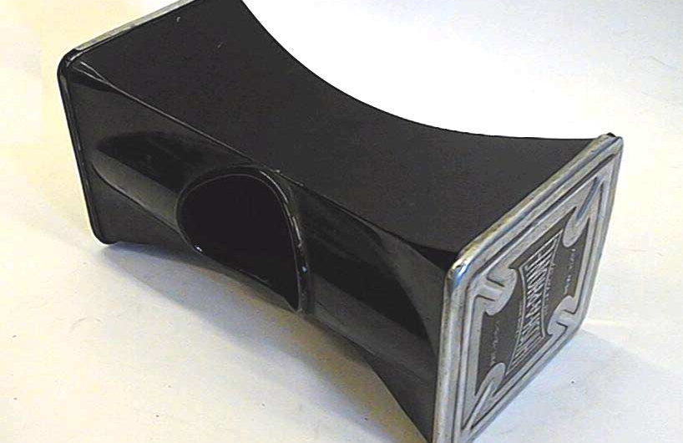
The Hush-a-Phone

Slide 18
More involuntary openness followed
Later court cases opened way for FAX machines, modems, and the like.
But the endpoints were still pretty dumb, until the PC was developed….

Slide 19
Which then gave us the Internet…
End points had complete freedom, and substantial computing power
Infrastructure just carried bits
Completely different economic model
Small guys can innovate
Big guys run dumb infrastructure (like utilities)
Result:
Rapid innovation in applications (e.g., email, web)
Diversity of content (on web)
Low barrier to entry
And finally, even the big companies noticed….

Slide 20
The Empire Strikes Back
Zipf’s law restores order to the universe
Popularity ~ 1/rank
Lots of weight at top (people like the same things)
Lots of weight in tail (but lots of idiosyncratic tastes)
A Tale of Two Markets
Lots of action in the tail (anyone can provide content)
But only few can create/provide the popular content
High barrier to entry at top: (CDNs)
Bandwidth
Servers
Management

Slide 21
Revenge of the Nerds
Peer-to-Peer restores the balance
Takes “contributed” nodes from participants
Together they provide enough aggregate bandwidth
The key is in coordinated these peer nodes
First: Napster (Shawn Fanning)

Slide 22
P2P Systems Do Three Main Things
Help user determine which content they want
Some form of search
P2P form of Google
Then locate that content
Locate where that content is on the Internet
P2P form of DNS (map name to location)
Then download that content
P2P form of Akamai

Slide 23
We need P2P forms of
Search (keyword)
Directory
CDN
What kinds of coordination mechanisms do we need for these tasks?
Have 100,000s of nodes at our disposal
How to coordinate them for search, directory, CDN?

Slide 24
Design Requirements
Scalable
Fault-tolerant
Able to use commodity parts

Slide 25
Design P2P Search
How would you do it?

Slide 26
P2P Search
Basic approach:
Since keyword search can be complicated,
…just do it on each machine independently,
…and keep going for as long as you need
Examples:
Broadcast request to all nodes
Broadcast among “superpeers”
Random walk (theory, papers)

Slide 27
Random Walk Search (Aside)
Ask random nodes, each has fixed size cache
Query rate q_{i}, where this represents popularity
How to replicate content “optimally”?
What is replication factor r_{i}
Goal: find result in shortest number of queries
What’s the right choice for r_{i}?
Uniform? Proportional to query rate? What?
Uniform and proportional have same performance
Optimal is proportional to sqrt(q_{i})

Slide 28
Design P2P Directory
How would you do it?

Slide 29
P2P Directory
In most cases, a few centralized servers will do
If you need to scale further, then use DHT
Distributed Hash Table
Put/Get interface
DHT: simple version is consistent hashing
Set up “linked list” of servers, each with ID in [0,1]
Each data object has key in [0,1]
Map key to server using the successor rule
Pick smallest server with an ID “larger” than key
Scalable, local repair of failures, etc.

Slide 30
Design P2P Download
How would you do it?

Slide 31
P2P Download
The first key is self-scaling
If every person who downloads something also has to upload it to someone else, the system works
The second key is asymmetric bandwidth
Download bwdth much greater than upload bwdth
That’s where chunks come in
Downloading many chunks overcomes asymmetry
Because each chunk is uploaded from a different source

Slide 32
Modern P2P Systems Use a Mixture
Search to find name (wildcard search)
Flood among superpeers
Directory lookup to find host given exact name
DHT-like structure
Chunked download
Self-scaling
Asymmetric bandwidth

Slide 33
Peer-to-Peer as Design Paradigm
Once you can coordinate many disparate peers…
…you can certainly coordinate co-located peers
Now the dominant design style in datacenters
DHT-like data structures are everywhere

Slide 34
What is the P2P Design Paradigm?
Scale out, not up:
To get more capacity, add more low-cost units
Don’t increase capacity of individual units
(This is why Sun/SGI/etc. are no longer with us)
This poses problem of coordination
The key to scalable coordination is how you deal with failures….
Because as system grows, failures are inevitable

Slide 35
Dealing with failures
Design as if failure is common
Recover from failures at highest possible layer
Generalized version of E2E principle
E.g. If routing fails, use another server
Don’t wait for routing to repair itself

Slide 36
This is Google’s Design Philosophy
Permeates culture
Much like Jobs’ attitudes at Apple
Provided consistent and winning paradigm
Where did this come from?

Slide 37
This is the Internet Design Philosophy
What I’ve been pontificating about all semester
The Internet design philosophy has taught us how to build systems at scale
The Internet is the first scalable P2P system
The Internet changed the world
Its design philosophy changed computer science

Slide 38
What you should remember….
I don’t care if you remember anything about TCP
Or DNS, or HTTP, or….
But if you ever build system that doesn’t scale well,
I will hunt you down….

Slide 39
Mission Accomplished

